Slide 1

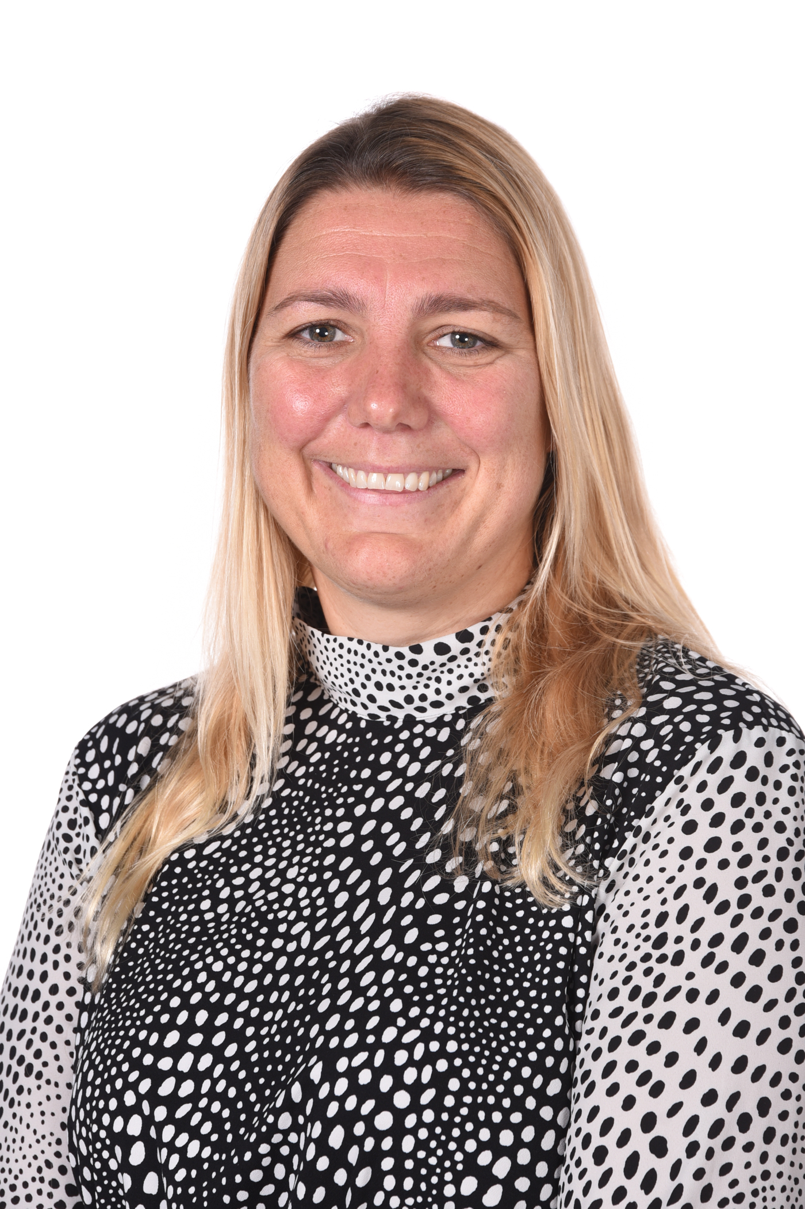
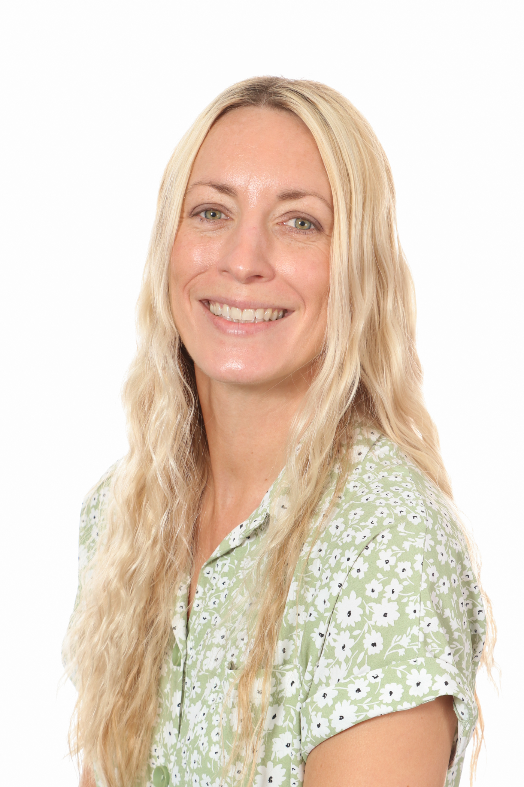
St Philip Westbrook CofE Aided Primary School
Child Protection Procedures
A member of staff, volunteer, parent or visitor is concerned about a child or a child makes a disclosure to them
Complete a CPOMs Concern/Concern Form and immediately discuss with
Designated Safeguarding Lead (DSL) – Miss D Stewart
or in their absence Miss S Burness, Mr P Stanley, Mrs A Deakin.
(Link club staff to call a member of the safeguarding team using phone numbers provided if needed).
DSL contacts School Improvement Liverpool for advice:
Nicky Noon 07793 660567, Jisette Murphy 07921 942091
or Maria Needham 07900 700922
Contact the MASH Team 01925 443322, 01925 444400 (out of hours)
Complete an Early Help Assessment or sign post to another agency for support
Accepted as a referral –Social work assessment undertaken
Child in danger of significant harm (S47) Child in Need (S17) Further Assessments needed
No specific services required please continue to monitor
Notes:
Emma
DO NOT LEAVE THIS BIT OUT!
2 Slides about safeguarding process in Warrington Signpost them to ‘What to do if you’re worried a child is being abused’
Mention the types of services that may be provided to a child in need eg through family centres, Homestart, support from school; Health Visitor
Explain that if they do not feel they have had an appropriate response from any agency they must report this to their manager so that action can be taken, following WBC’s Escalation Policy.
If they are not happy with their manager’s response to concerns, Working Together points out that all members of the community can act if they have concerns about a child’s welfare and thus they could make contact with agencies themselves

