Slide 1
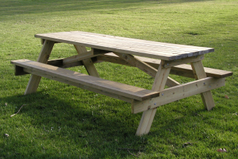
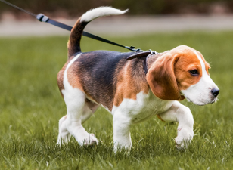
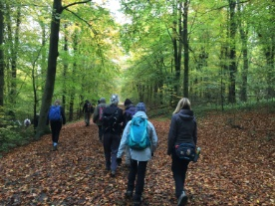
Year 2: Fieldwork Knowledge Mat
Subject Specific Vocabulary |  | Map Symbols | Important Knowledge
village | A small group of houses and shops. |  | I know which physical and human features are in the area I live. I can ask questions about the use of the orchard area. I can find out about the use of the orchard area. I can create my own map of the way to the orchard. I can use Ordinance Survey symbols. I can identify physical and human features on a map. I can label physical and human features on Digimaps. I can use graphs and tables to show the use of the orchard area.
orchard | Where trees that produce fruit are grown.
woodland | Land covered with trees.
suburb | An area of houses where people live, outside the main town.
bridge | A structure to cross over roads or rivers. | How do we use spaces?
footpath | A safe place for people to walk.
town | A town is a place with many streets and buildings, where people live and work. Towns are larger than villages and smaller than cities.
city | A very big place where people live and work. There are lots of buildings.
aerial | Looking at something from above.
bird’s eye view | Looking at something from above.

