Slide 1
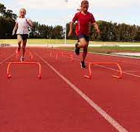
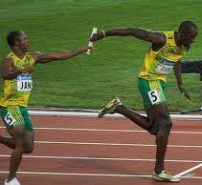
Year 2: Obstacles and Races
Subject Specific Vocabulary |  | Important Information | Important knowledge
track | The place you would perform the run. | When you run over an object you must take a longer stride. You must change the baton over when changing a runner in relay. | I can run at different speeds.
 |  |  | I can perform running using awareness.
tag | Chasing someone and stopping them by touching them or taking something away.
 |  |  | I know when to change my running speed.
distance | How far you run.
 |  |  | I can step over an obstacle and hurdle.
speed | How fast you run.
 |  |  | I can run over an obstacle and hurdle.
relay | Running the same distance as part of a team.
 |  |  | I know how to create an imaginative obstacle course.
technique | How you perform a skill.
 |  |  | I can perform the correct technique when running over an obstacle and hurdle.
tactic | A plan you make to help you win.
 |  |  | I can perform different running styles on an obstacle course and during races.
skill | Something that you do.
 |  |  | I know how to handle equipment safely.
aim | Finding a target to throw or strike towards.
 |  |  | I know how to comment on my own performance to get better.
coordination | When two or more body parts work together.

