Slide 1
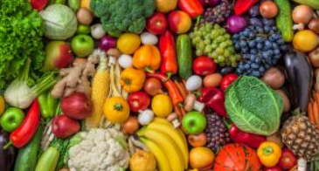
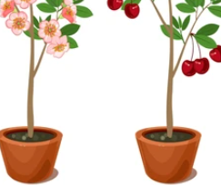
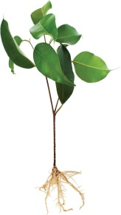
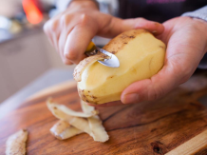
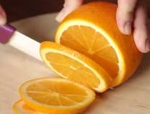
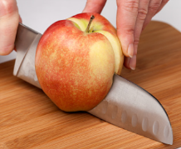
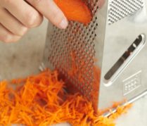
Year 1: Food Knowledge Mat
Subject Specific Vocabulary |  | Fruit or vegetable? | Important knowledge about food
appealing | Something that looks attractive of interesting. |  | I know the difference between a fruit and a vegetable. I know that fruits and vegetables are grown. I can describe the taste and appearance of a range of fruit and vegetables. I can say which fruits and vegetables I like/dislike and why. I can use good hygiene when handling food. I can prepare fruits and vegetables by peeling, cutting, slicing, grating and squeezing. I can say what went well with my design. I can say how my product met the design criteria. I can say how I would improve my design to make it even better.
grate | To break something into small pieces by rubbing it against something rough.
peel | To remove the outer skin from a fruit or vegetable.
slice | A thin, broad piece of food cut from a larger piece.
grow | When something increases in size and changes over time.
product | An object that is made for people to buy. | Preparation
user | The person that the product is made for.
purpose | The reason the product is created.
choose | To pick or decide on something.
construct | To build or make something.
fruit
vegetable
leaf
flower
stem
roots
peel
slice
cut
grate

