Slide 1
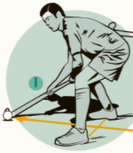
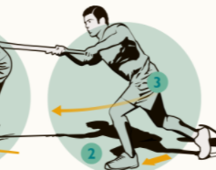
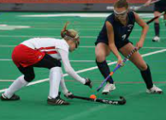
Year 4: Hockey
Subject Specific Vocabulary |  | Important Information | Important knowledge
tackle | To remove a ball from someone’s possession. | Push pass Tackle | I can dribble a ball showing control.
accuracy | To send a ball to a target. |  | I can dribble a ball whilst moving fast.
 |  |  | I can send a ball using a push pass.
reaction | How you respond to moving balls.
 |  |  | I can shoot a ball using accuracy.
push pass | A technique used to send a ball to another player.
 |  |  | I can make the ball move at different paces.
centre pass | The type of pass used to start a game.
 |  |  | I can use the right amount of power to send a ball to a partner.
fundamental movements | Basic movements of hockey.
 |  |  | I can send and receive a ball avoiding a defender.
side-line | The edge of the pitch.
 |  |  | I can tackle the ball safely.
obstruction | When a foot or another body part gets in the way of the ball.
 |  |  | I can pass a ball through a gate to a partner.
rebound | the ball bounces off another player’s stick or the side of the goal
 |  |  | I can send and receive a ball accurately with a partner.
intercept | To take a moving ball that has been sent to someone.
 |  |  | I know the rules of hockey and how to apply them to a game.

