Slide 1
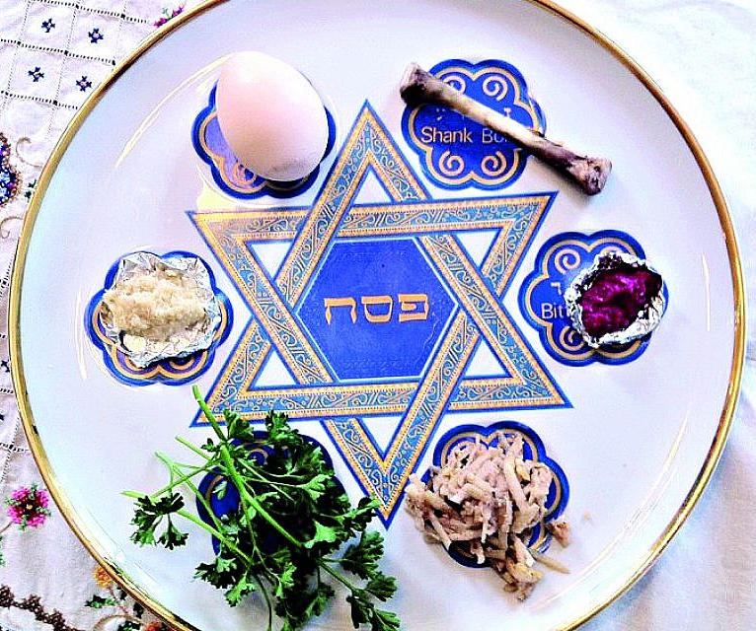
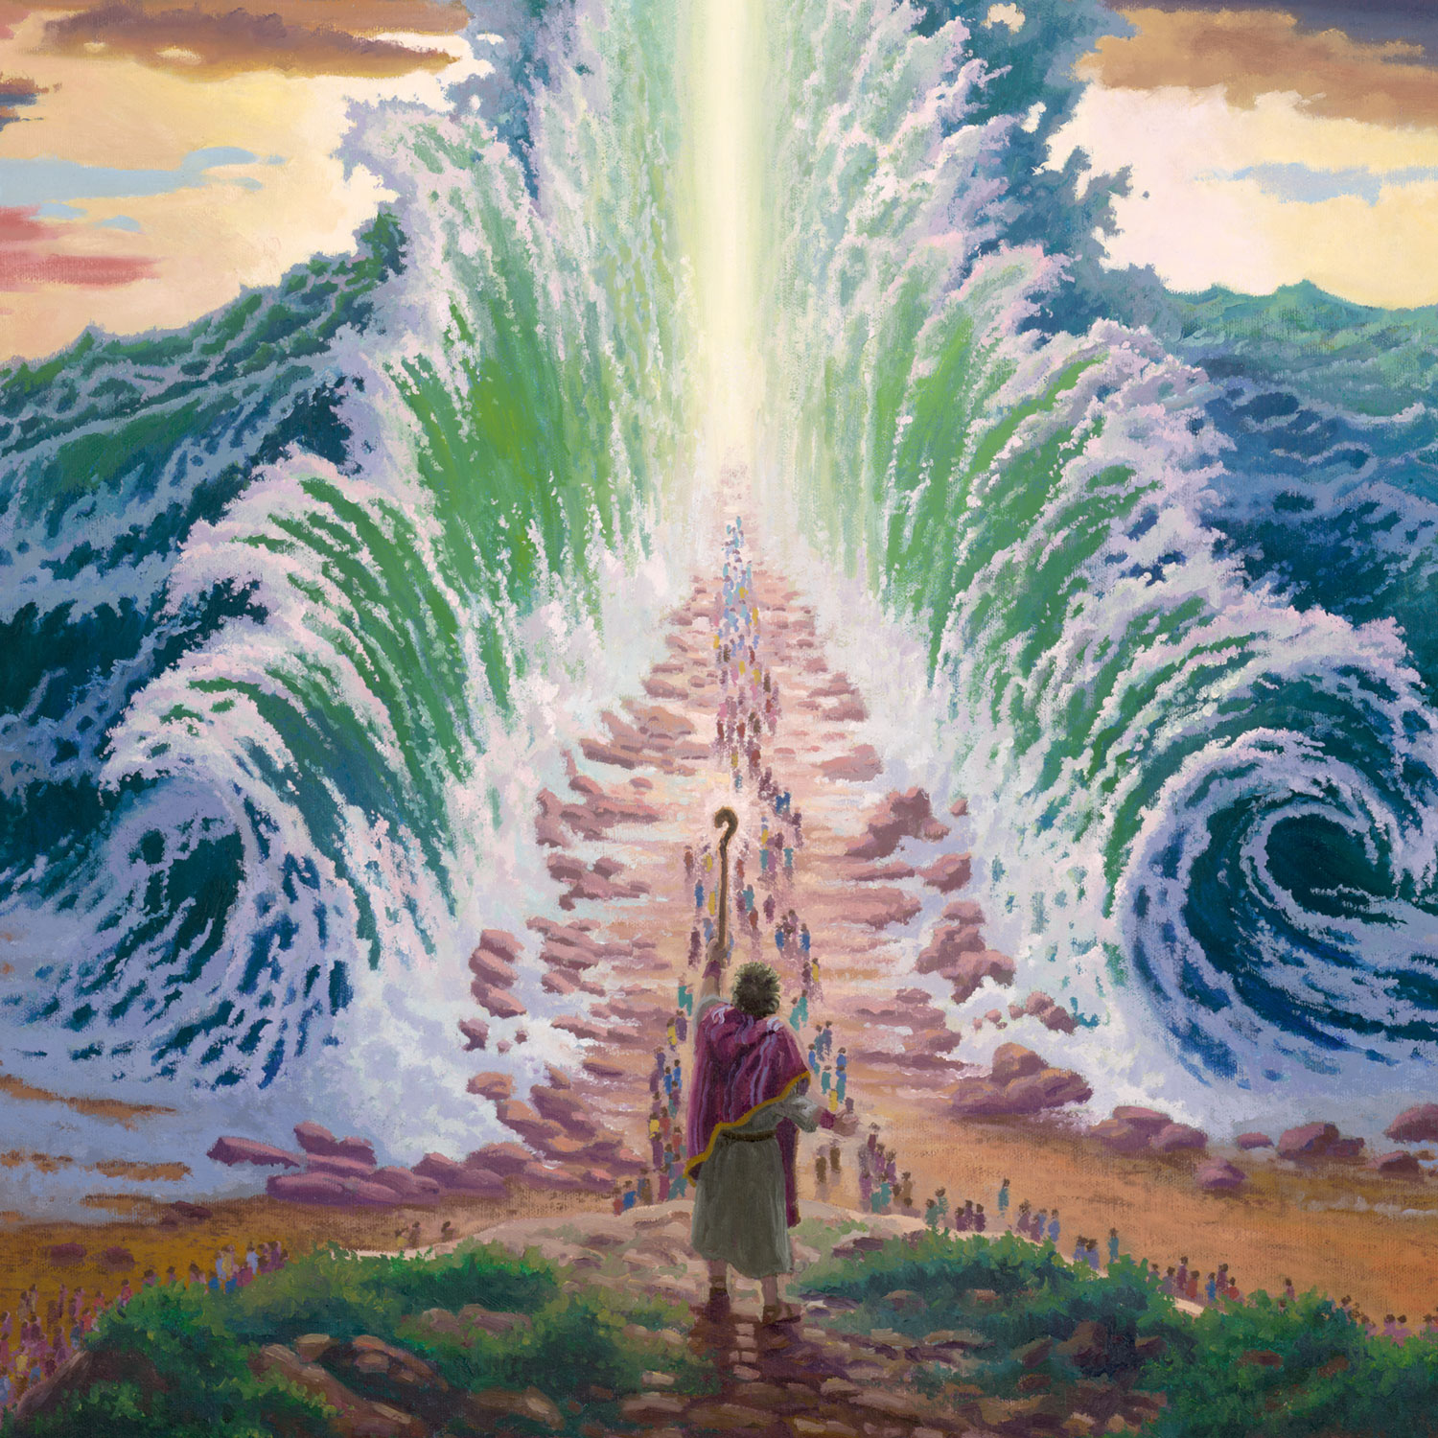
Year 6: Exodus Knowledge Mat
Subject Specific Vocabulary |  | Seder Meal | Important knowledge
Exodus | The departure of the Israelites from Egypt, led by Moses |  | I know that the Exodus is a significant event in Jewish and Christian history
significant | Extremely important and worthy of attention |  | I know that the Seder is the special meal celebrated by Jews on the first evening of the festival of Passover
Seder | A Jewish ritual feast for the first evening of Passover
 |  |  | I know that Christianity is rooted in Judaism and Jesus celebrated the Passover
symbolise | Something that represents or stands for something else. Where something stands for something else
 |  | Significant Events | I know the similarities and differences between the importance placed on the Passover by Jews and Christians
Eucharist | The Christian service remembering the Last Supper where bread and wine are consumed
 |  | William Wilberforce helped to abolish the slave trade Moses parting the Red Sea during the Exodus from Egypt
 |  |  | I know that Christians remember the Passover and the Last Supper during the Eucharist I can reflect on the Exodus story highlighting the connections to the Seder meal
represent | Where something stands for something else |  | I can tell you about what happened to Zechariah.
Passover | The Jewish festival remembering and celebrating the freedom of Israelites during the Exodus
 |  |  | I can make links between the Passover, Last Supper and the Eucharist
Last Supper | Jesus’ last meal celebrating Passover with his disciples before his crucifixion
freedom | Not being imprisoned or enslaved |  | I know Passover is a festival of memory and freedom and why it is not forgotten
leadership | The action of leading a group of people
 |  |  | I can express my opinions about freedom, what it is and what it is not

