Slide 1
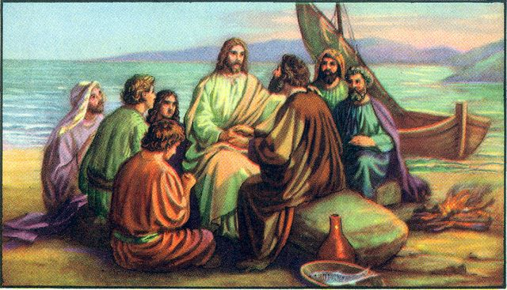

Stories that Jesus told

Slide 2


