Slide 1
this
then
them
that
with

Slide 2
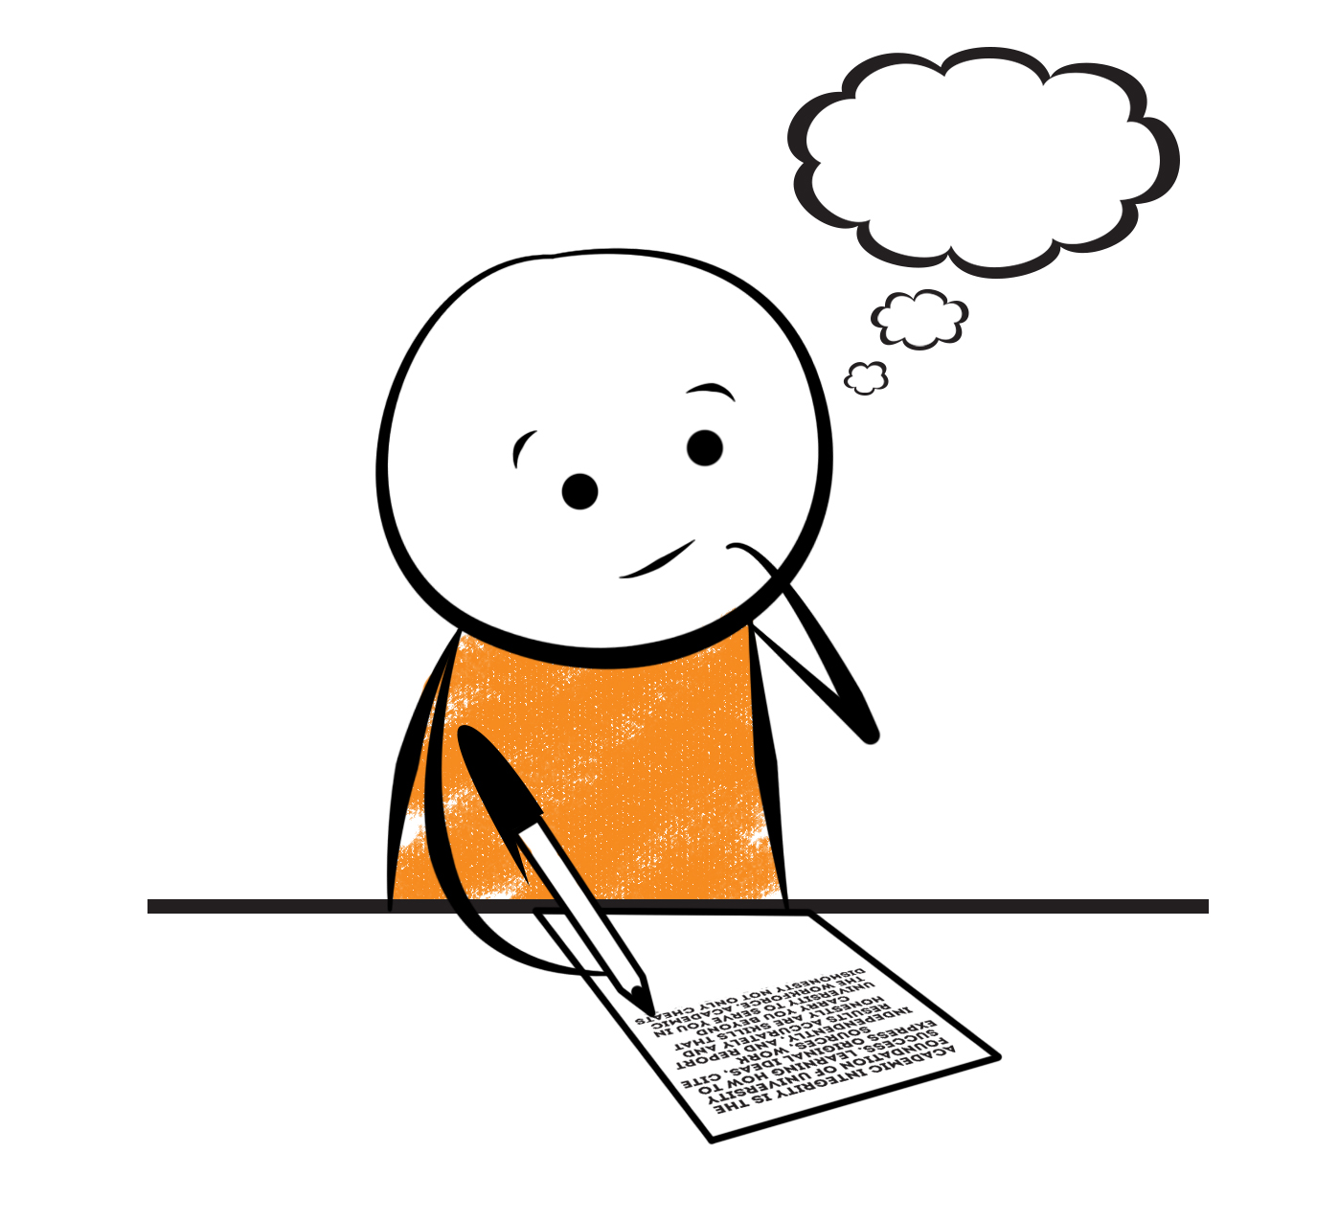
Now that you can read words with the ‘th’ sound, let’s see if you can write some! Look at the pictures and then try to spell the ‘th’ word. Think carefully about where the sound appears in the word. Then click to see if you were right. Good luck!

Slide 3
thin

Slide 4
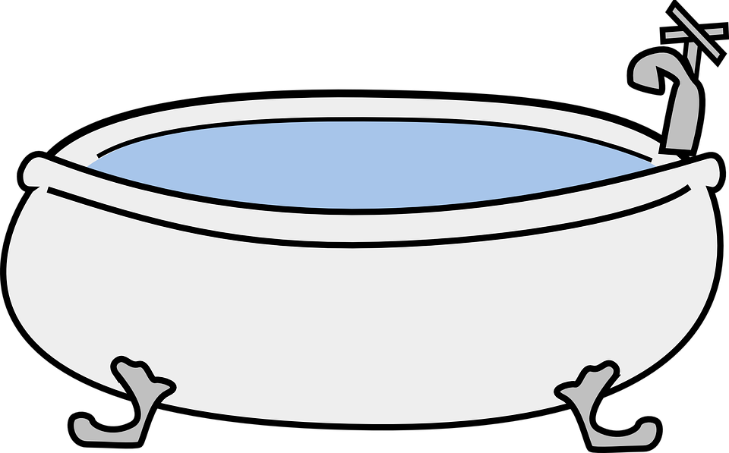
bath

Slide 5
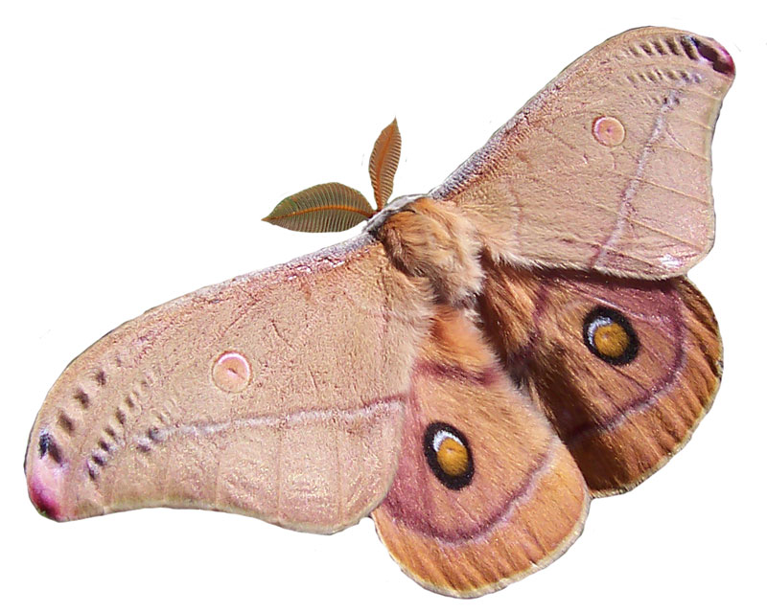
moth

Slide 6
path

Slide 7
tooth

