Slide 1
Words with ‘ar’
Read the words and click to see if you are right!

Slide 2
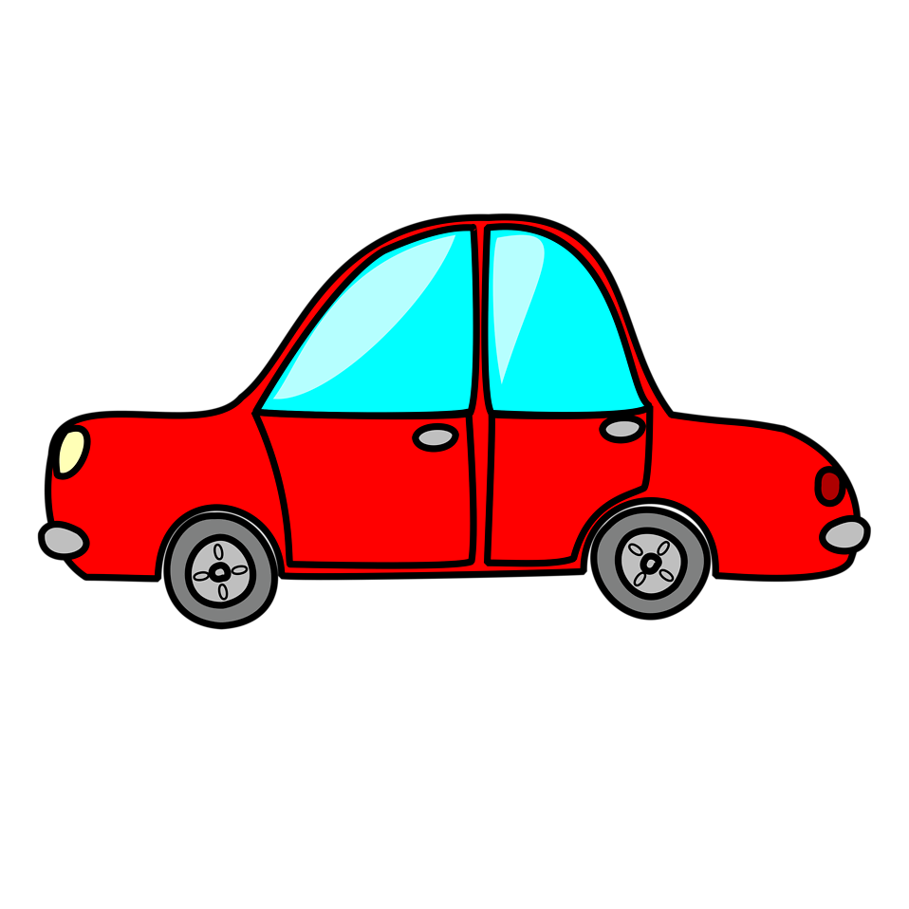
car

Slide 3
jar

Slide 4
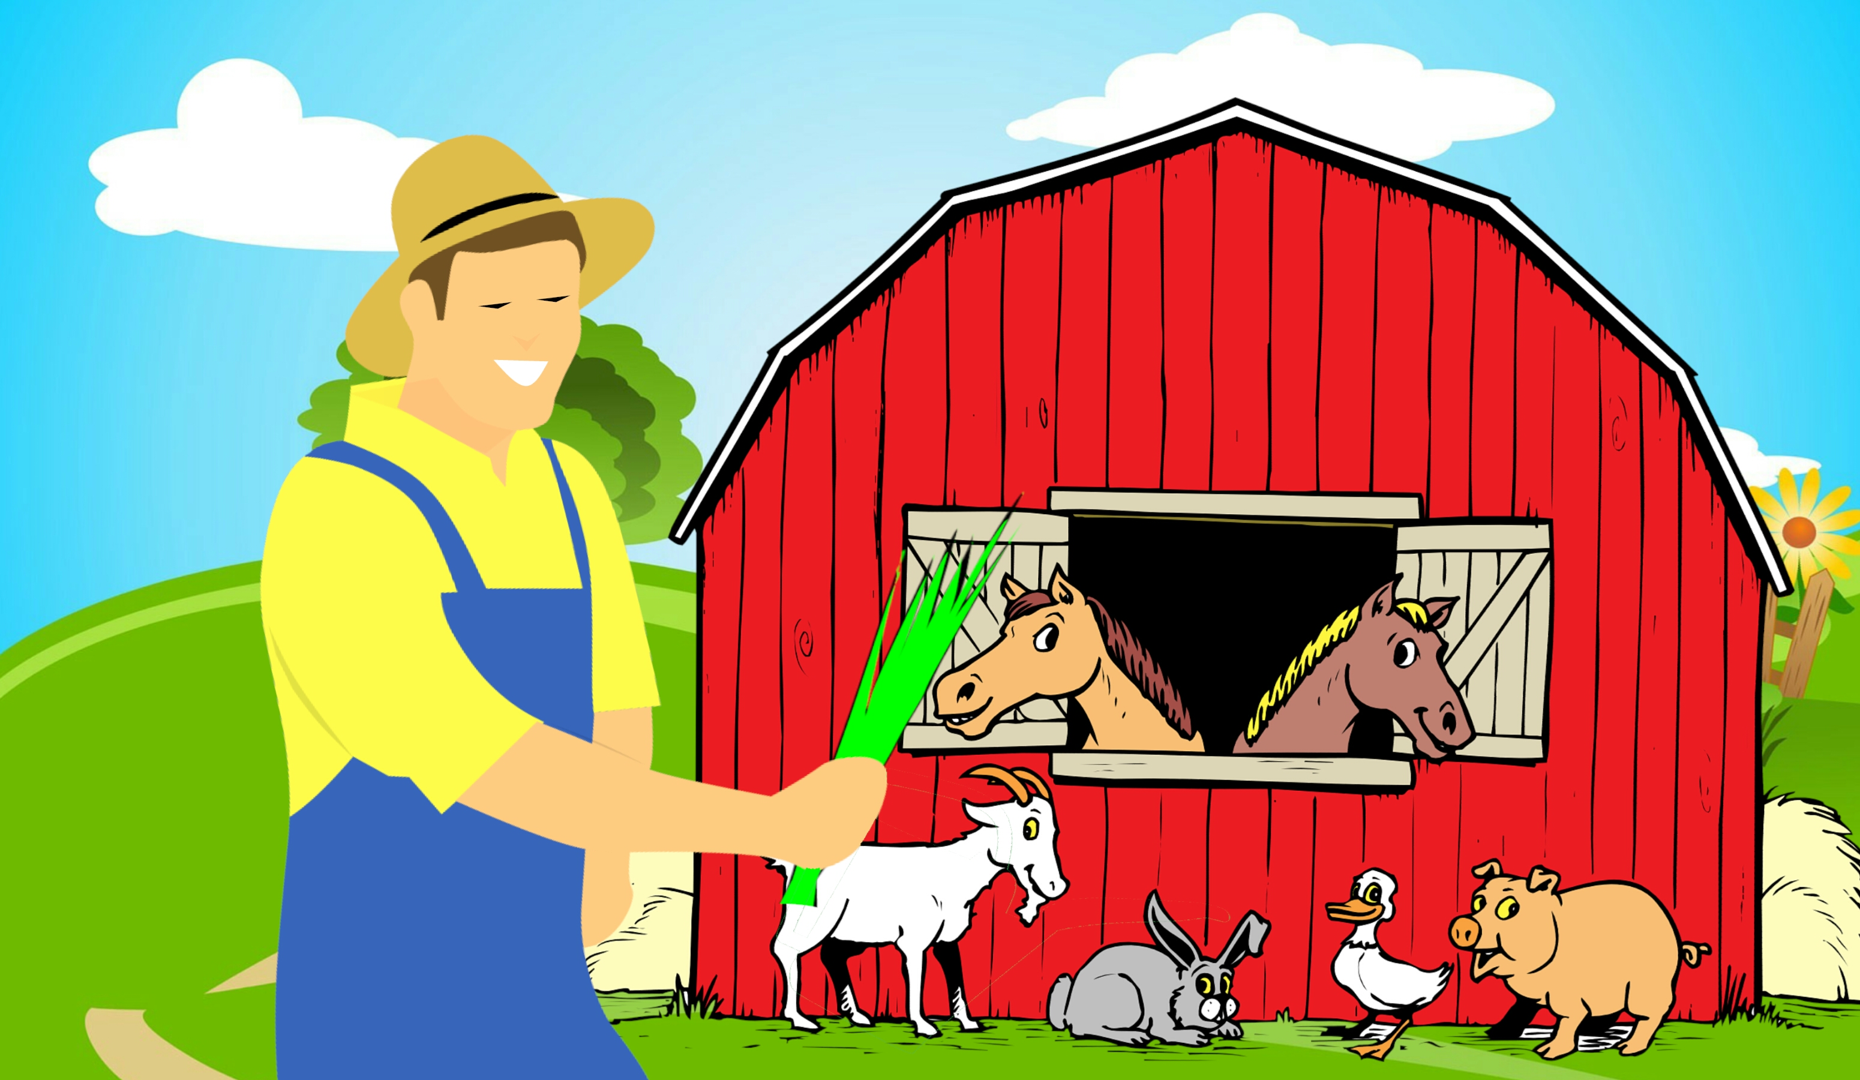
farm

Slide 5
star

Slide 6
Words with ‘ar’
Now, can you write the ‘ar’ words?
Click to see if you are right!

Slide 7
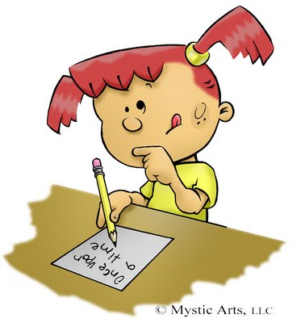
arm
ar

Slide 8
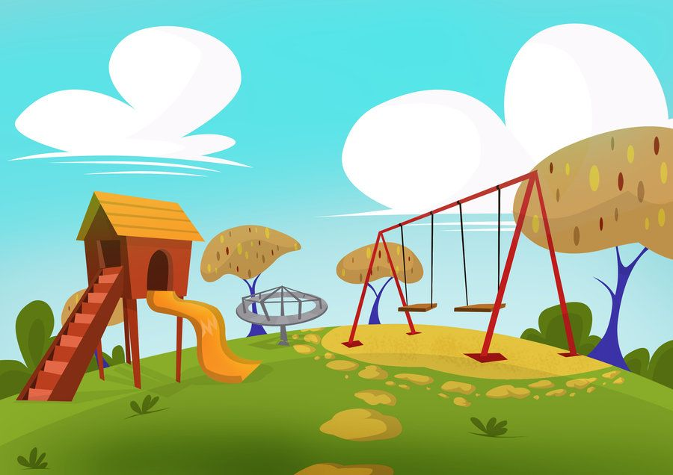
park
ar

Slide 9
shark
ar

Slide 10
scarf
ar

