Slide 2
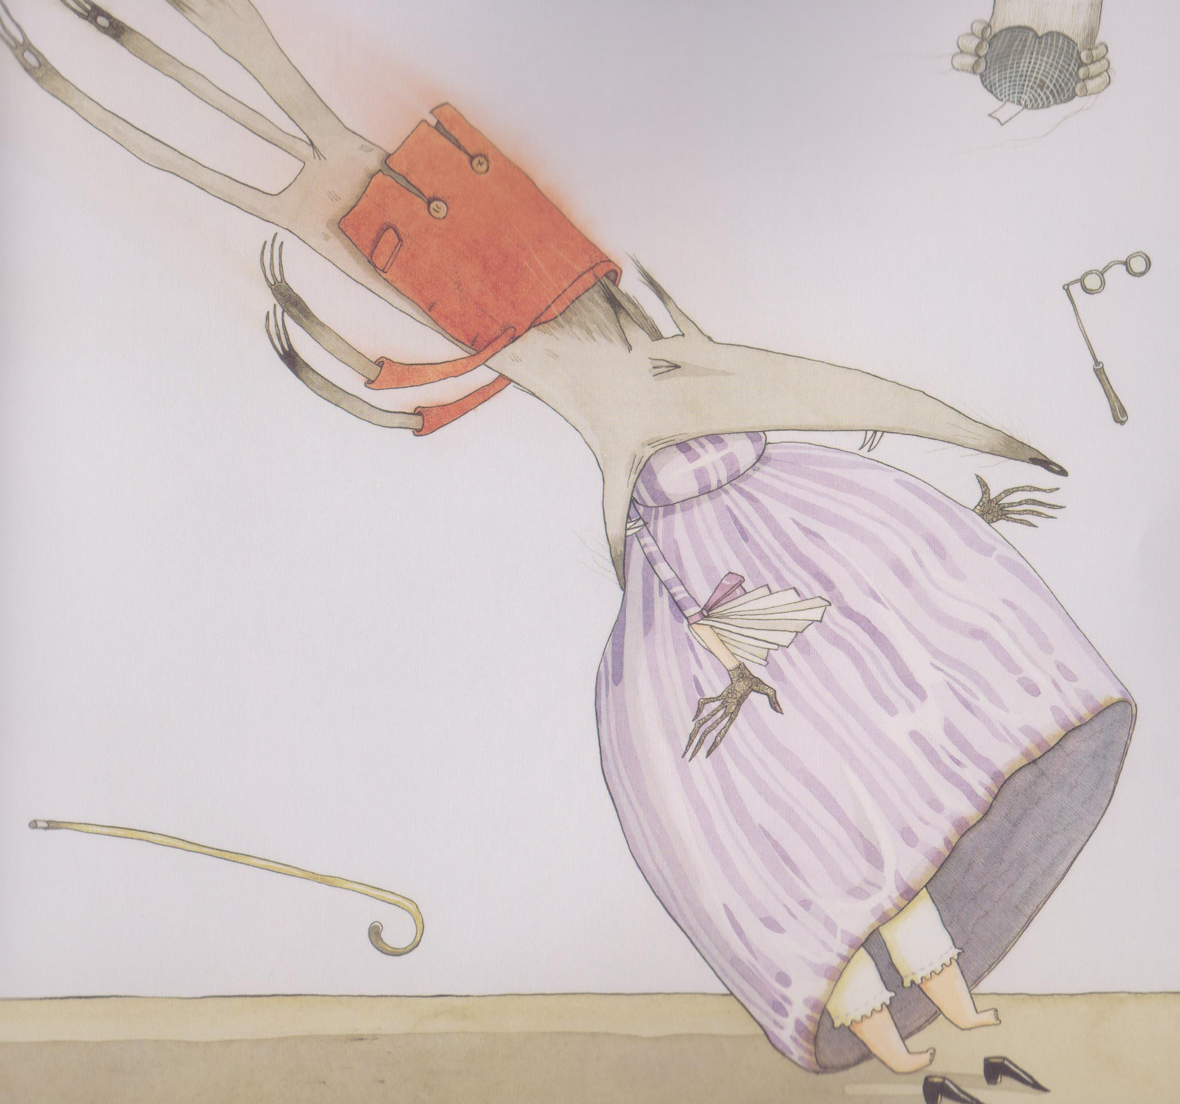
Problem
Build up
Resolution
Beginning
Ending

