Slide 1

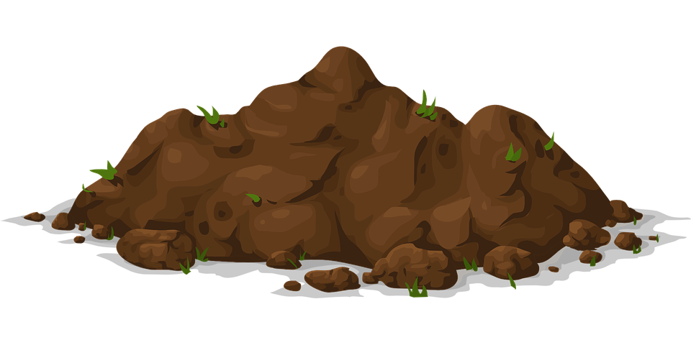

Read the words with the ‘oi’ sound. Click to see if you are right!

Slide 2
s oi l

Slide 3

f oi l

Slide 4

t oi l e t

Slide 5

Now, look at the pictures of things with the ‘oi’ sound. Can you write the words to match?

Slide 6
f oi l

Slide 7
s oi l

Slide 8

c oi n s

