Slide 1

I had 4 pumpkin pies. Then I had 3 more. How many pies did I have?

Slide 2
To solve the problem I am going to look for the key numbers.
I notice the numbers 4 and 3.
I will put 4 in my head, then I am going to count on “5,6,7”
4+3=7

Slide 3
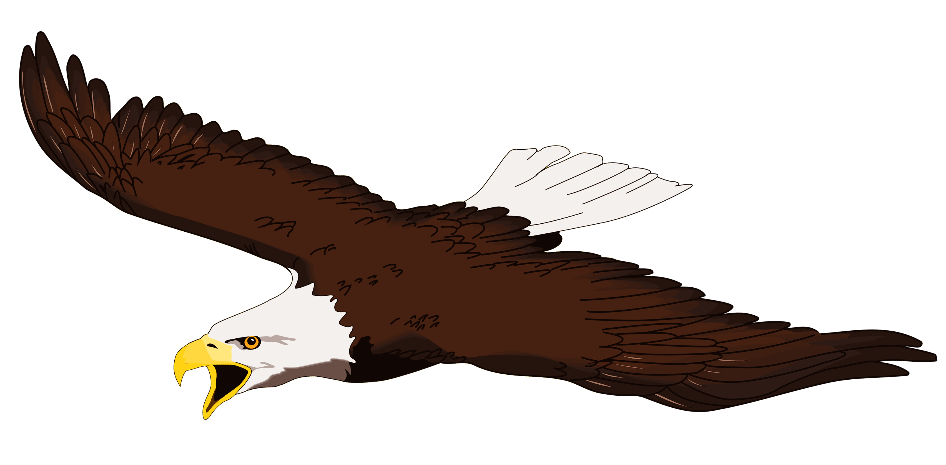
Can you find the correct number sentence?
5 bald eagles flew in the sky. 4 more flew with them. How many eagles were flying?
5+4=9
5+3=9
6+4=9

Slide 4

I cooked 6 burgers. Then I cooked 4 more. How many burgers did I cook?
7+4=9
6+4=10
5+4=9

Slide 5

Now can you record the number problem yourself? Look for the key numbers and add them together!
I had 7 flags and I got 5 more flags. How many flags do I have?

Slide 6
Can you think of a word problem?
Ask your grown up to work out the problem.

