Slide 1
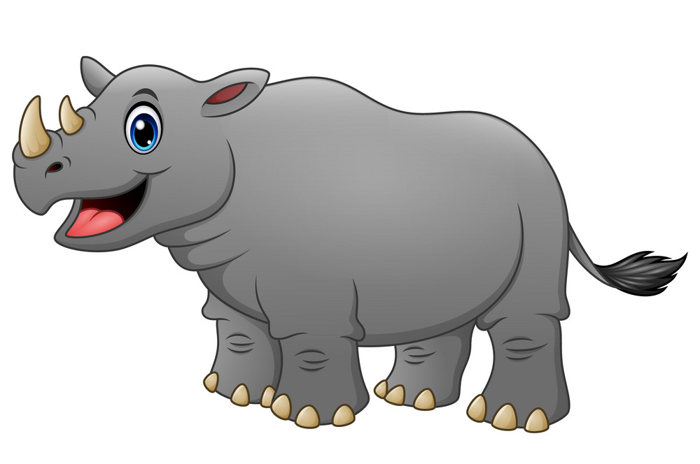
The Rhinos

Slide 2

What is Mass (Weight)?
When we are measuring weight what are we measuring?
Weight is how heavy something is
Click to find out more.

Slide 3
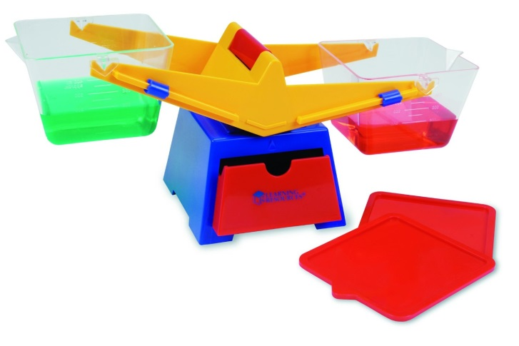
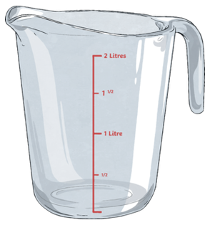
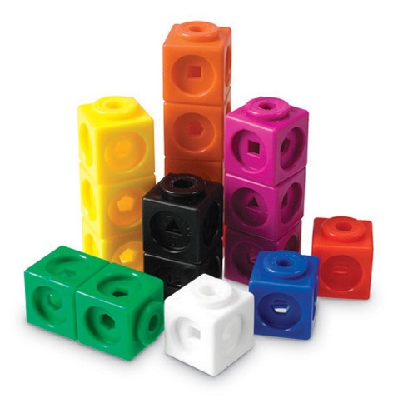

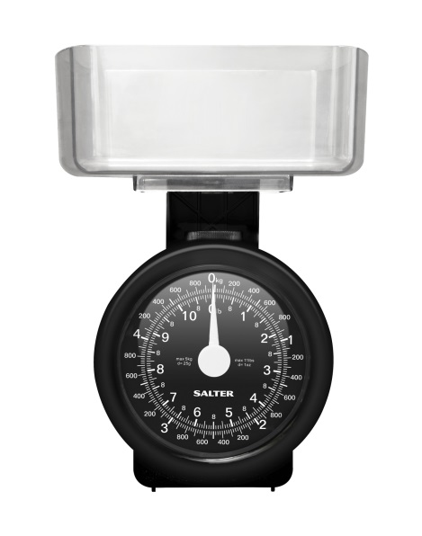
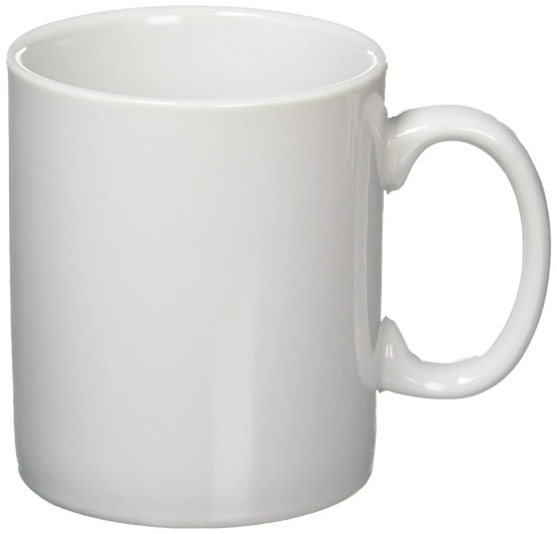
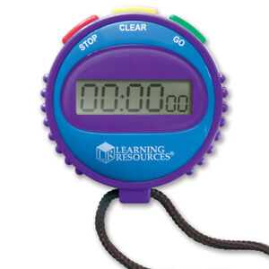
What things here might we measure weight in?

Slide 4


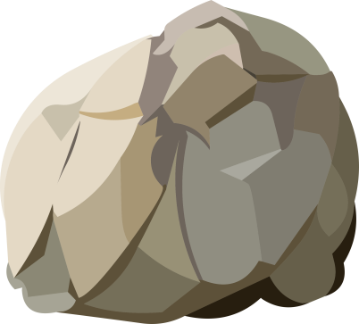

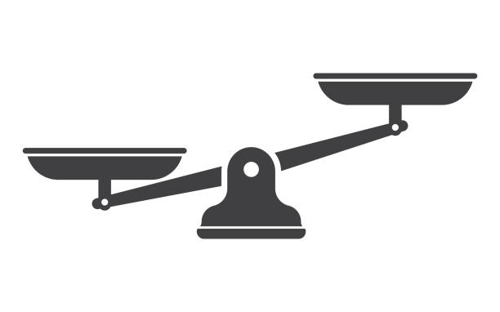
The rhinos are very strong and they are using the balancing scales to see who can carry the heaviest rock. Which rhino carried the heaviest rock?

Slide 5
Which rhino carried the heaviest rock?

Slide 6
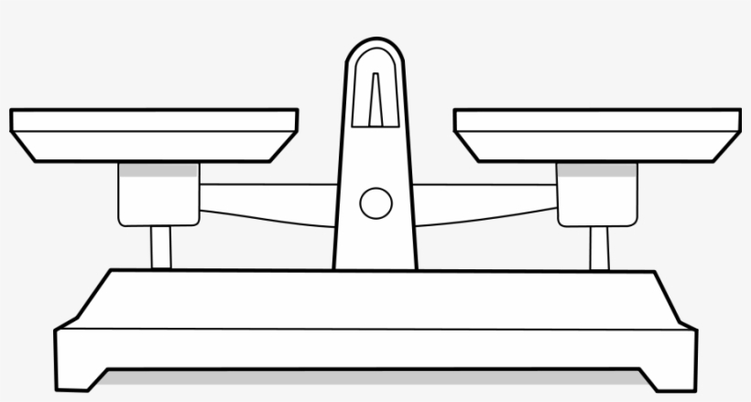
Which rhino carried the heaviest rock?
Both are as song as each other as the scales are equal?

Slide 7
Explore these interactive balancing scales.
Balance the shapes at either side of the balancing scales to see if you can make the scales even.
Which are the heaviest shapes?
Which are the lightest shapes?
Balancing scales

