Slide 1
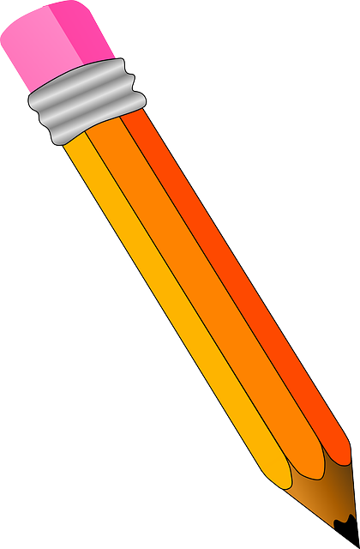
Handwriting practise:
Monday

Slide 2
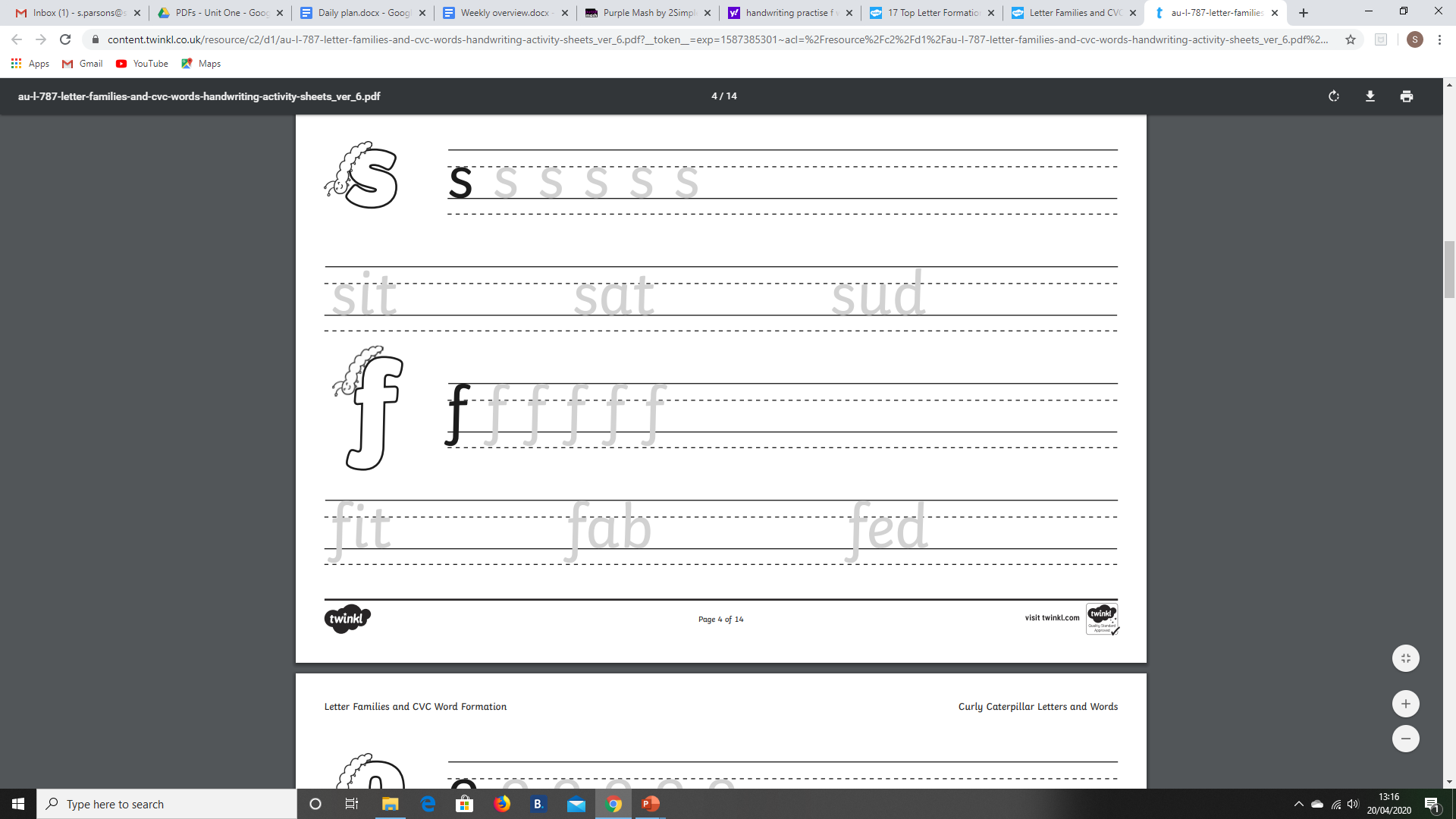

Start at the top, curl back and down, then curl back again. Take off your pen and cross it through the middle.

Slide 3
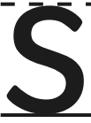
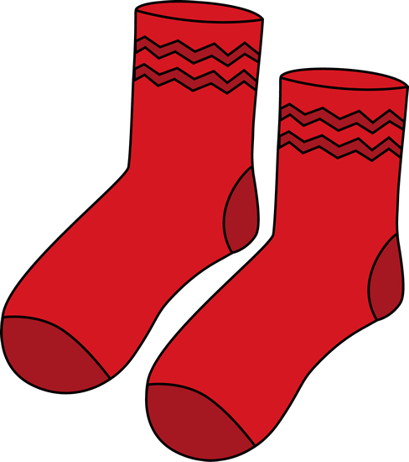
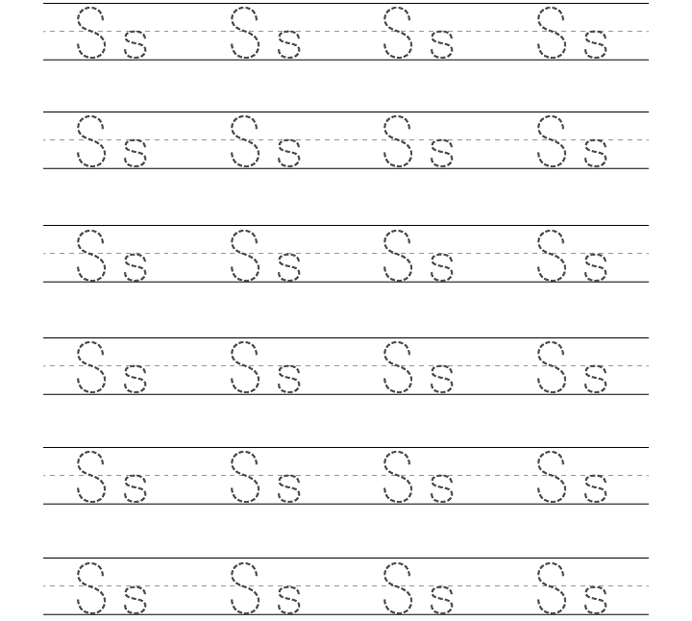
Start at the top, curl back, forwards, back.

Slide 4
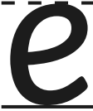


Push through the middle, curl back and round.

