Slide 1
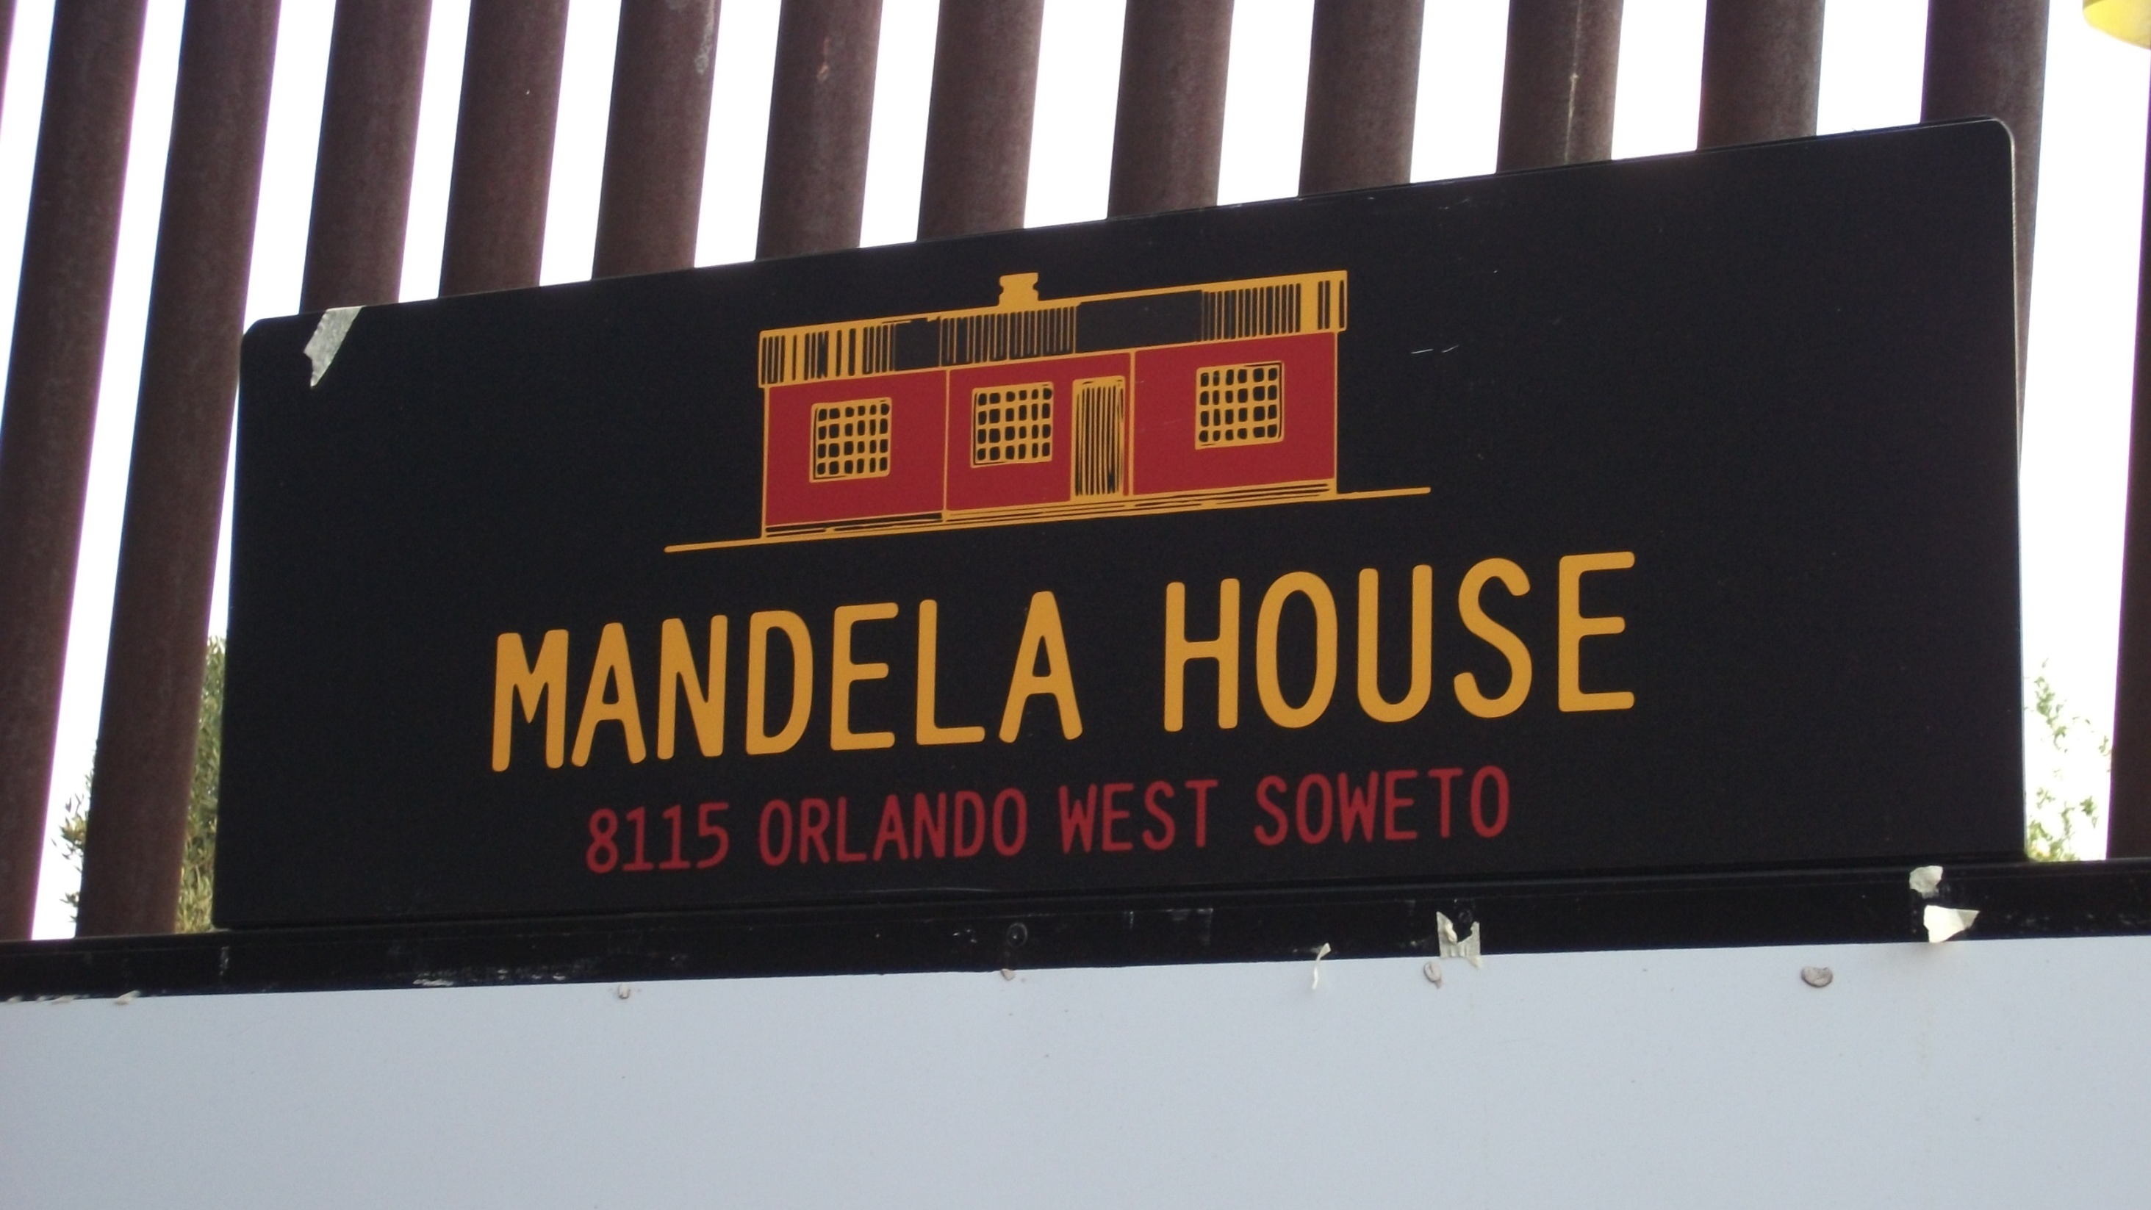
Inside the home of Nelson Mandela

Slide 2
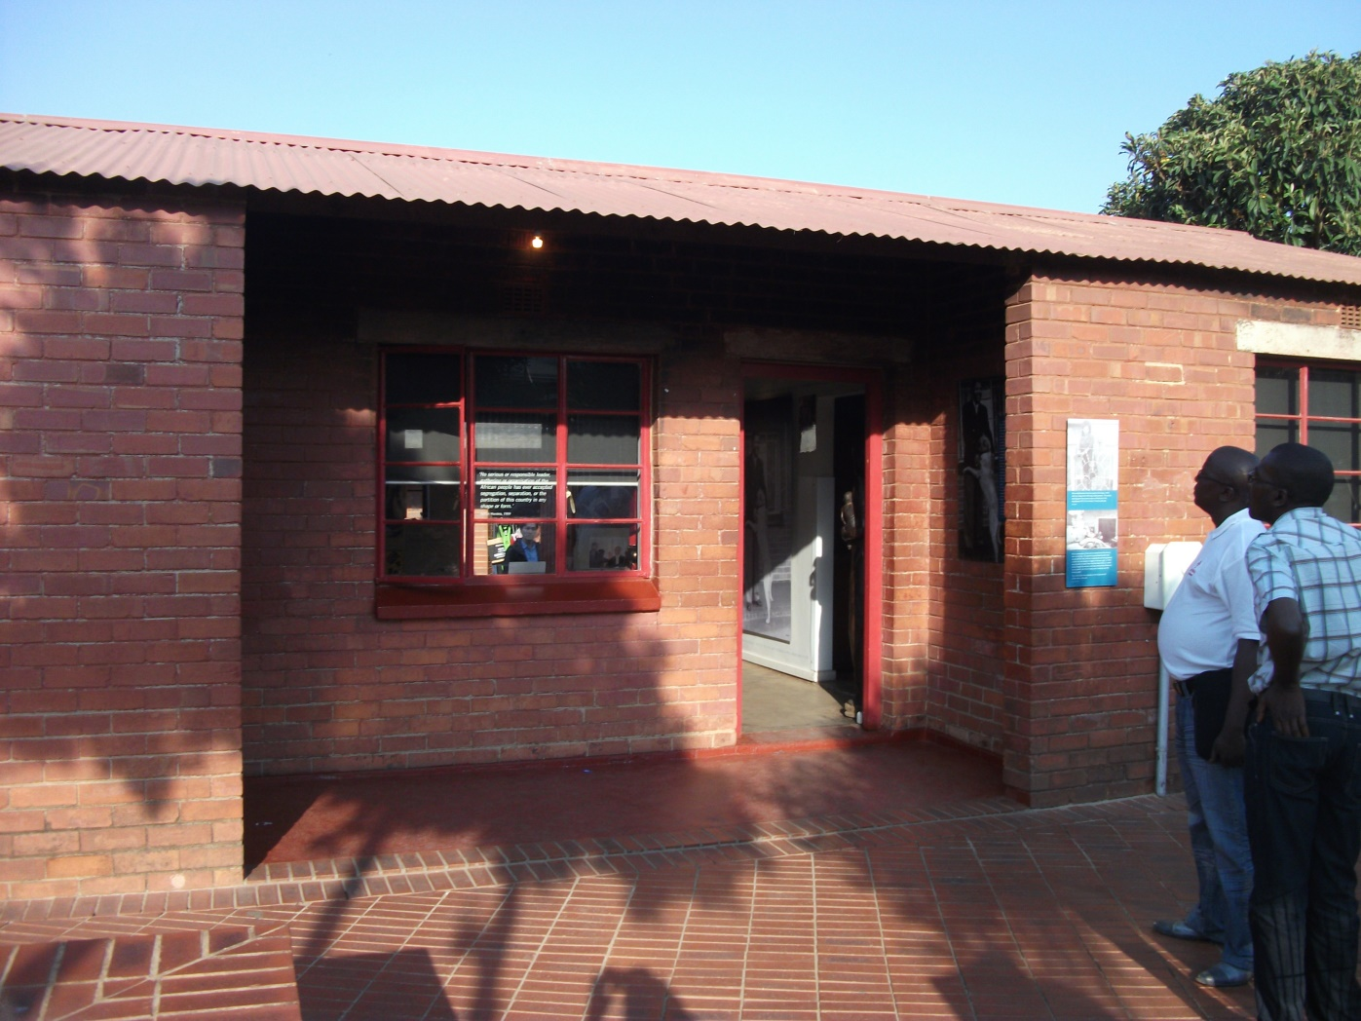
This is the house.
The house is now a museum so that people can see inside.

Slide 3
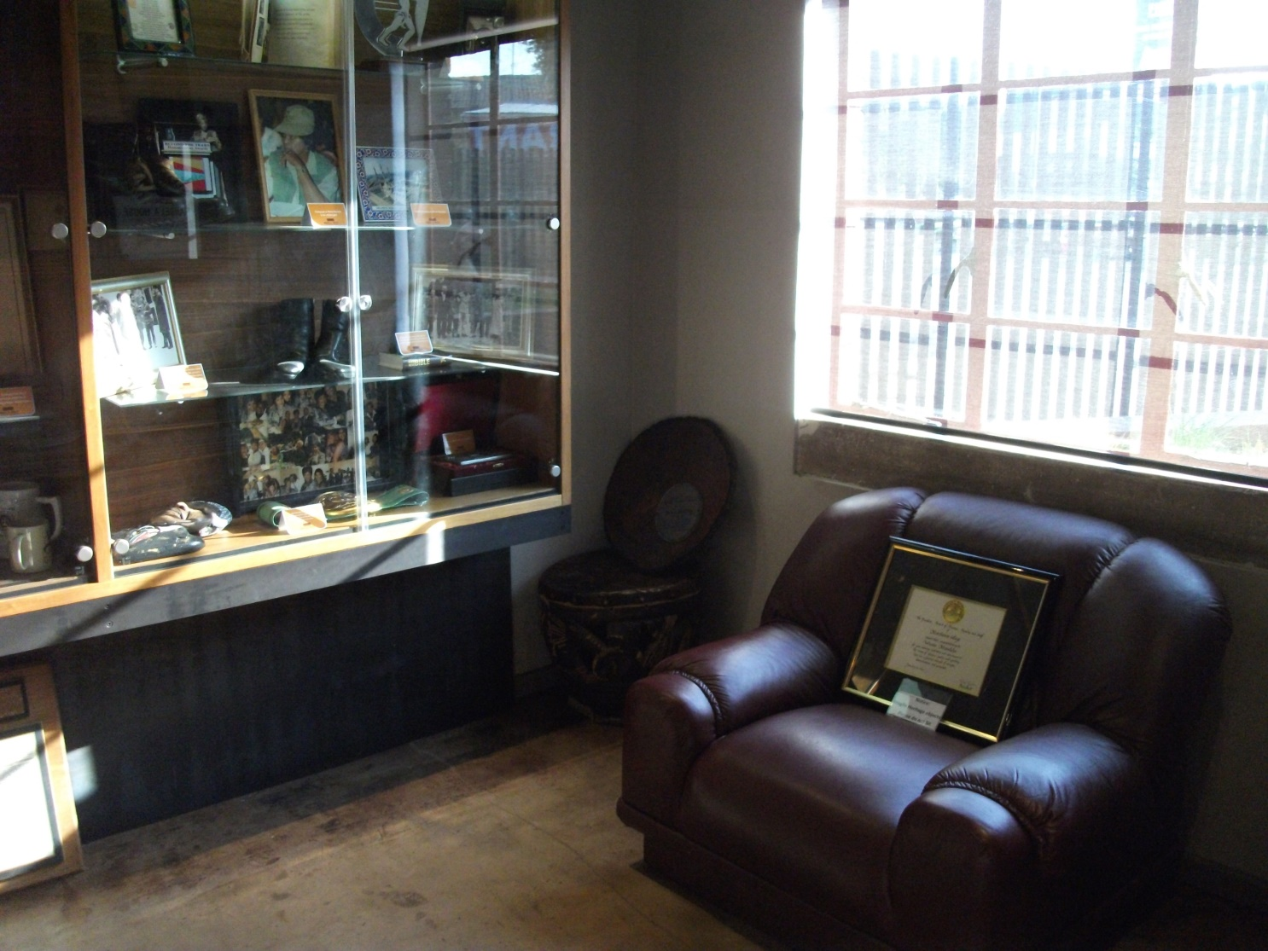
This is his arm chair.
Visitors are not allowed to sit on the furniture.

Slide 4
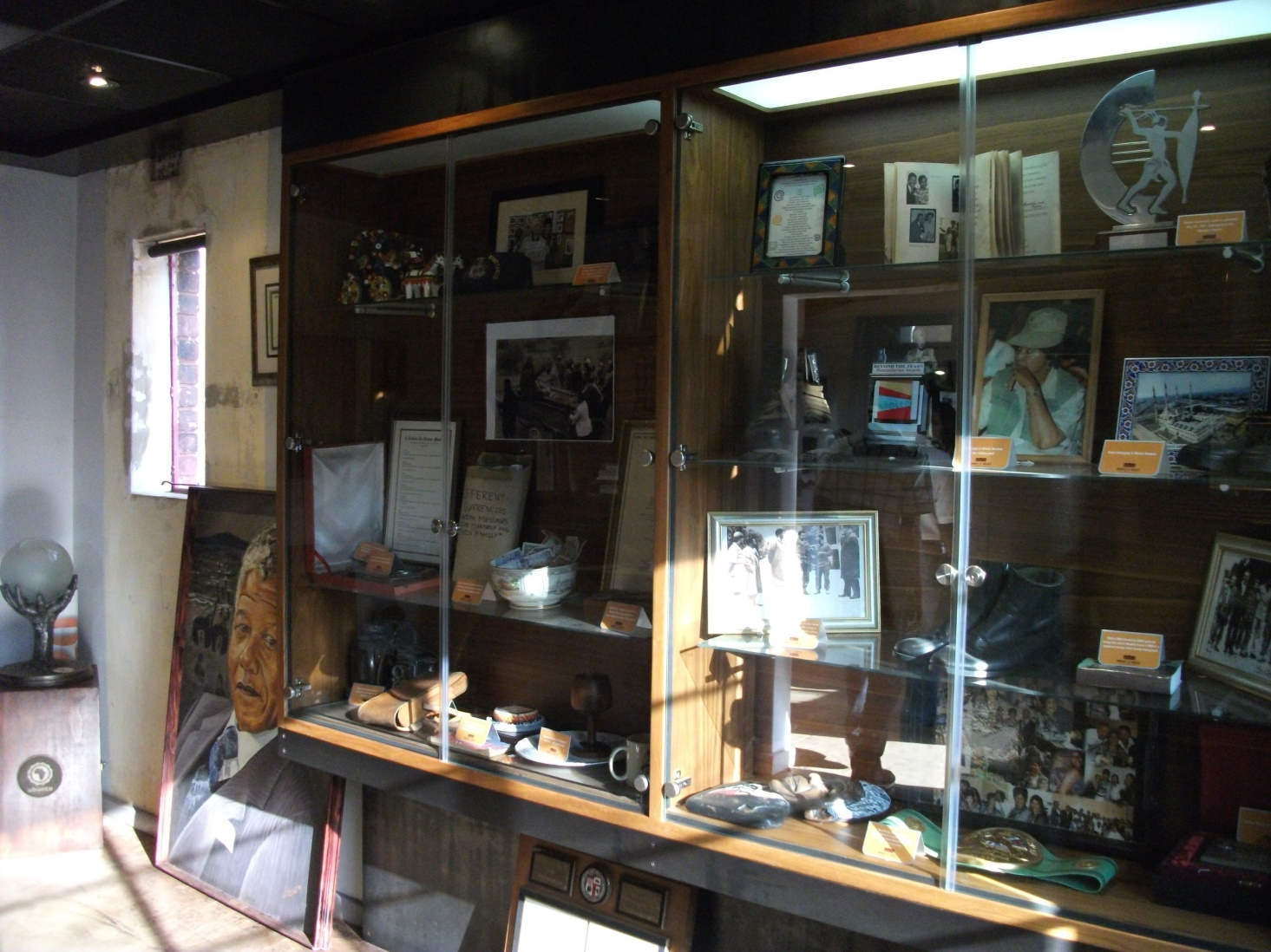
There are lots of pictures.
This cabinet also displays his boots, his trophies and some of his old plates and cups.

Slide 5
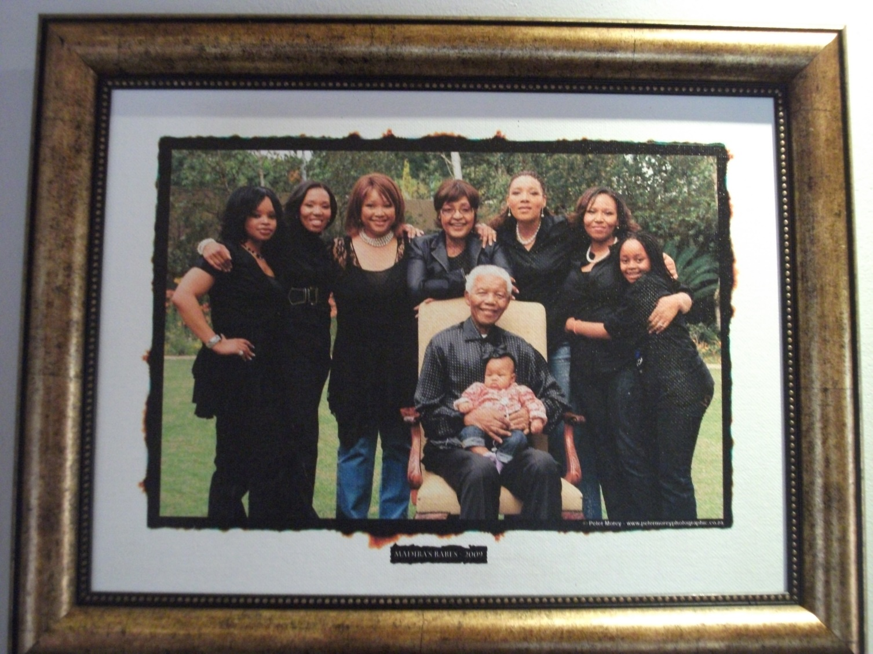
This is a picture of his family.
Nelson Mandela’s wife was called Winnie Mandela.

Slide 6
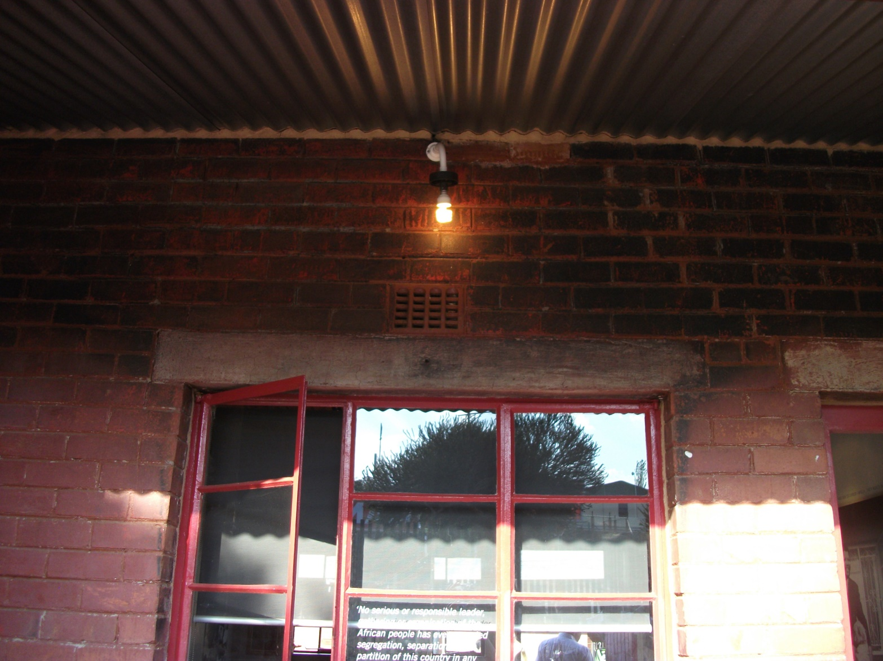
The wall was burnt.
Some police threw fire at the house to make him come outside so that they could arrest him.

Slide 7
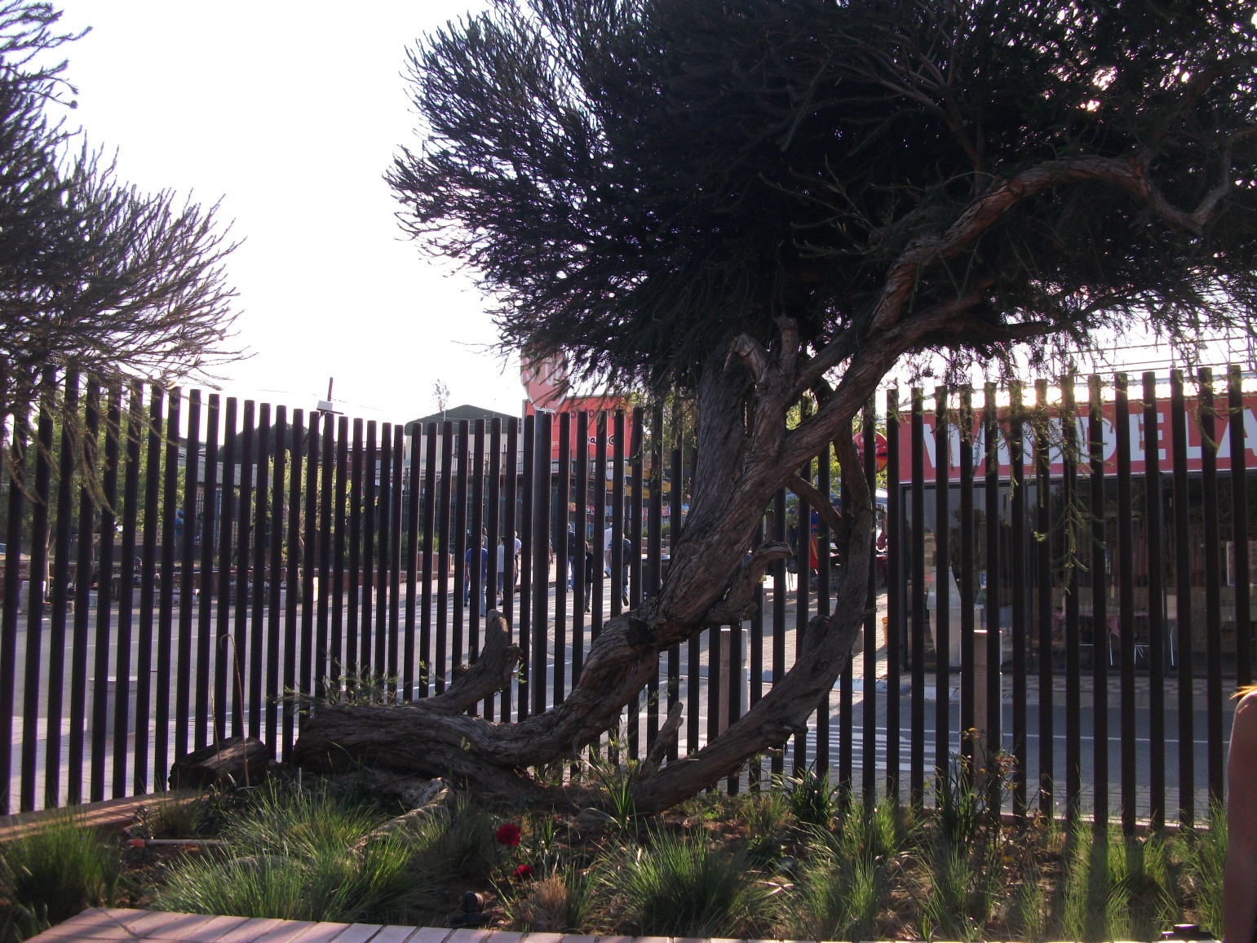
This is the tree in his garden.
The umbilical cords of all his grandchildren are buried under this tree.

Slide 8
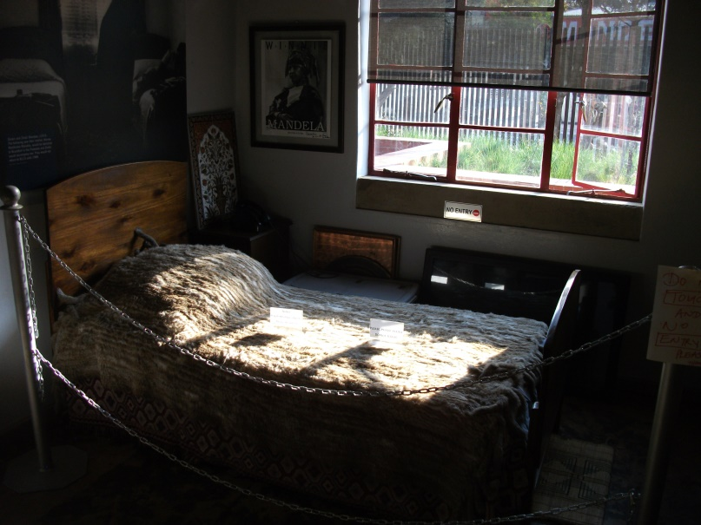
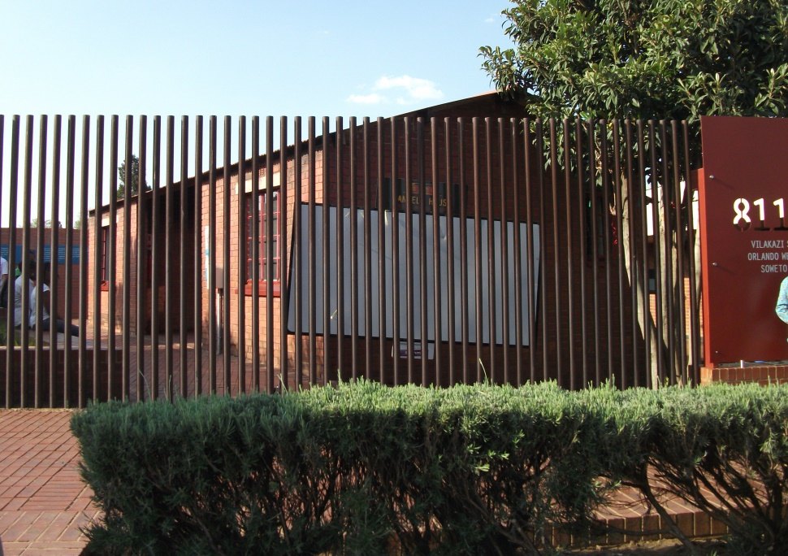
Can you fix the sentences below?
Use your writing tricks to help you.
Vis isthe bed hee slept in
This is the bed he slept in.
the bars ar near the boosh
The bars are near the bush.

