Slide 1
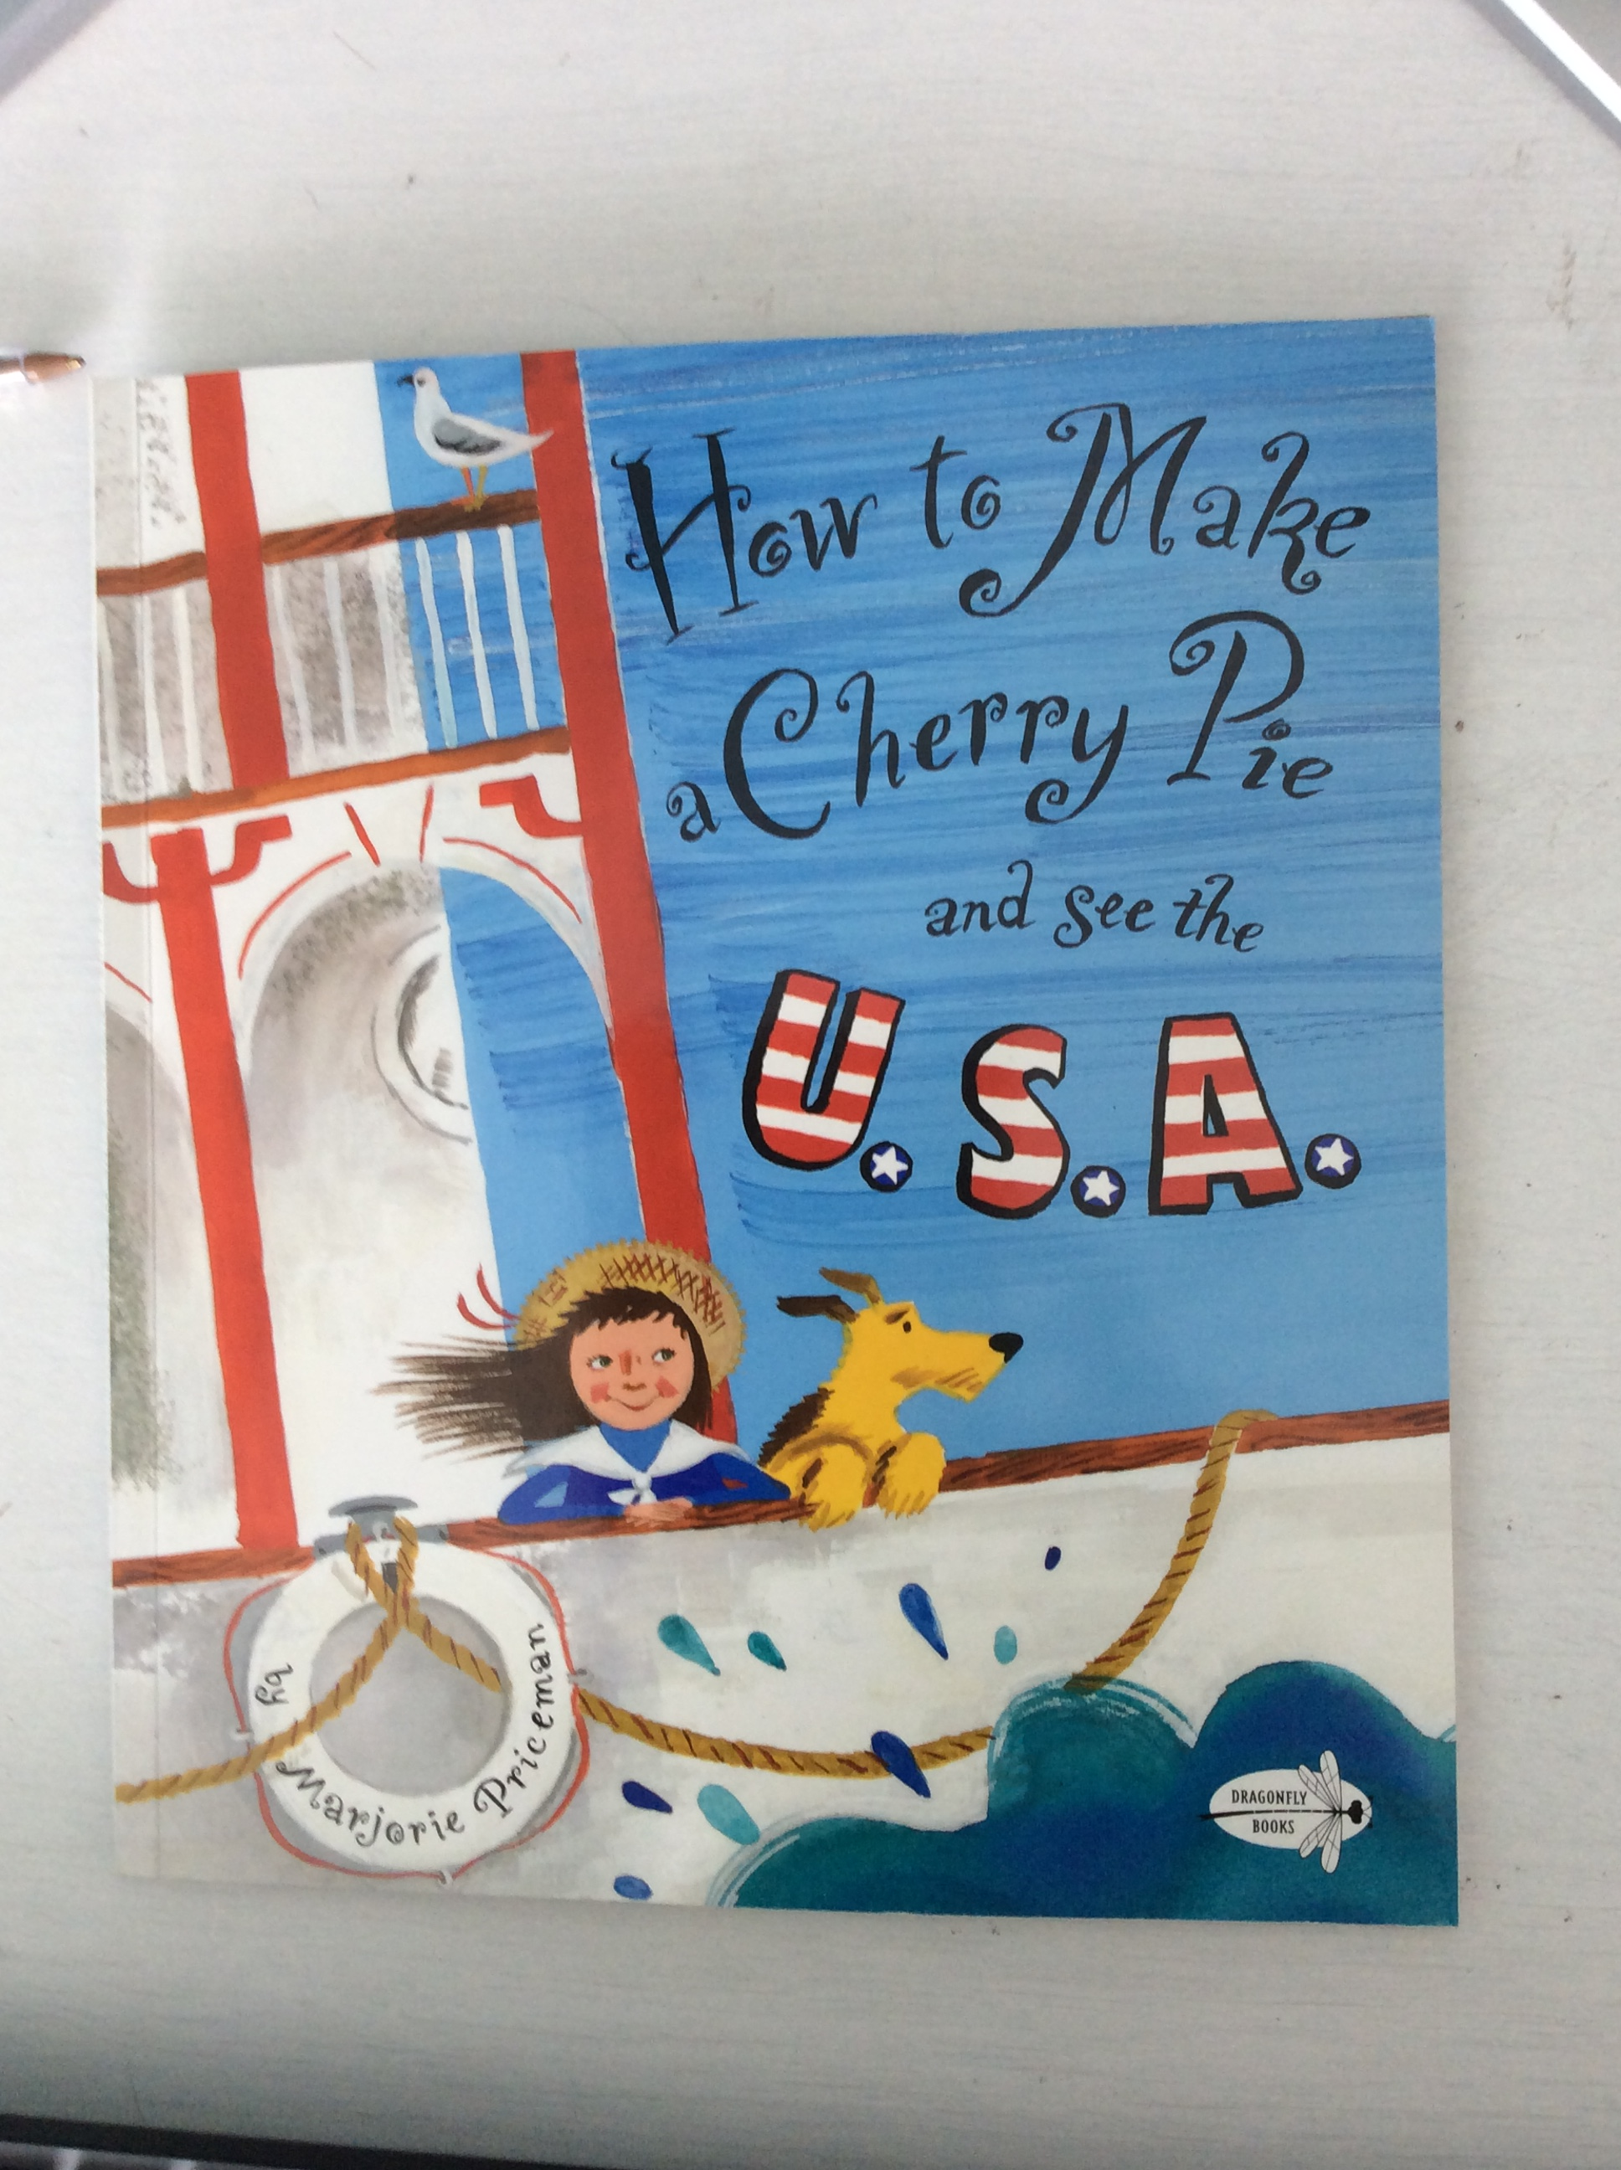

Slide 2



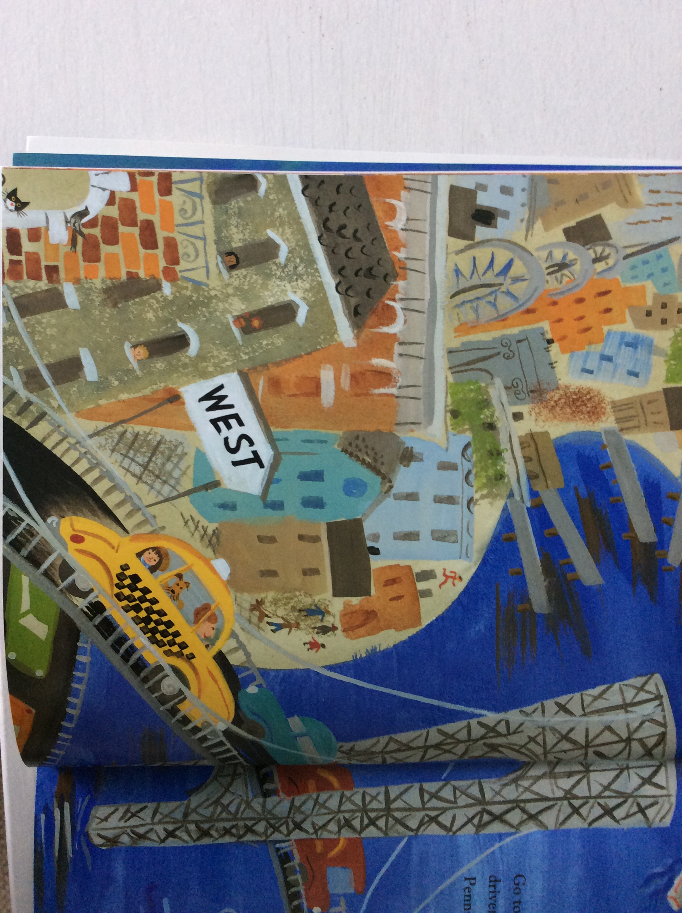
goto New Yuk and hayl a taxi
ABC
Go to New York and hail a taxi.

Slide 3
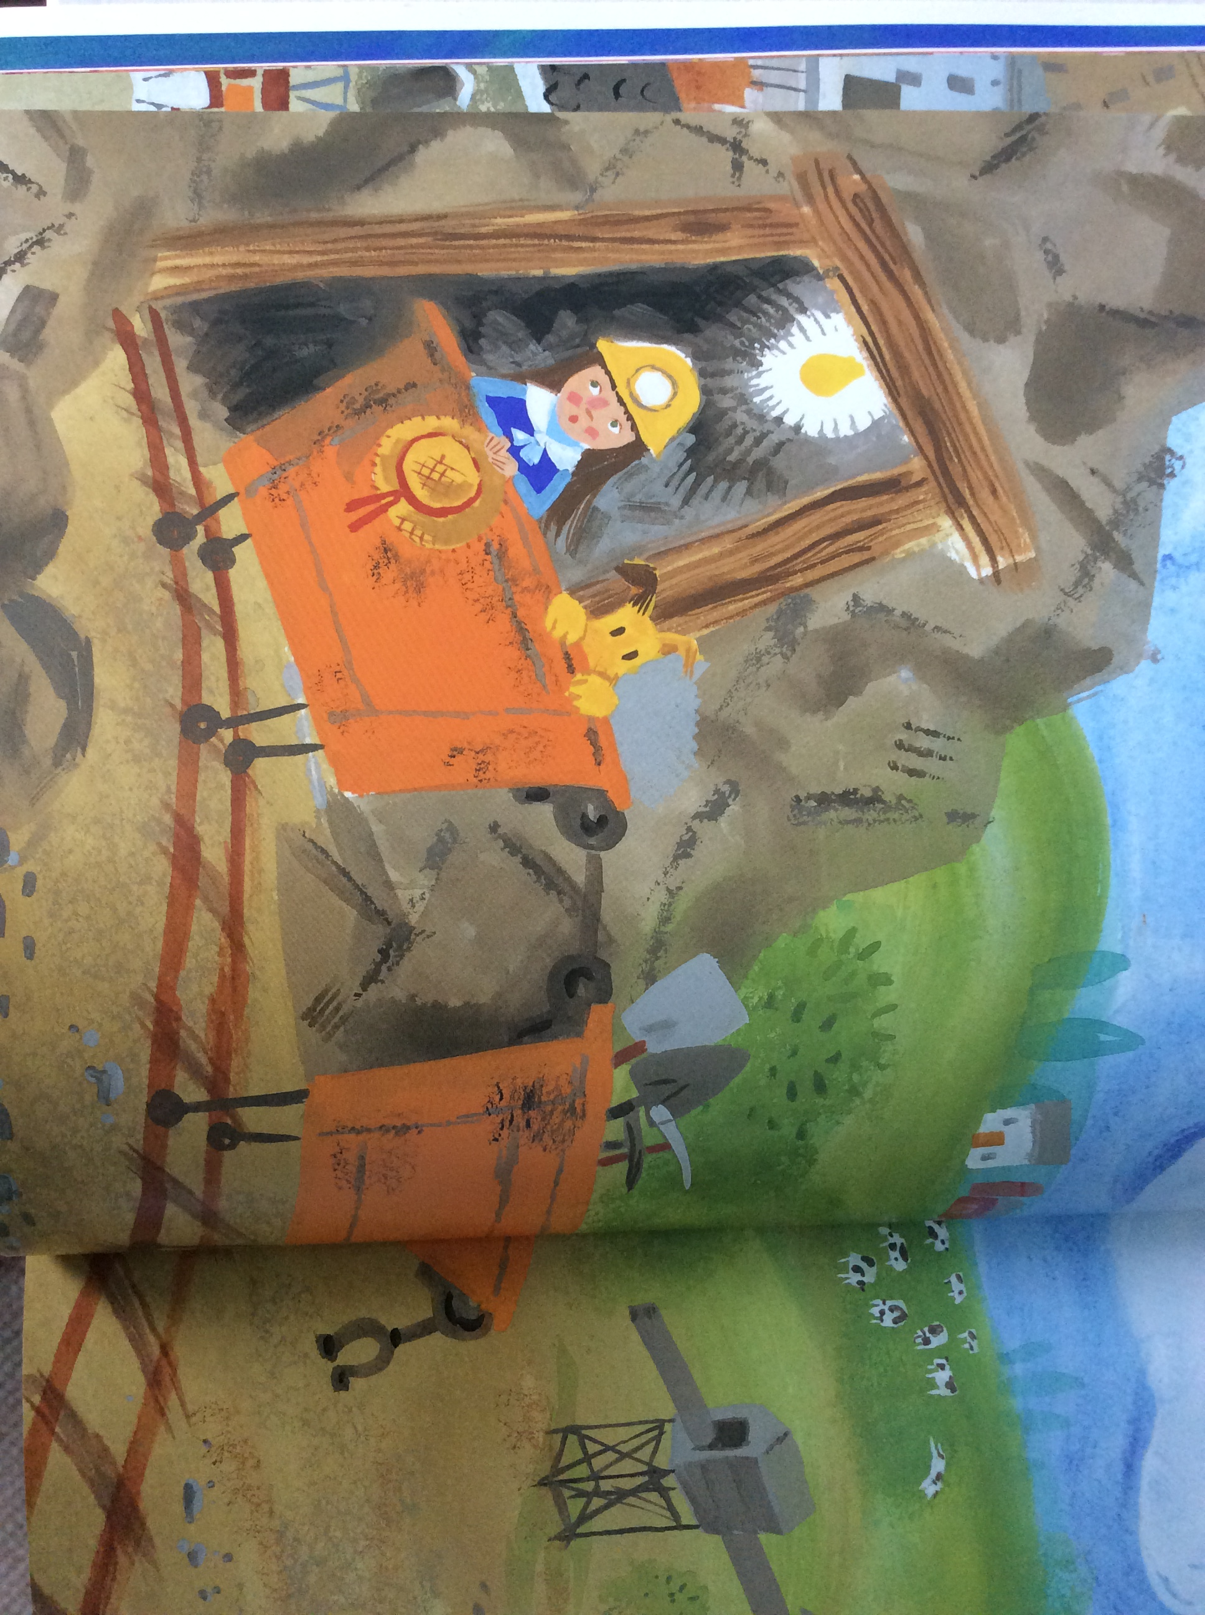
filla bucket wiv cowl
ABC
Fill a bucket with coal.

Slide 4
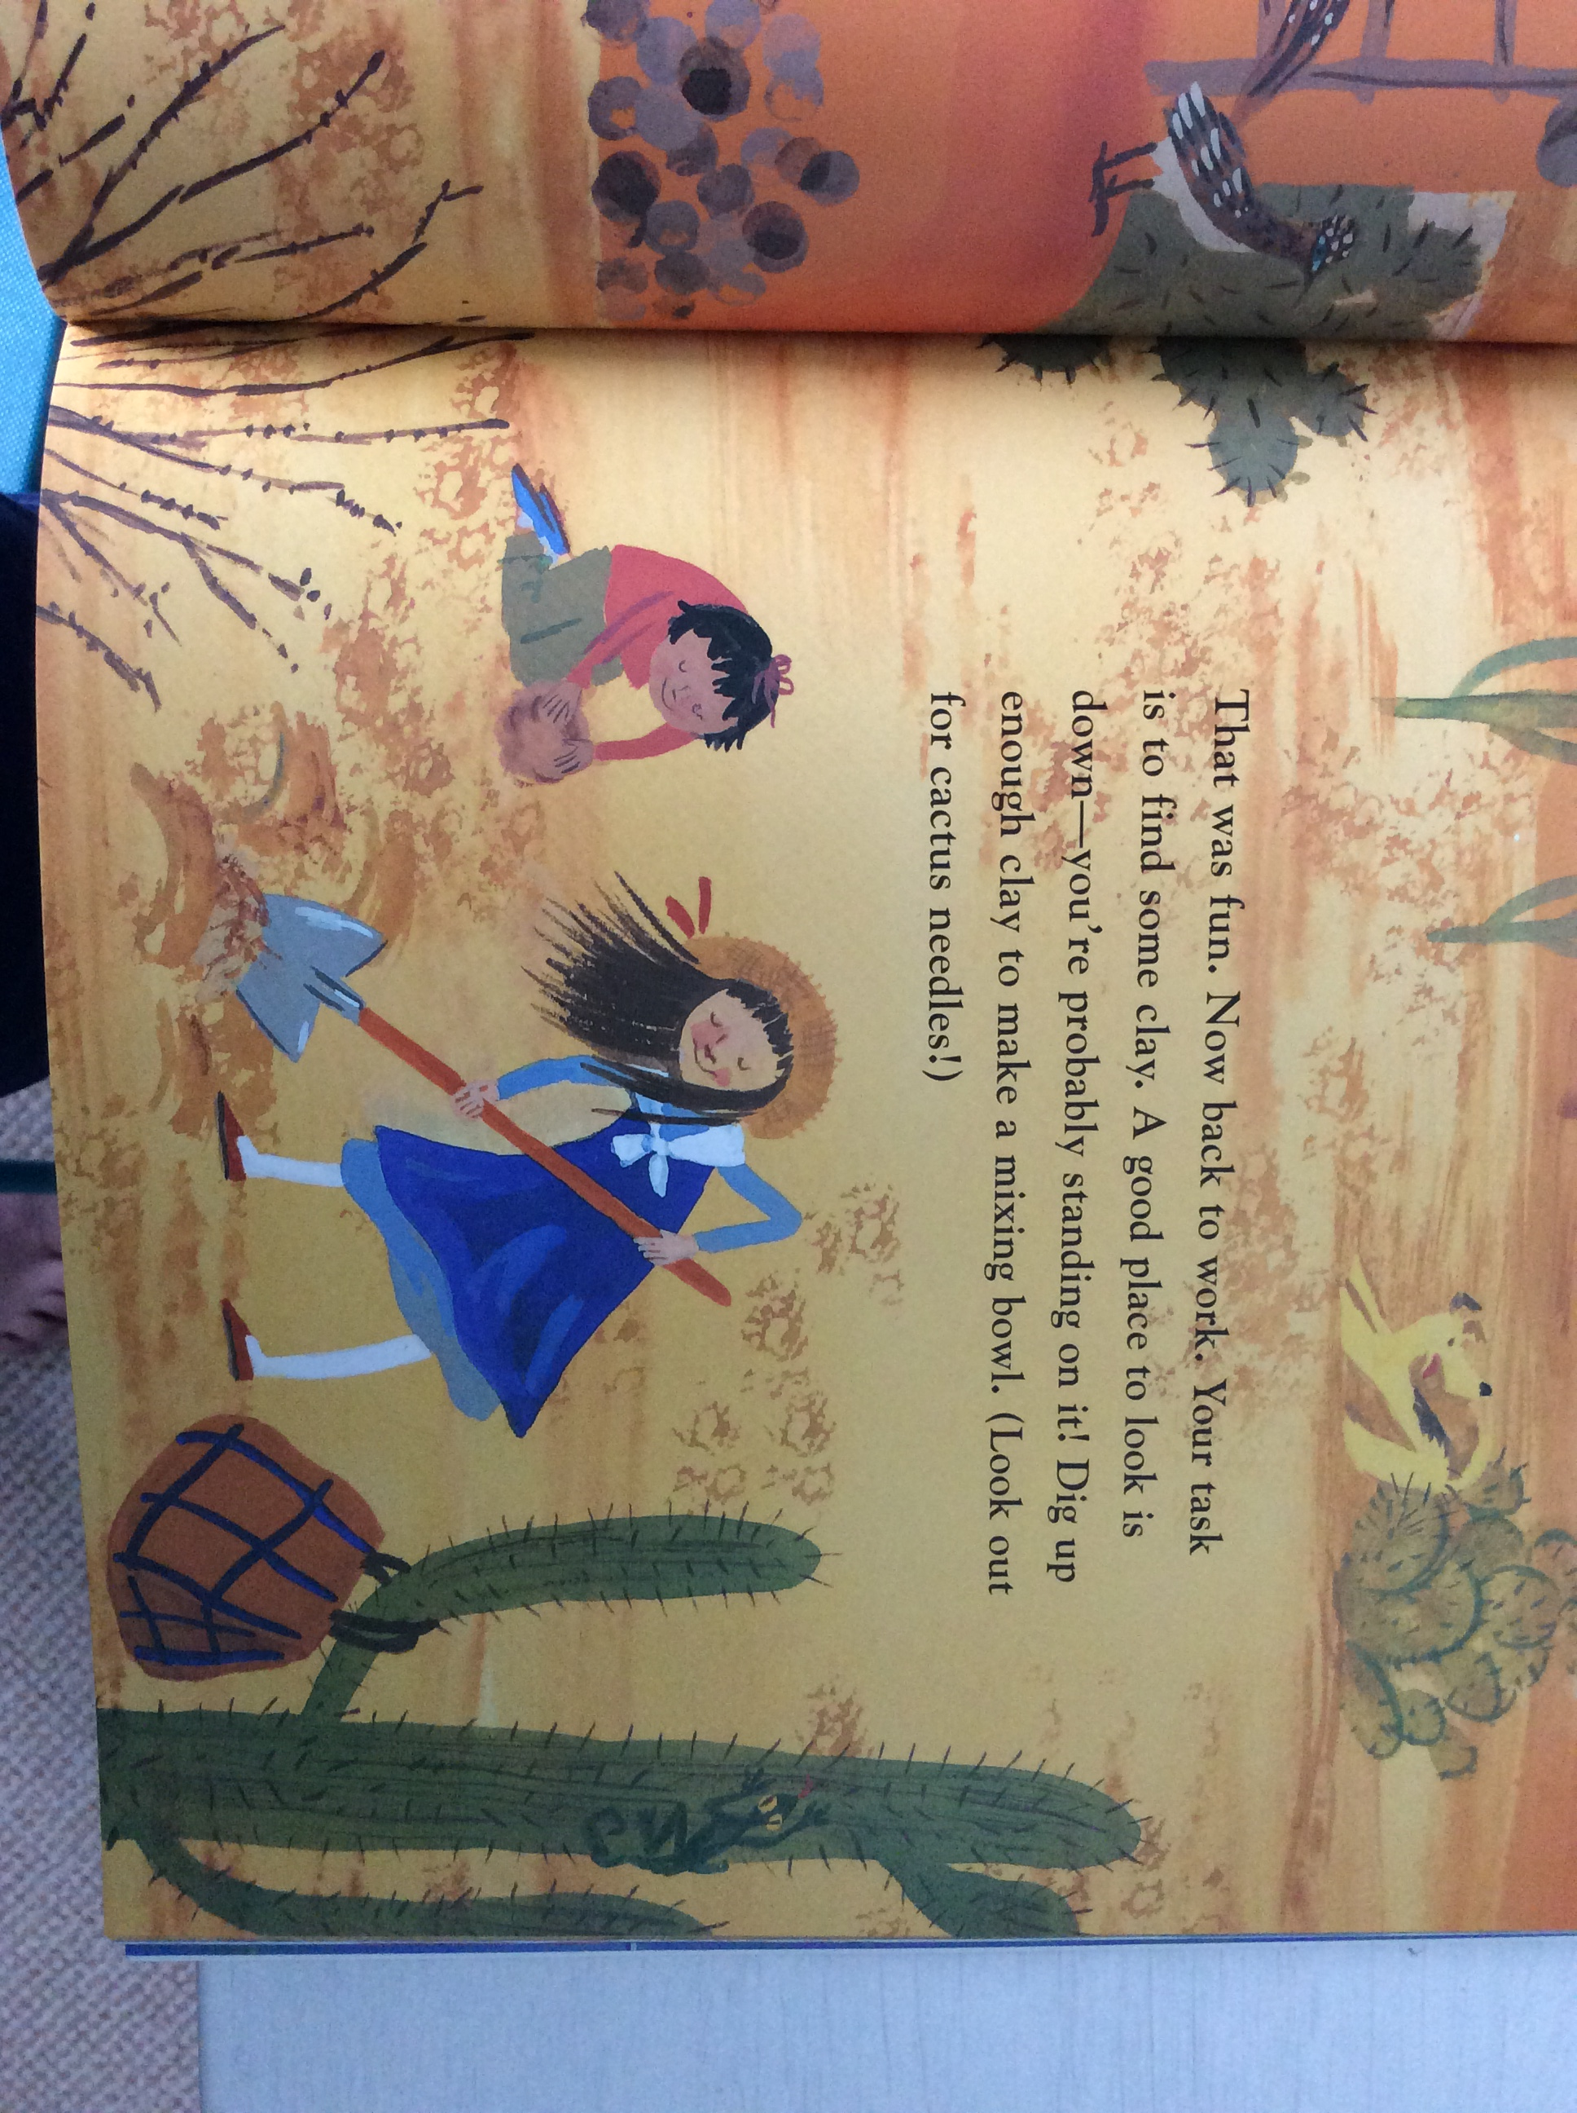
dig fur some clai
ABC
Dig for some clay.

Slide 5
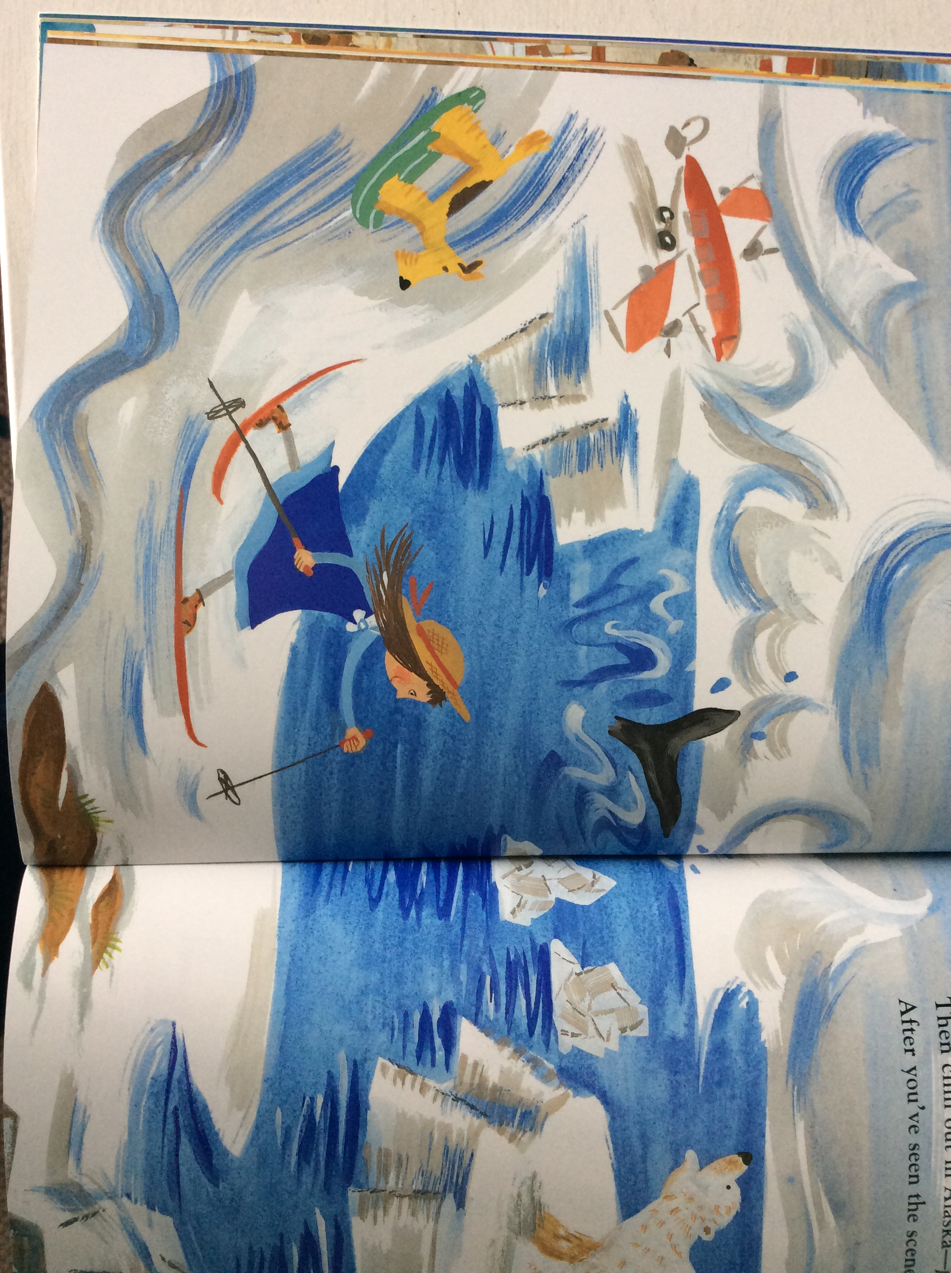
then shillawt in alaska
ABC
Then chill out in Alaska.

