Slide 1
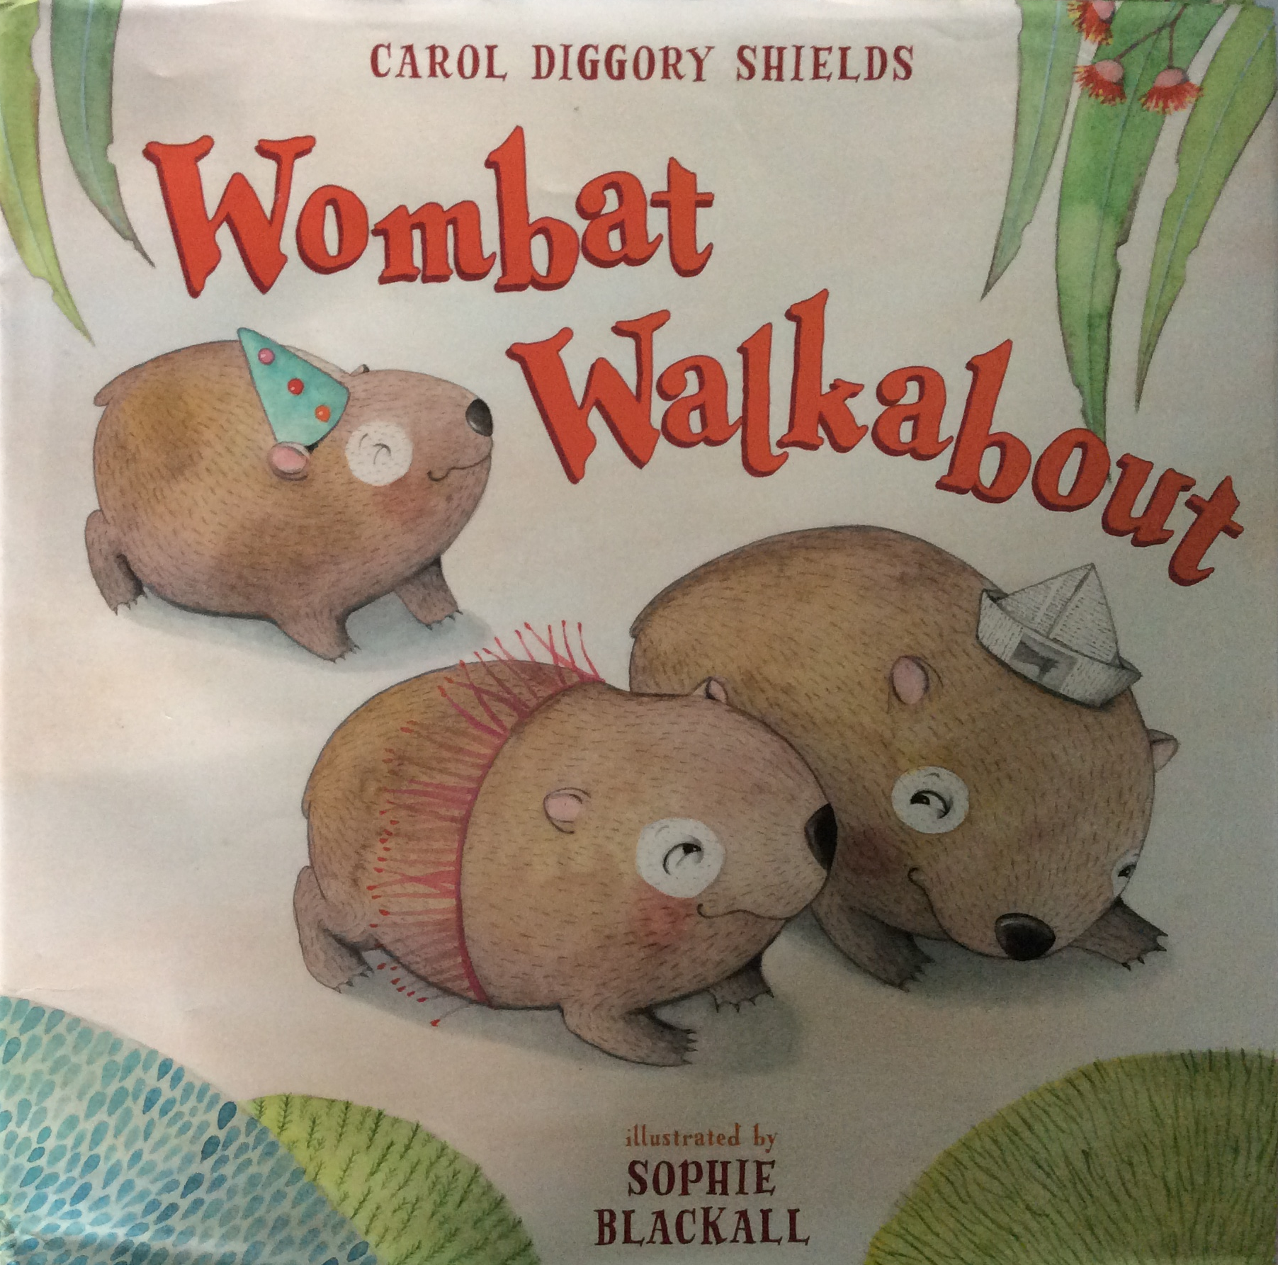

Slide 2
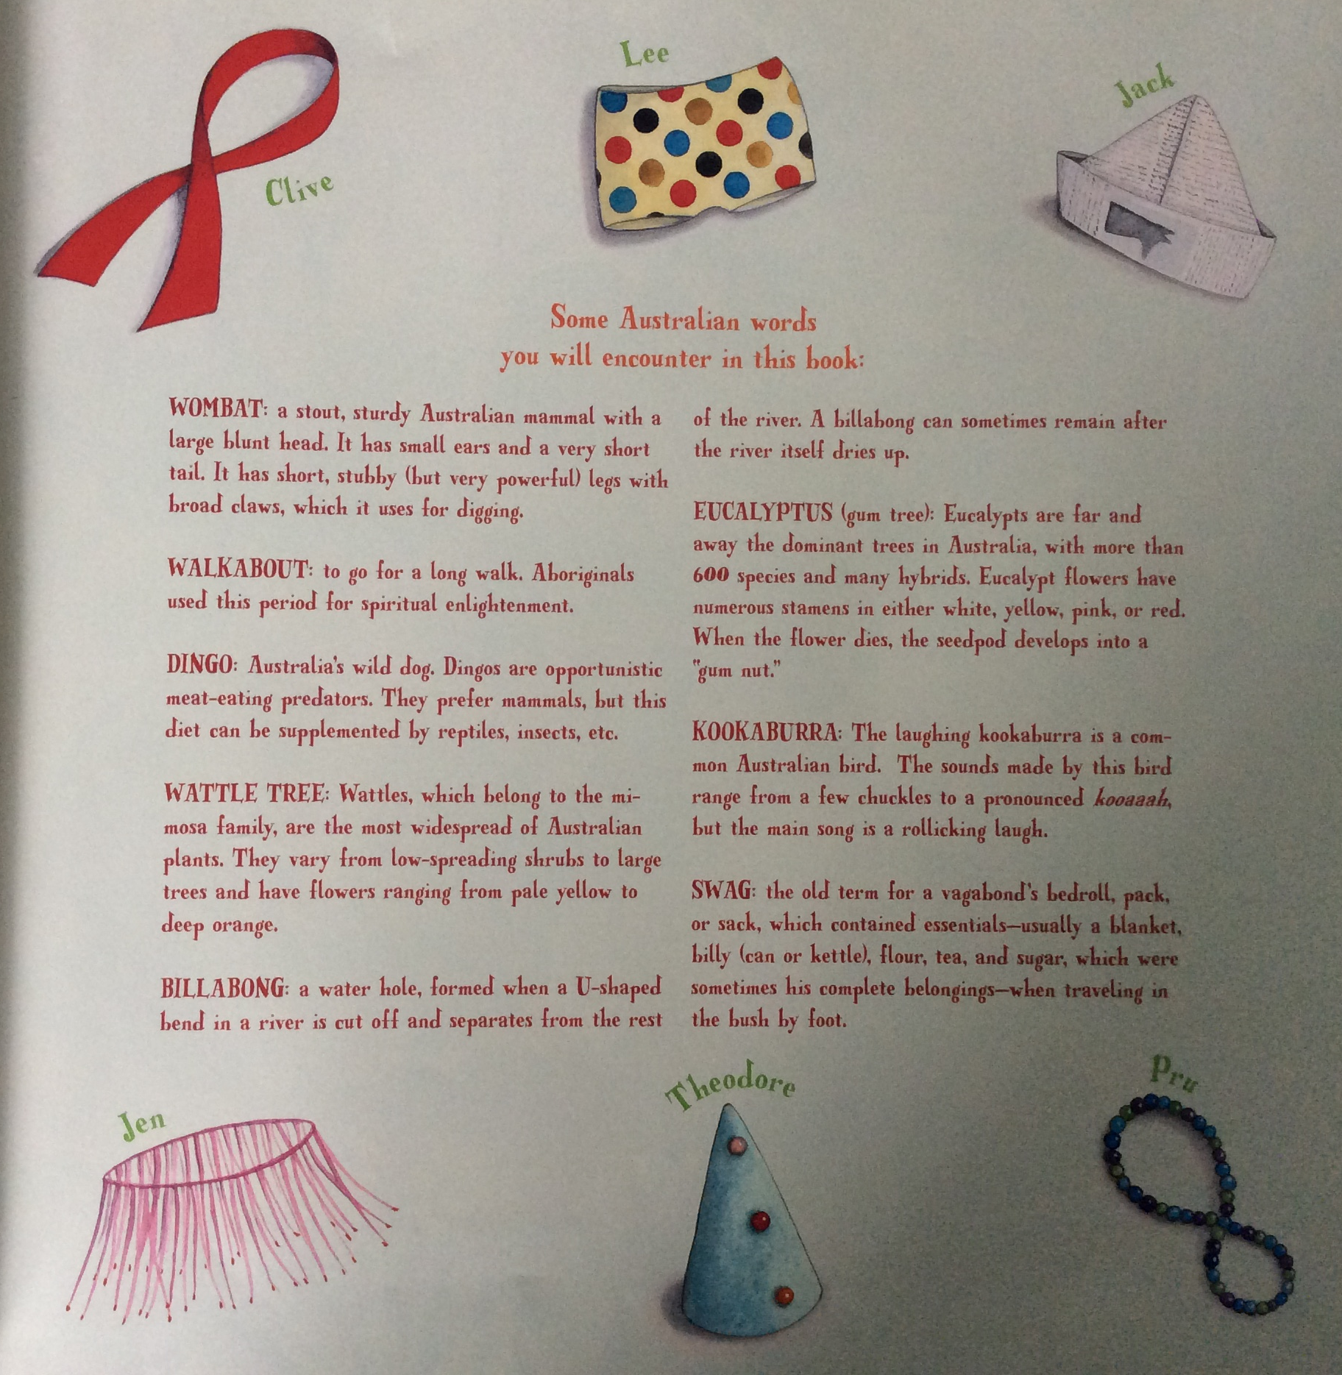

Slide 3
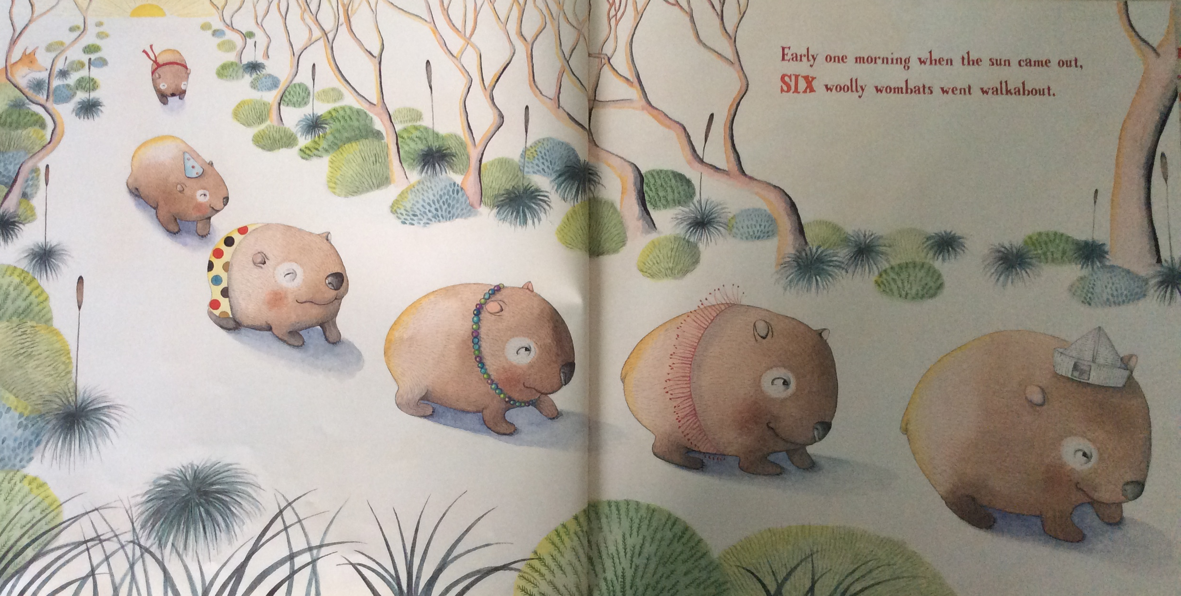
Can you spot the spying dingo?
Can you hear the words that rhyme?

Slide 4
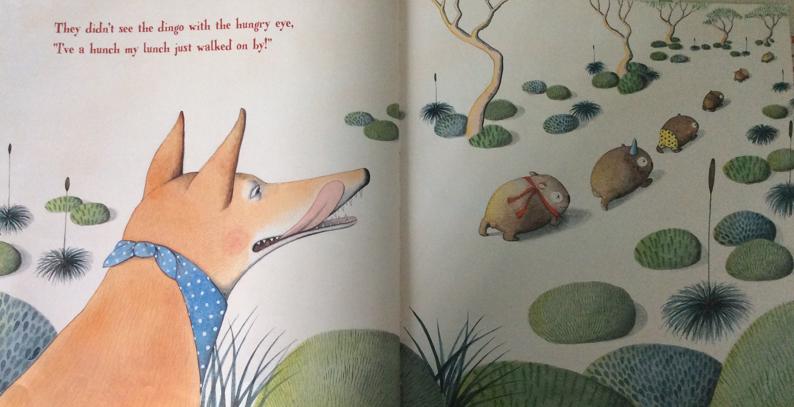
Can you hear the words that rhyme?

Slide 5
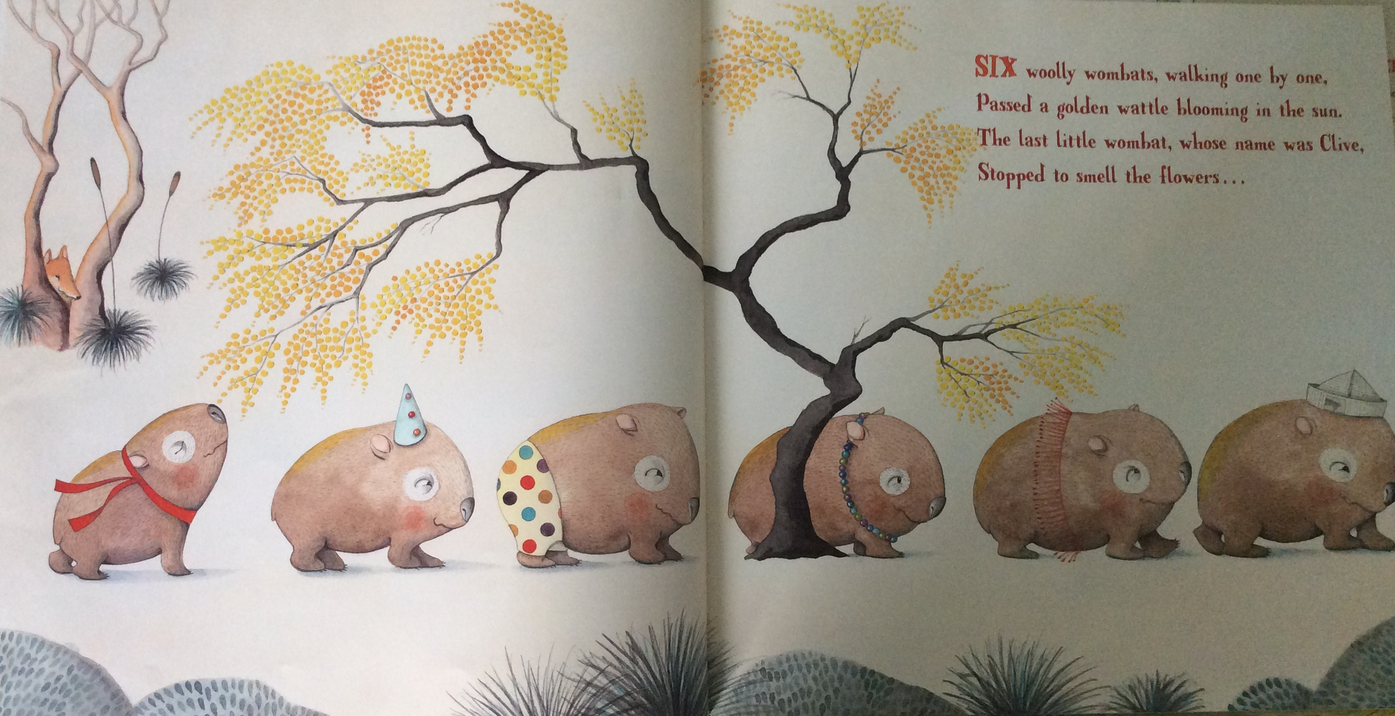
Can you guess what will happen?

Slide 6
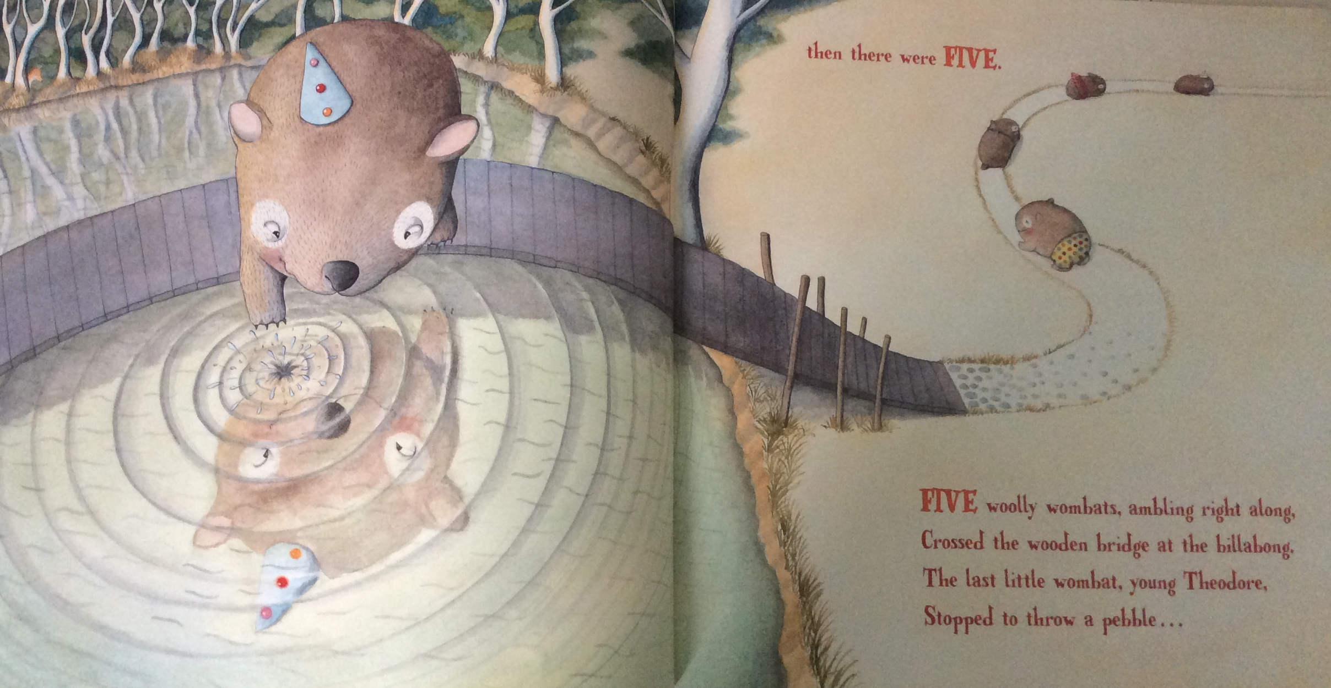
Can you hear the words that rhyme?

Slide 7
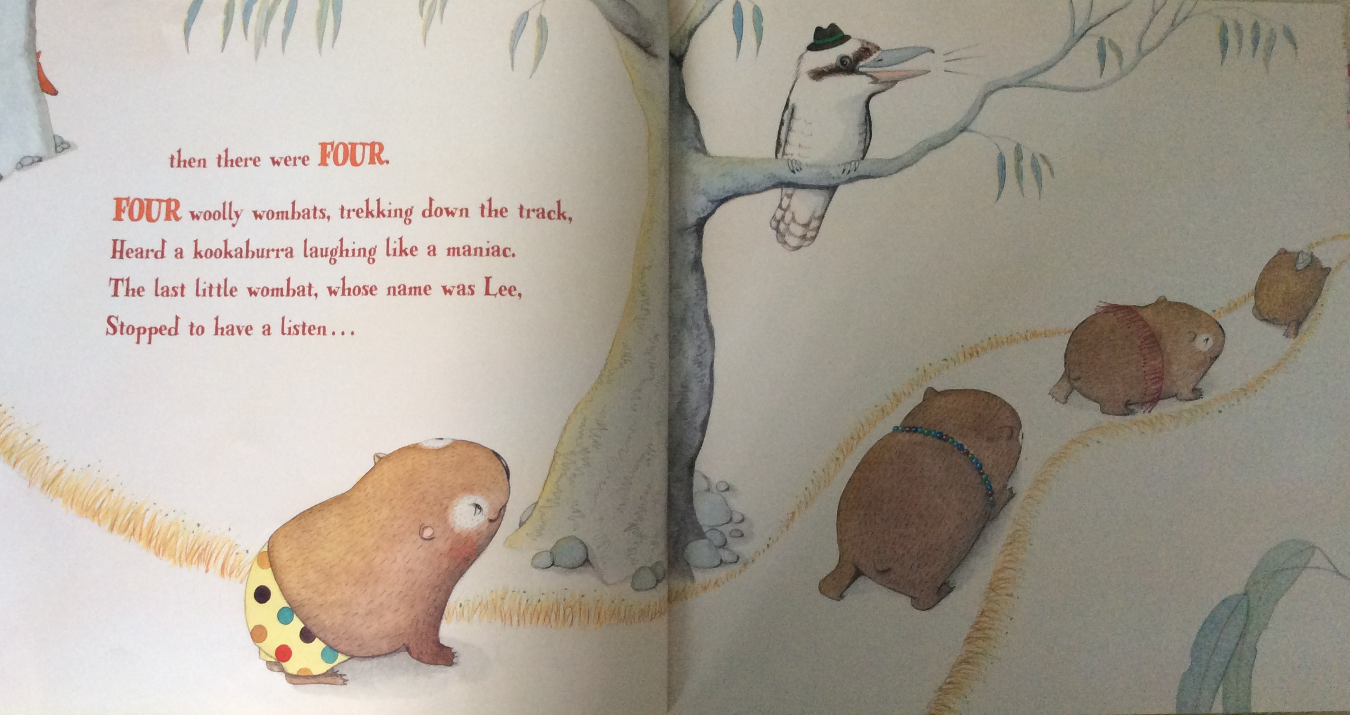
Can you guess what I am thinking? What do you think will happen next?

