Slide 1
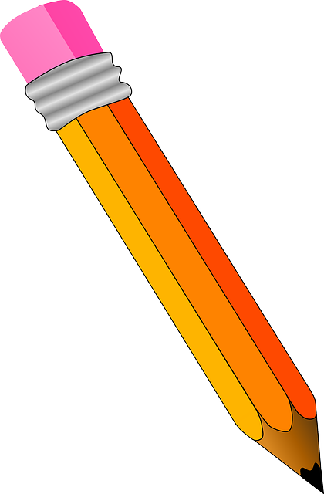
Handwriting practise:
Thursday

Slide 2

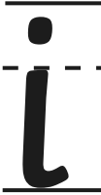
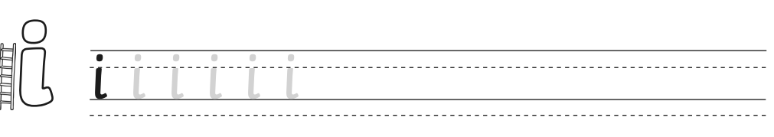
Start at the top, a straight line down and then curl it forwards. Add the dot at the end.

Slide 3

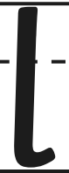
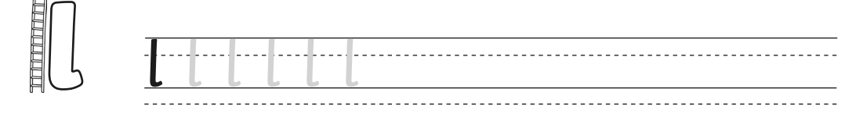
Start at the top, a straight line down and then curl it forwards.

Slide 4
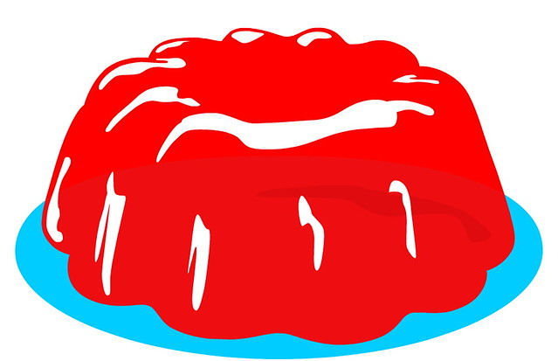
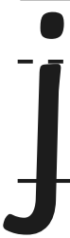
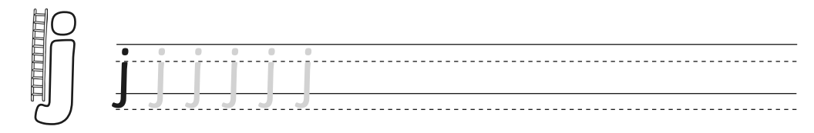
Start at the top, a straight line down and then curl it backwards. Add the dot on the top.

Slide 5
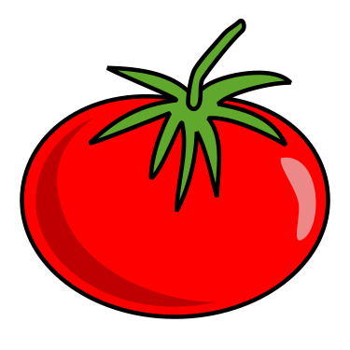
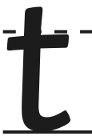
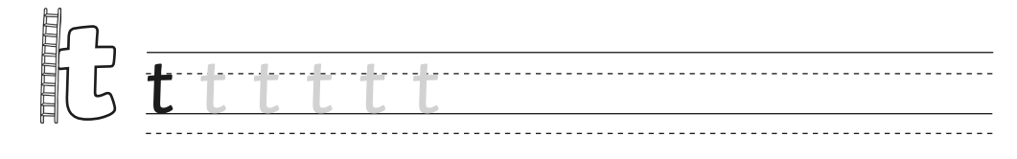
Start at the top, a straight line down and then curl it forwards. Cross it through the middle.

Slide 6
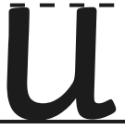

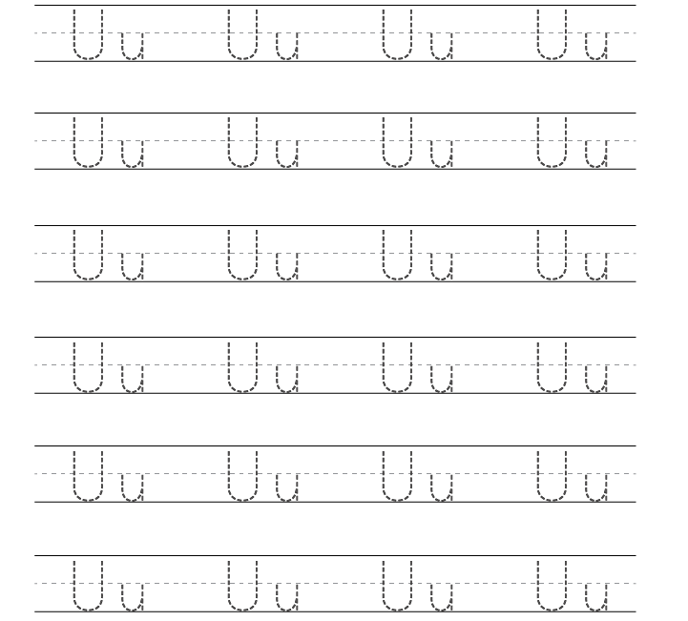
Start at the top, a straight line down and then curl it round and back up. Then come back down.

Slide 7

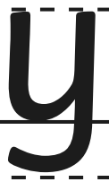
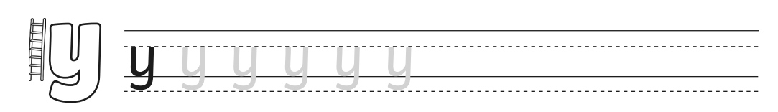
Start at the top, go down, curl it back and go up. Come straight down and keep going, then curl it back.

