Slide 1
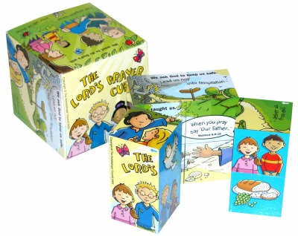






Chatterbox
What are learning about in RE?

