Slide 1
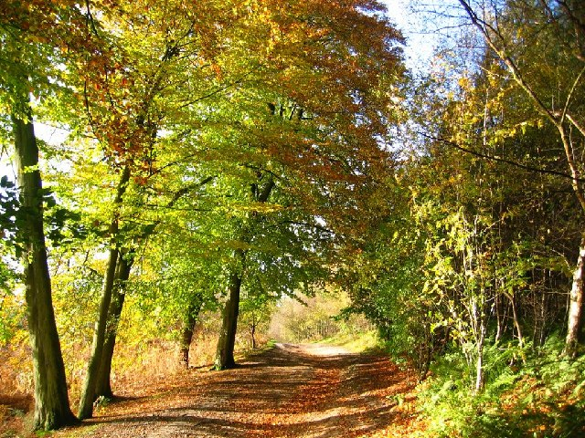

Foxhowl Meeting

Slide 2

Agenda
Information about the centre
Activities
What to bring and what not to bring
Itinerary
Questions

Slide 3
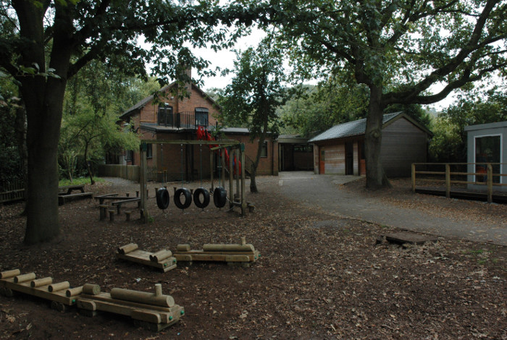
Foxhowl
Conway Centres: Delamere

Slide 4
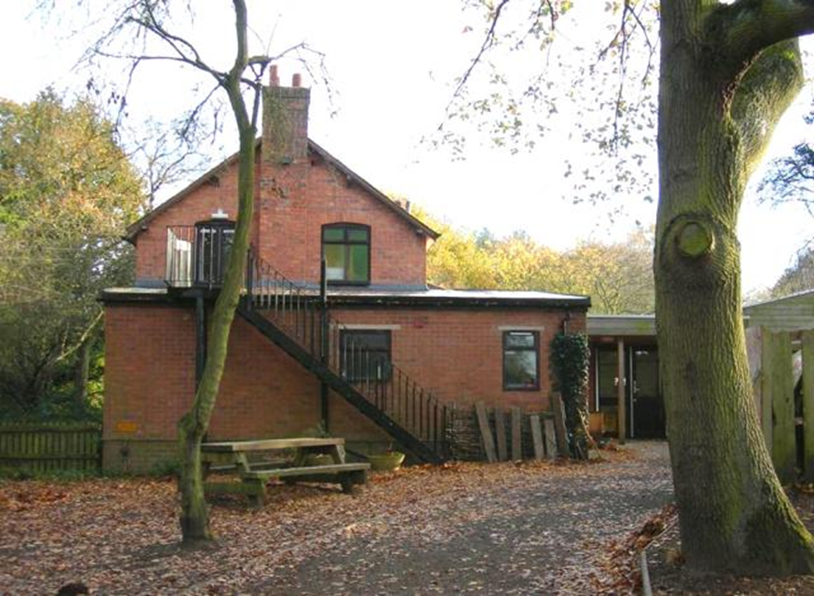
Notes:
This is the centre that we will stay in.

Slide 5
Foxhowl
Conway Centres: Delamere
Originally known as Foxhowl, the building used to be a Youth Hostel and it is well known for its homely appeal.
Available within the grounds is a well established nature pond.
There is safe access to Delamere Forest where children can participate in activities such as orienteering, den building, survival skills, stream dipping, environmental games, forest art and walks which study animal habitats and the different flora and fauna of the forest.
Children as young as reception age to older juniors visit Conway Centres: Delamere for what may be their first stay away from home.

Slide 6
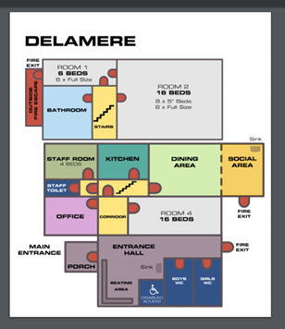

Slide 7
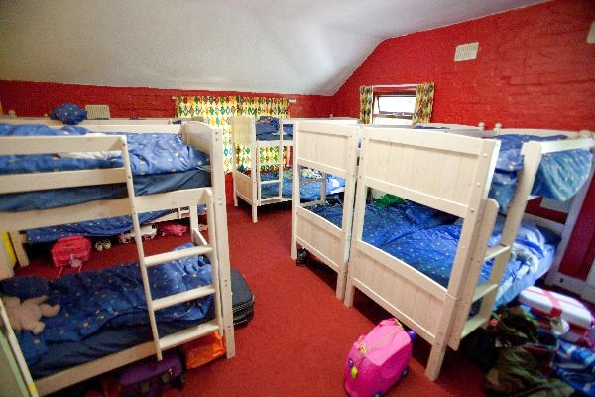
Bedroom
Notes:
There are 2 rooms. The girls sleep in one room and the boys in another. There are separate facilities for staff adjoining the children’s rooms.

Slide 8
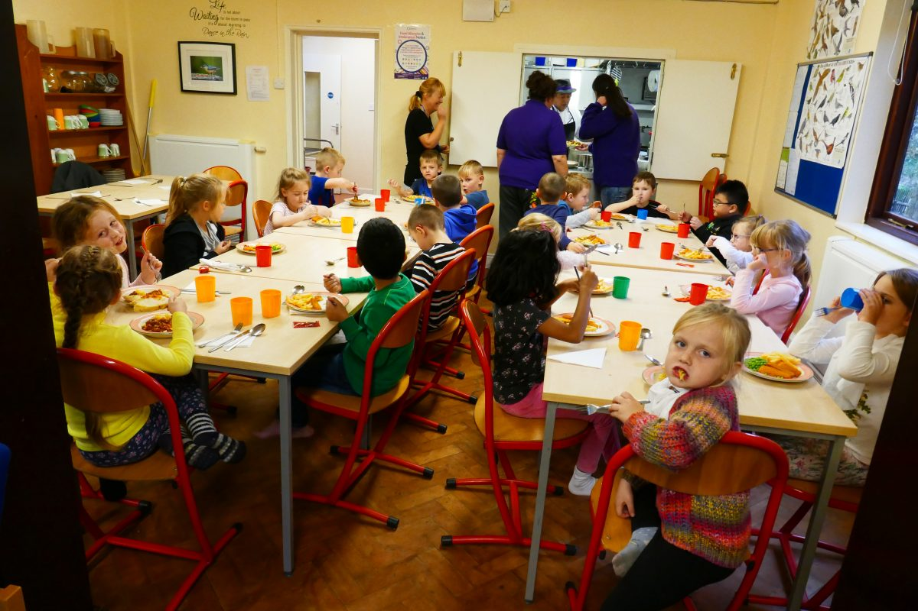
Dining Room
Notes:
All tastes are catered for. The food is wonderful and there is lots of it. The children do not go hungry.

Slide 9
Catering
Breakfast
A selection of cereals, juice and yoghurts are in the dining room for children to help themselves to, followed by a hot option served at 8.15 am.
Lunch
Lunch is sandwiches, crisps, fruit or yoghurt and a hot option which is served at 12.30 pm or a packed lunch which you can take out.
Evening Meal
The main meal is a 2 course meal with 2 options usually served at 4.45 pm.
Snacks
Tea, coffee, squash, milk, hot chocolate, biscuits and toast are available at all times from the dining room.
Special Diets
The centre has a wealth of experience in providing meals for all sorts of allergies and intolerances from mild to serious conditions. We ask for dietary requirements on the booking forms.

Slide 10
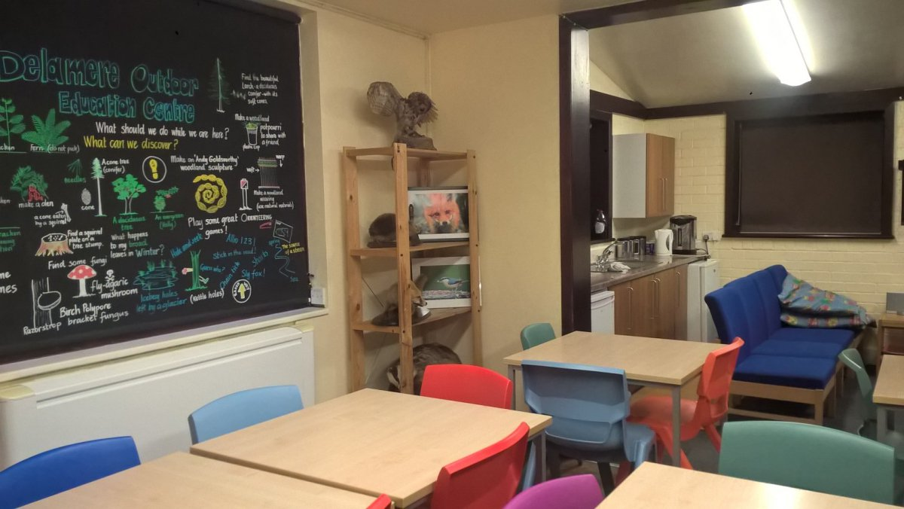
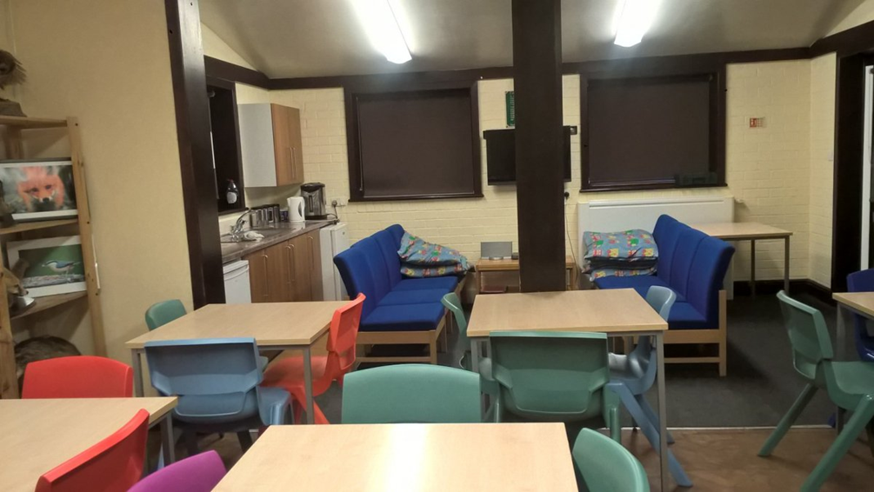
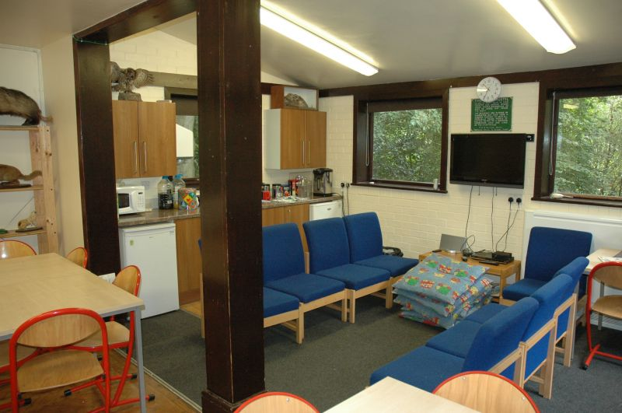
Notes:
There are areas for the children to sit, eat, relax and watch a film.

Slide 11
What to Bring
Children need to come to school wearing:
warm clothes that are not new and can get dirty
layers of t-shirts and jumpers/sweatshirts
a warm coat, hat and gloves
warm leg coverings such as joggers (not jeans)
sensible footwear such as trainers
They will also need:
Rucksack, wellies in a bag and small overnight bag that children can carry themselves

Slide 12
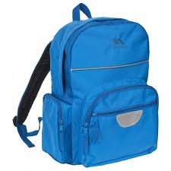
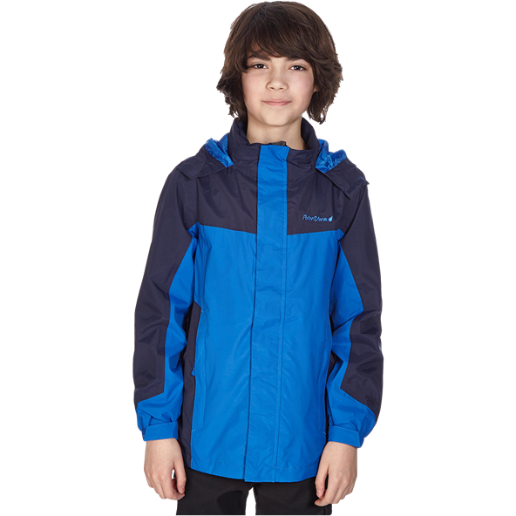
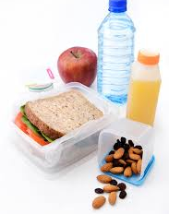
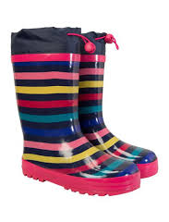

Rucksack
Packed lunch
in a labelled carrier bag,
the school kitchen
will not provide these.
Waterproof Coat
Wellies in a labelled carrier bag
Disposable
Camera

Slide 13

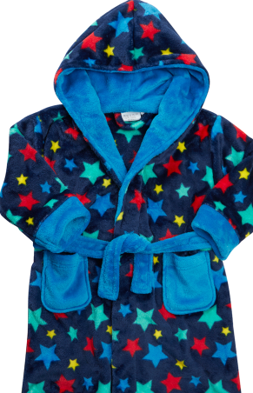


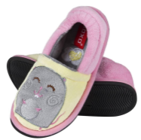


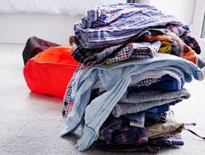
Overnight bag…
Teddy
Wash bag with flannel,
soap, toothpaste
and toothbrush
Night wear,
dressing gown
and slippers
Clothes for next day
spare clothes and underwear
Hair brush
Old clothes,
no jeans
Towel

Slide 14
Overnight bag…
Please ensure that you pack your child’s bag with them to avoid them claiming that they do not have what you have packed.
Teddy
Wash bag with flannel,
soap, toothpaste
and toothbrush
Night wear,
dressing gown
and slippers
Clothes for next day
spare clothes and underwear
Hair brush
Old clothes,
no jeans
Towel

Slide 15



Overnight bag…
Bin bag for
dirty clothes
Story Books
Puzzle Books

Slide 16


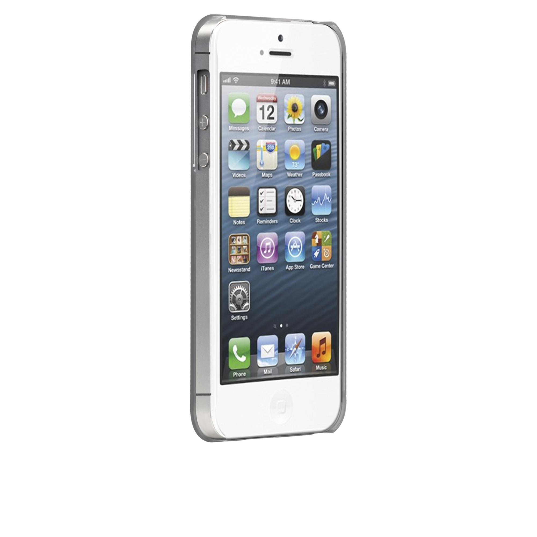


Items that will not be joining us…
NO ELECTRONIC
EQUIPMENT
No mobile phones
or tablets
No gaming
consoles

Slide 17



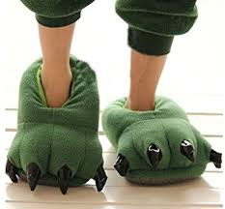

Items that will not be joining us…
No food or drinks other than in packed lunch bag
No aerosols
or sprays
No novelty slippers

Slide 18
Itinerary
Mrs Hogan’s Class
Monday 5th – Tuesday 6th Jul
Mr Dean’s Class
Tuesday 6th – Wednesday 7th Jul
Miss Wright’s Class
Wednesday 7th – Thursday 8th Jul

Slide 19
Itinerary – Day 1
8.40am - Arrive at school
Leave school once children and bags are on the coach
10am - Arrive at centre
Familiarisation, H&S including fire drill
12.30pm - Packed Lunch
Afternoon activity – Den building
4.45pm - Tea
6.30pm - Campfire
7.45pm - Supper
8.30pm - Bed

Slide 20
Itinerary – Day 2
8am - Breakfast
9am - Strip Beds and pack bags
9.30 am Morning activity – stream or other option
12.30 pm - Lunch
2pm - Leave centre
3pm - Arrive back at school

Slide 21
No News is Good News
We will not be sending any messages to school or to parents due to the poor signal in the forest
The centre does have a landline which we will use if there is an emergency

Slide 22

Any questions?
Send your questions, in an email, to the office and we will put together an answer sheet.
We will not be able to answer these questions during your parent meeting next week.

