Slide 1
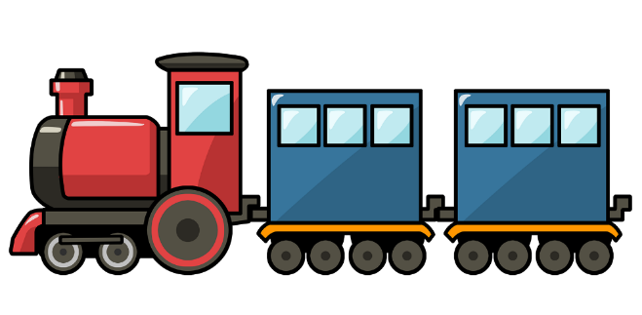
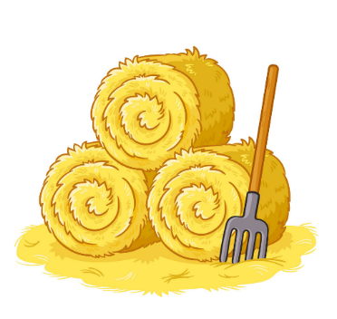
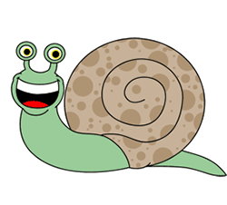



a
i
a
y

Slide 2



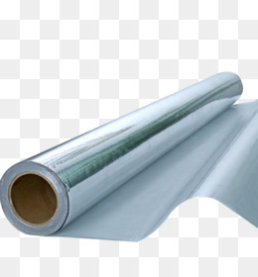


o
i

Slide 3


Let’s draw some pictures of things with oi

Slide 4
coin

Slide 5
soil

Slide 6

Let’s write some words with oi

Slide 7

oil
oi

Slide 8

boil
oi

Slide 9

point
oi

Slide 10

toilet
oi

