Slide 1

Land, air and sea dinosaurs.

Slide 2
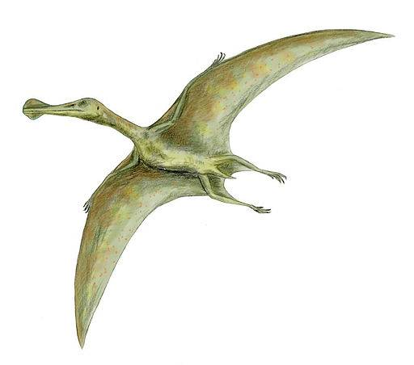
air
land
sea

Slide 3
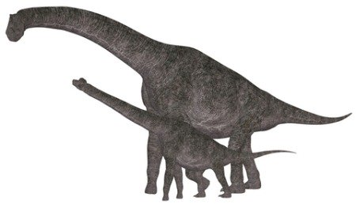
air
land
sea

Slide 4
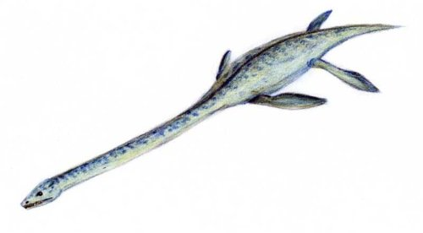
air
land
sea

Slide 5
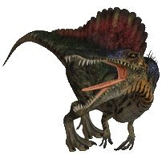
air
land
sea

Slide 6

Swimming Dinosaurs
Of all the dinosaurs, it was Spinosaurus that took to the water
This was the biggest meat eating dinosaur that we know of. Scientists think it could live on both land and water like crocodiles. But it could definitely swim (it had webbed feet) and hunt in the water. It probably ate sharks and large fish.
Spinosaurus is the only dinosaur we know that spent time living in the water. Another dinosaur, Ceratosaurus, could probably swim and catch aquatic prey, such as fish and crocodiles.

Slide 7
Sort the dinosaurs into land, sea and air.
Is there any that can be in both groups?

