Slide 1
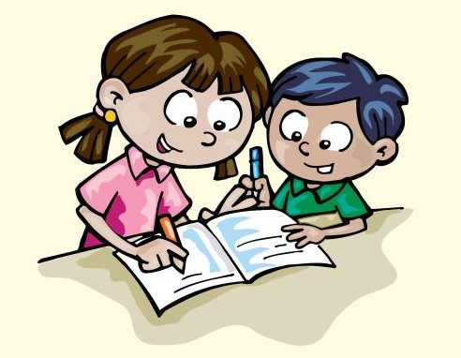
Spelling Practise

Slide 2
Read the word then click to make it disappear. Can you spell the word?
not

Slide 3
Read the word then click to make it disappear. Can you spell the word?
up

Slide 4
Read the word then click to make it disappear. Can you spell the word?
put

Slide 5
Read the word then click to make it disappear. Can you spell the word?
had

Slide 6
Read the word then click to make it disappear. Can you spell the word?
big

Slide 7
Read the word then click to make it disappear. Can you spell the word?
he

Slide 8
Read the word then click to make it disappear. Can you spell the word?
she

Slide 9
Read the word then click to make it disappear. Can you spell the word?
we

Slide 10
Read the word then click to make it disappear. Can you spell the word?
me

Slide 11
Read the word then click to make it disappear. Can you spell the word?
be

Slide 12
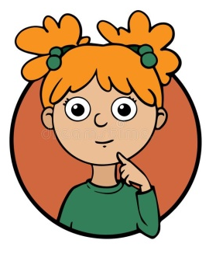
If you found the spellings easy, why not try one of the tricky challenges below…
Can you write the word in a sentence?
How many times can you write the word in 20 seconds?
Can you make the words using household items? (see below)

