Slide 1
Read the words. Which one is correct?
they
thay

Slide 2
Read the words. Which one is correct?
hav
have

Slide 3
Read the words. Which one is correct?
ar
are

Slide 4
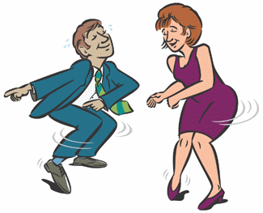
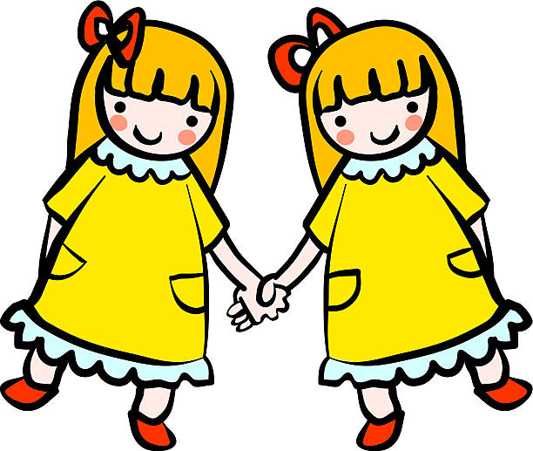
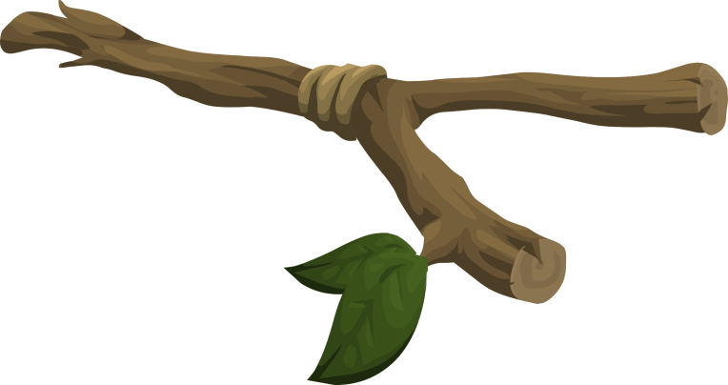
t
What is the cluster?
How do you say it?
Look at the pictures can you hear the cluster in each word?
w

Slide 5
Read the words. Can you match them to the correct picture?
twist
twin
twig
tweet

Slide 6
Can you read the sentences?
They are twins.
The twig fell off the tree.

