Slide 1
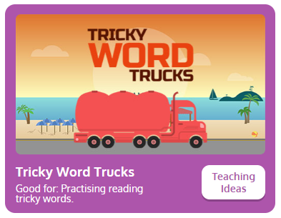
What tricky words do we know? Let’s play tricky word trucks and see if we can read all of them.
Tricky Word Trucks (phonicsplay.co.uk)

Slide 2


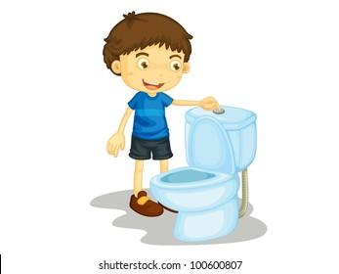

fl
flag
flip
flush
flat

Slide 3
flag
flip
flush
flat

Slide 4
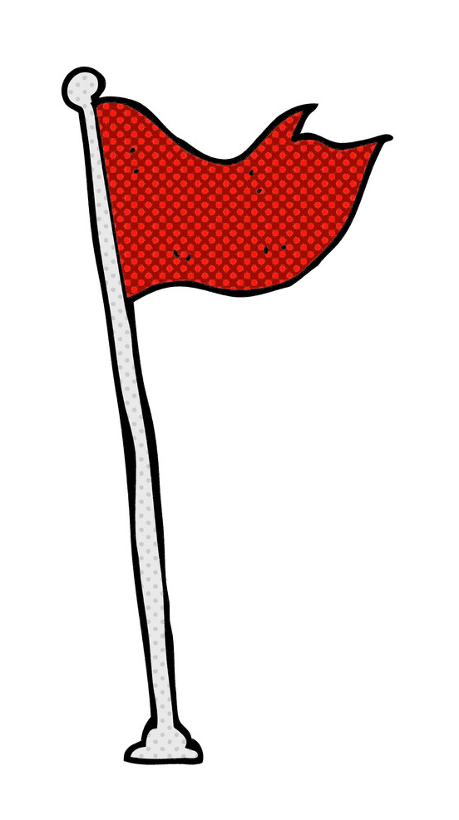
Can a flag fly?
Can a flag flip?

