Slide 1



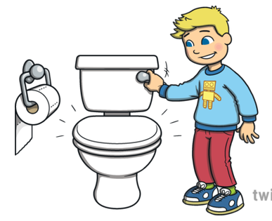
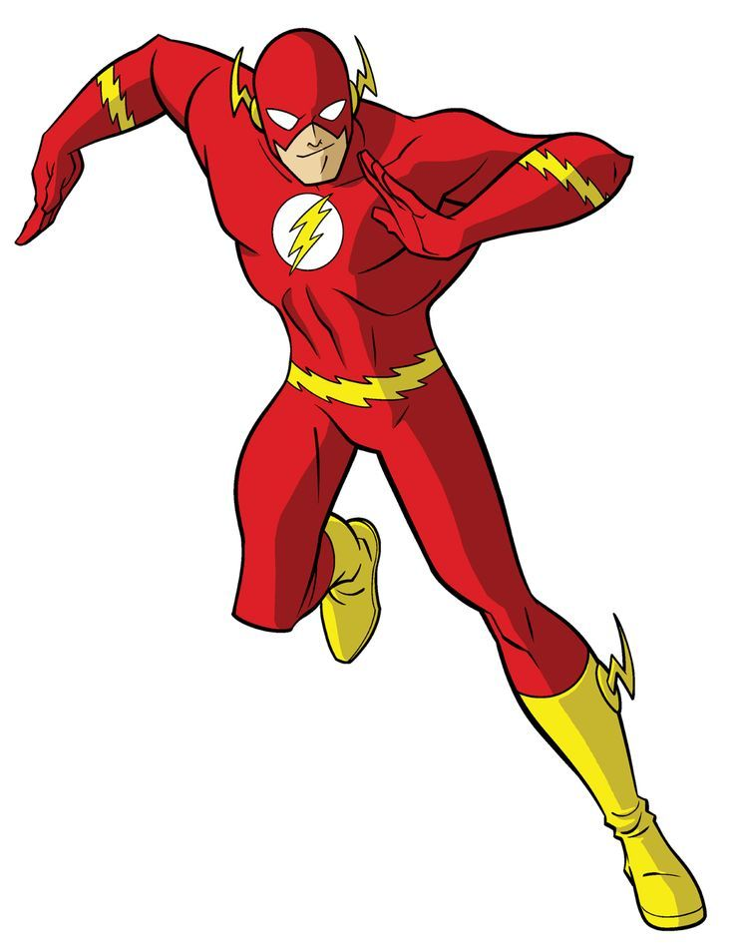
f
What are the ‘fl’ words?
Can you spell them?
l

Slide 2

Can you read the silly questions?
Where are the ‘fl’ words?
Can a flag flush a toilet?
Will Flash have flip flops?

