Slide 1



The Land Before Time…

Slide 2
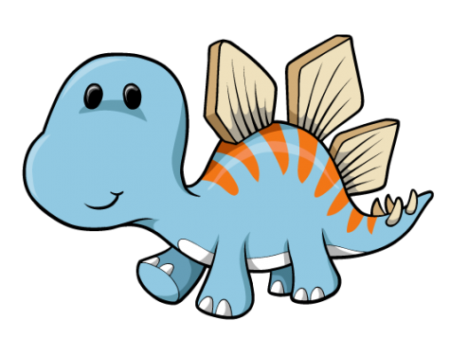
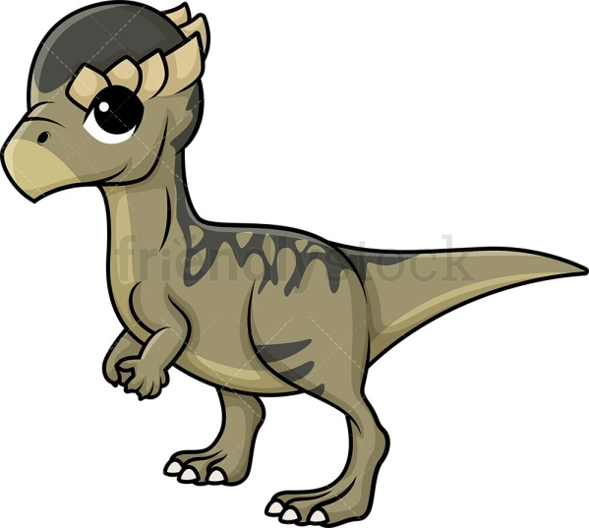
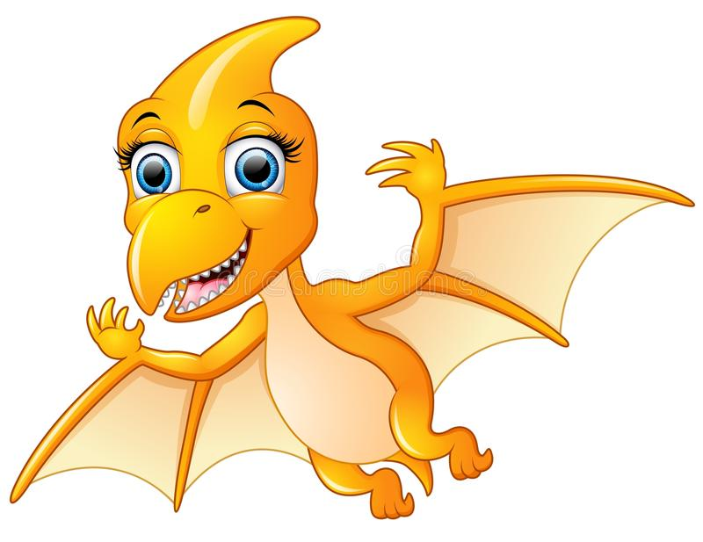
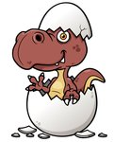
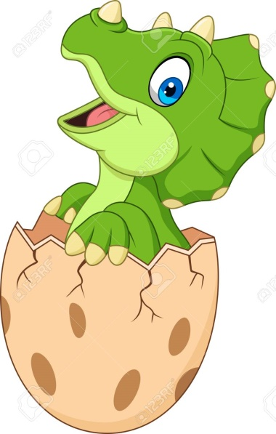
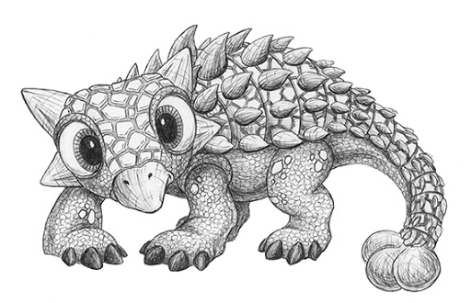
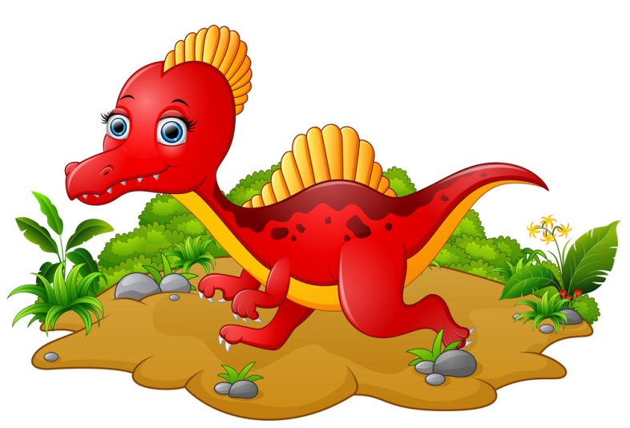
pterodactyl
stegosaurus
pachycephalosaurus
What dinosaur is in the egg?
T-Rex
ankylosaurus
spinosaurus
triceratops

Slide 3




d-o-g
d o g
What does a good reader do?
the I to
go can no
dog?
animal?

Slide 4

To Reception,
I hope you have had a nice rest.
Thank you for looking after my egg.
Is it still green?
Has it got a crack in it yet?
I hope I feel better soon.
From Terry xx

Slide 5



The egg is green.
ABC
the eggis bran and grin

