Slide 1
Addition ₊
Look at the number stories. Count how many vegetables you can see all together and write the answer.
Challenge: Can you write the number sentence?

Slide 2
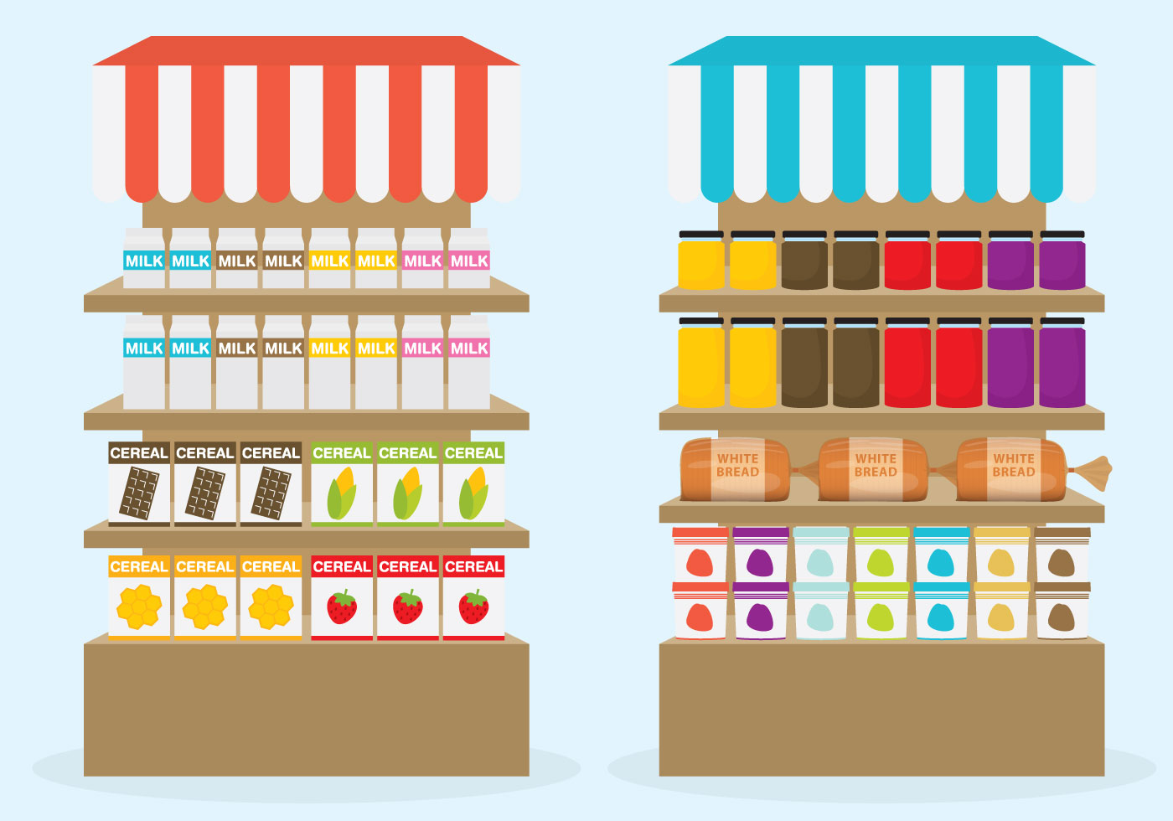
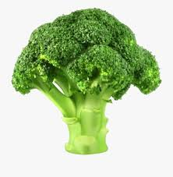

Slide 3
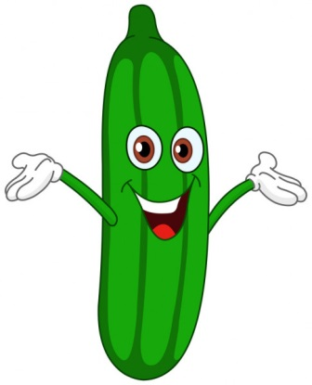

Slide 4
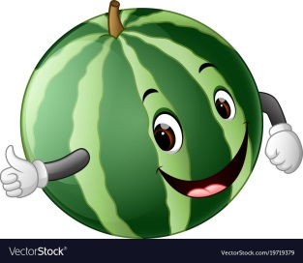

Slide 5
