Slide 1
Living and Non-Living
https://www.bbc.co.uk/bitesize/topics/z6882hv/articles/zs73r82 Watch the video and then Spot the living things and click on the leaves to listen to the next audio clip.

Slide 2
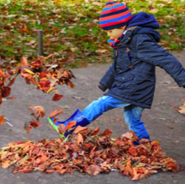
Things that were previously alive but are non-living now.
These leaves are dead.
They can't breathe or grow or make new leaves. But they were once part of a living tree which could do all those things.
They are no longer living things.
How do you know the leaves were living when on the tree?
How do we know they are non living now?

Slide 3
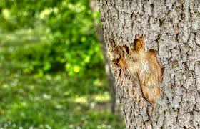
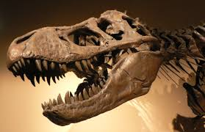
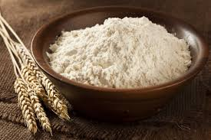
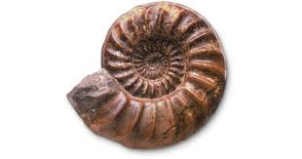
Can you think of any more things that were living before?

Slide 4
Can you think of or find any more examples?
Things that previously lived but are now non-living.

