Slide 1
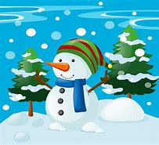
Icanseeasnowman.

Slide 2
I can see a snowman.

