Slide 1
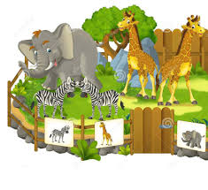
Can you blend the sounds?
zoo

Slide 2
Can you blend the sounds?
boot

Slide 3
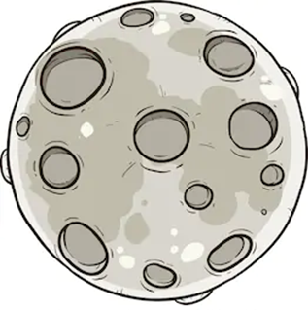
Can you blend the sounds?
moon

Slide 4
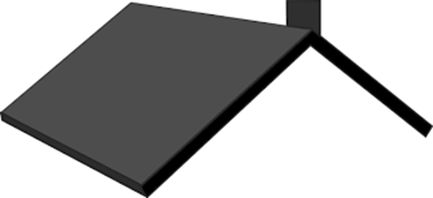
Can you blend the sounds?
roof

