Slide 1
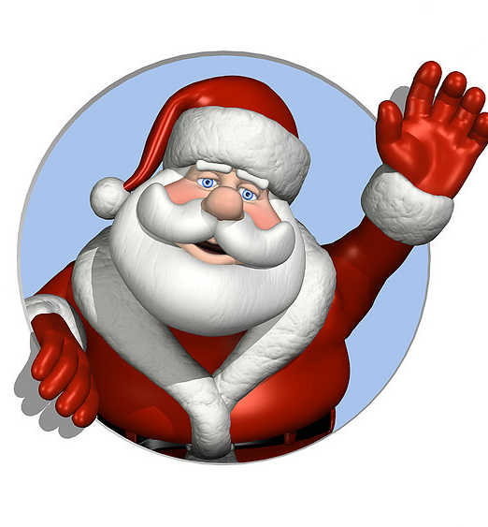
A vehicle for Santa

Slide 2
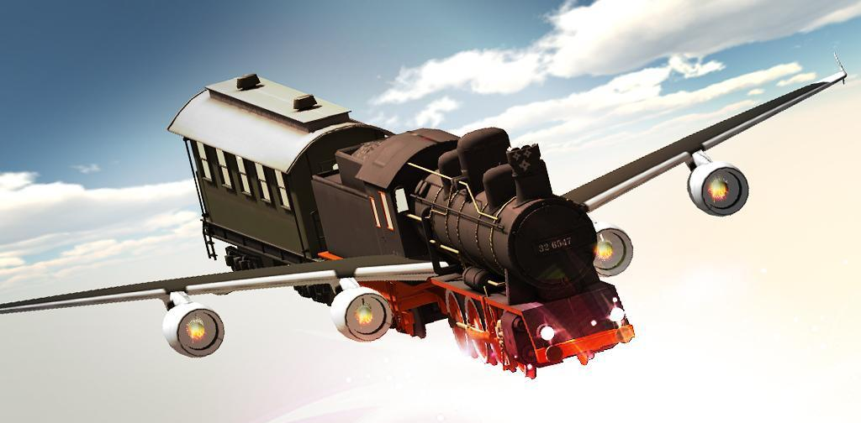
roof
wing
windows
wheels

Slide 3
it isa train
ABC
it canfly

