Slide 1
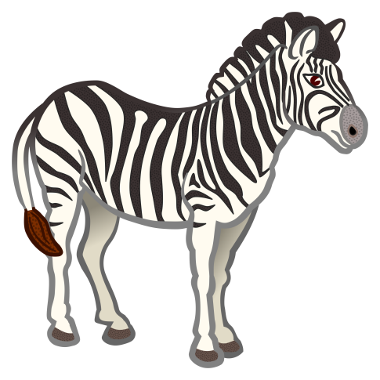
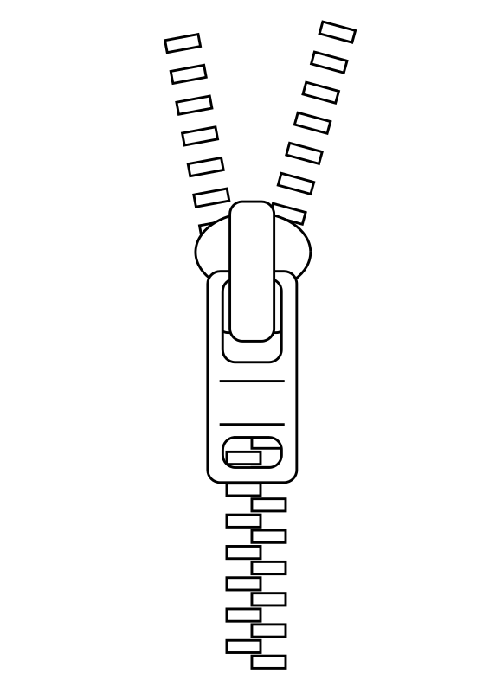
z

Slide 2
zz

Slide 3
Can a web buzz?
Will the box fit in a van?

