Slide 1
s

Slide 2
a

Slide 3
t

Slide 4
p

Slide 5
i

Slide 6
n

Slide 7
m

Slide 8
d

Slide 9
g

Slide 10
o

Slide 11
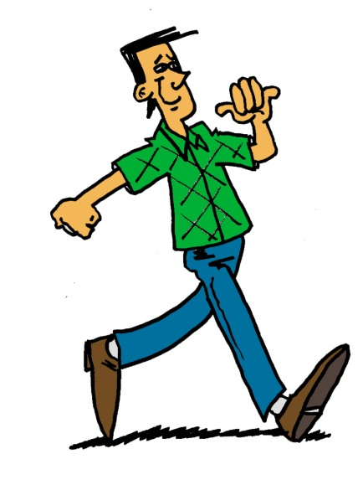
to
no
go

