Slide 1
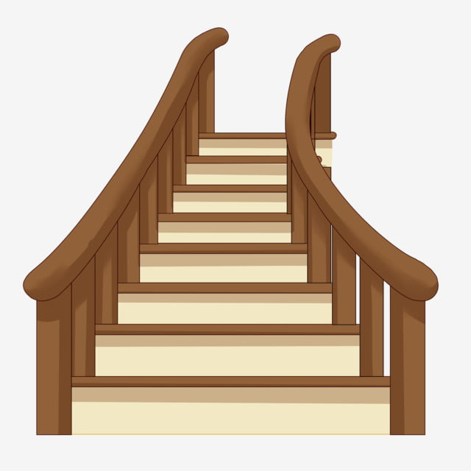
What sound are we learning?
air

Slide 2
Can you use the sound buttons to help you read the words?
Are the words real or alien?

Slide 3
fair

Slide 4
stairs

Slide 5
plairp

Slide 6
pair

Slide 7
lairg

