Slide 1
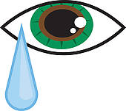
t
ear

Slide 2
s
p
ear

Slide 3
b
ear
d

Slide 4
g
ear
s

