Slide 1
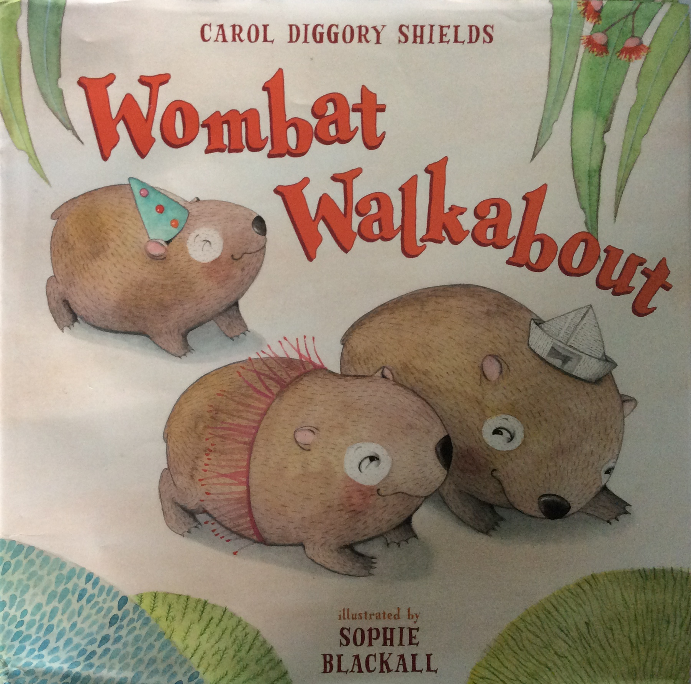

Slide 3
Can you spot the spying dingo?
Can you hear the words that rhyme?

Slide 4
Can you hear the words that rhyme?

Slide 5
Can you guess what will happen?

Slide 6
Can you hear the words that rhyme?

Slide 7
Can you guess what I am thinking? What do you think will happen next?

