Slide 1
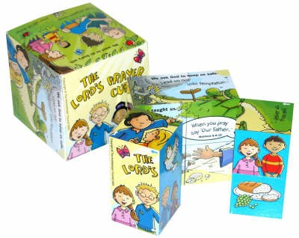
Chatterbox
What are learning about in RE?

