Slide 1

Prayer
What is a prayer?
When do people pray?
How do we pray?
Where do people pray?

Slide 2

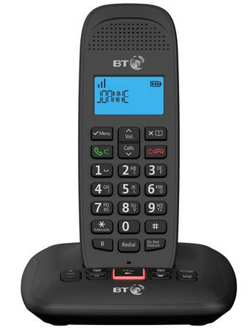

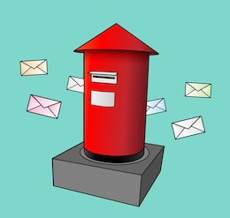
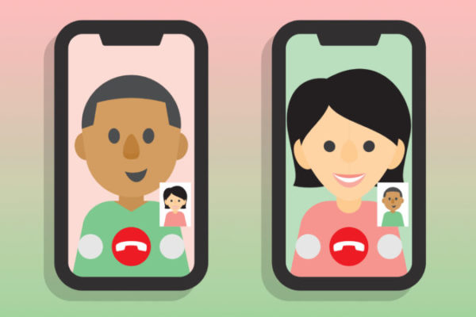
Whilst we have been in lockdown, how have you given each other messages?

Slide 3
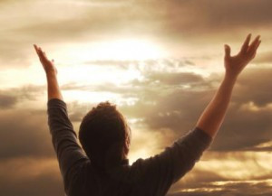
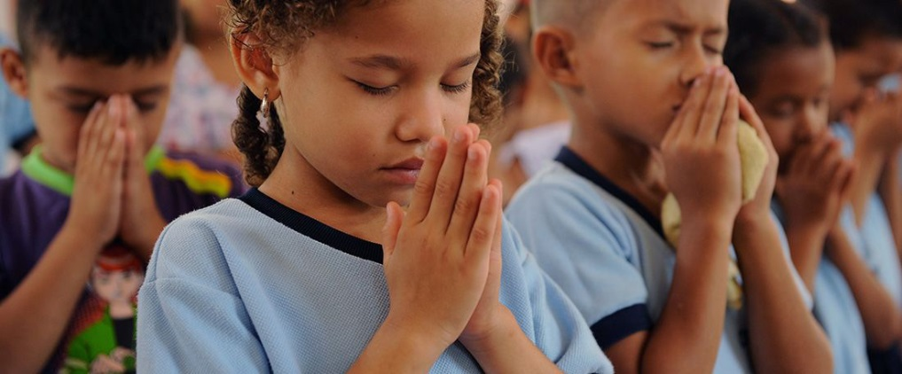
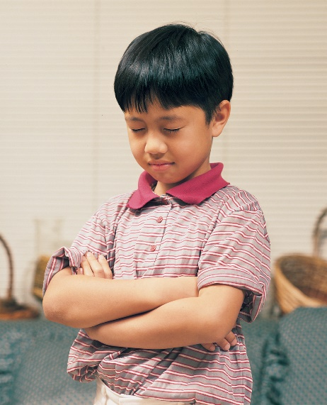
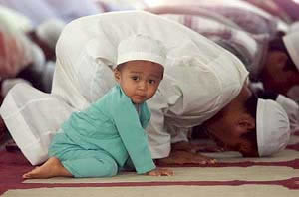
How do we send messages to God?
How are these people praying differently?
What is the same?

Slide 4

Why do people pray?
Thank you
Sorry
Look after
Help
Love

