Slide 2
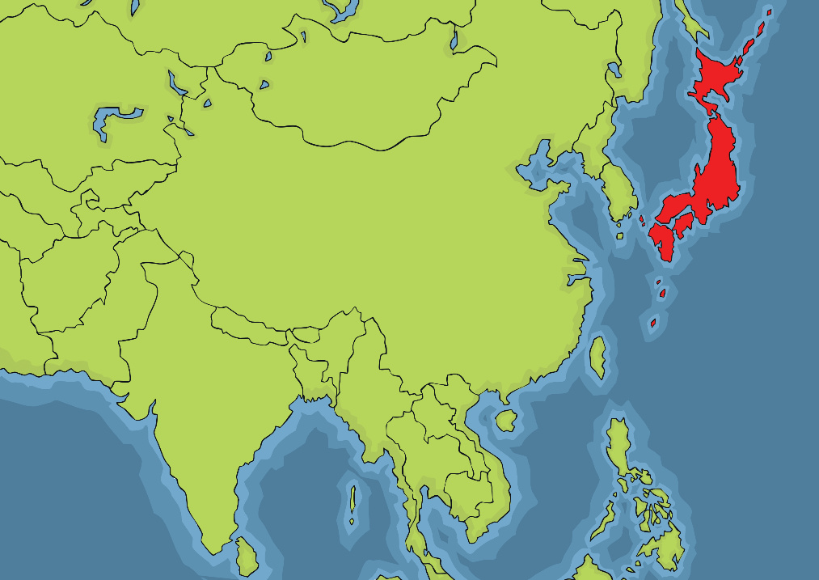
Where is Japan?
Japan is a country in Asia.
It is an island country. It is surrounded by the Sea of Japan in the east and the Pacific Ocean in the west.
Japan

Slide 3
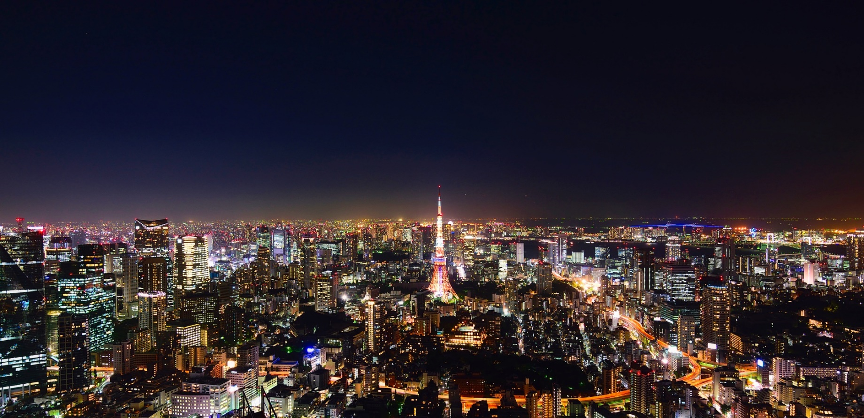
Facts About Japan
The capital city of Japan is Tokyo. It is the largest city in Japan.

Slide 4
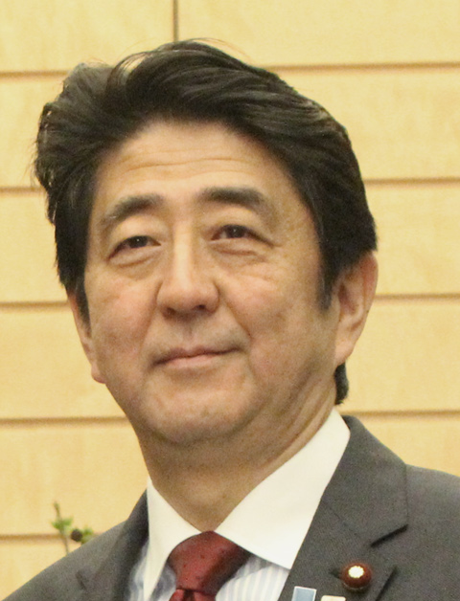
Facts About Japan
Japan has a population of over 127 million people.
The prime minister of Japan is called Shinzō Abe.
The currency is the Japanese Yen.
The main language spoken in Japan is Japanese.
“Shinzo Abe in Japan” by [GODL-India] is licensed under CC BY 2.0

Slide 5
Some Japanese Phrases
Konnichiwa
Hello.
O-genki desu ka?
How are you?
Sumimasen
Excuse me.
Jaa ne
See you.

Slide 6
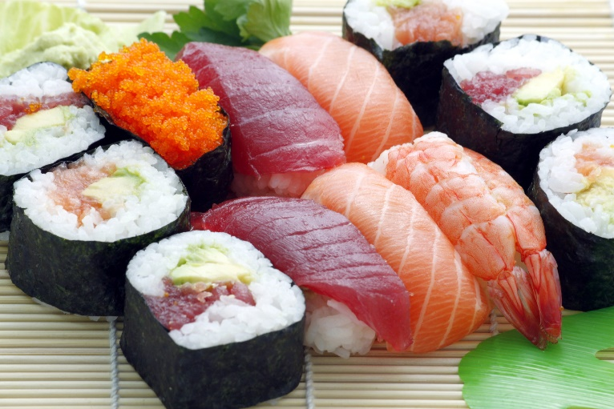
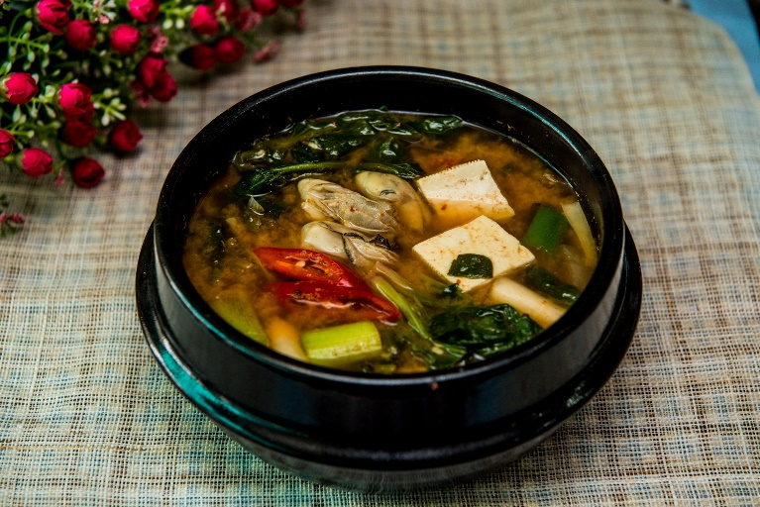
Japanese Food
Japan is famous around the world for its food, especially sushi.
Sushi is usually made of cold rice and vegetables or raw fish, sometimes wrapped in seaweed.
Soups are popular in Japan, as well as rice and noodle dishes.

Slide 7
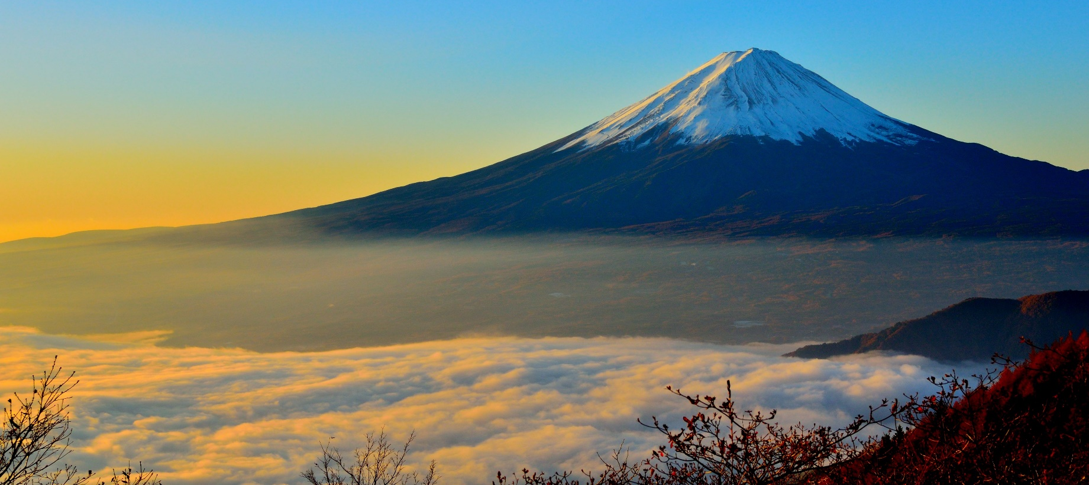
Mount Fuji
Mount Fuji is Japan’s tallest mountain. It is 3776 metres high.
Thousands of locals and foreigners climb the mountain every year.

Slide 8
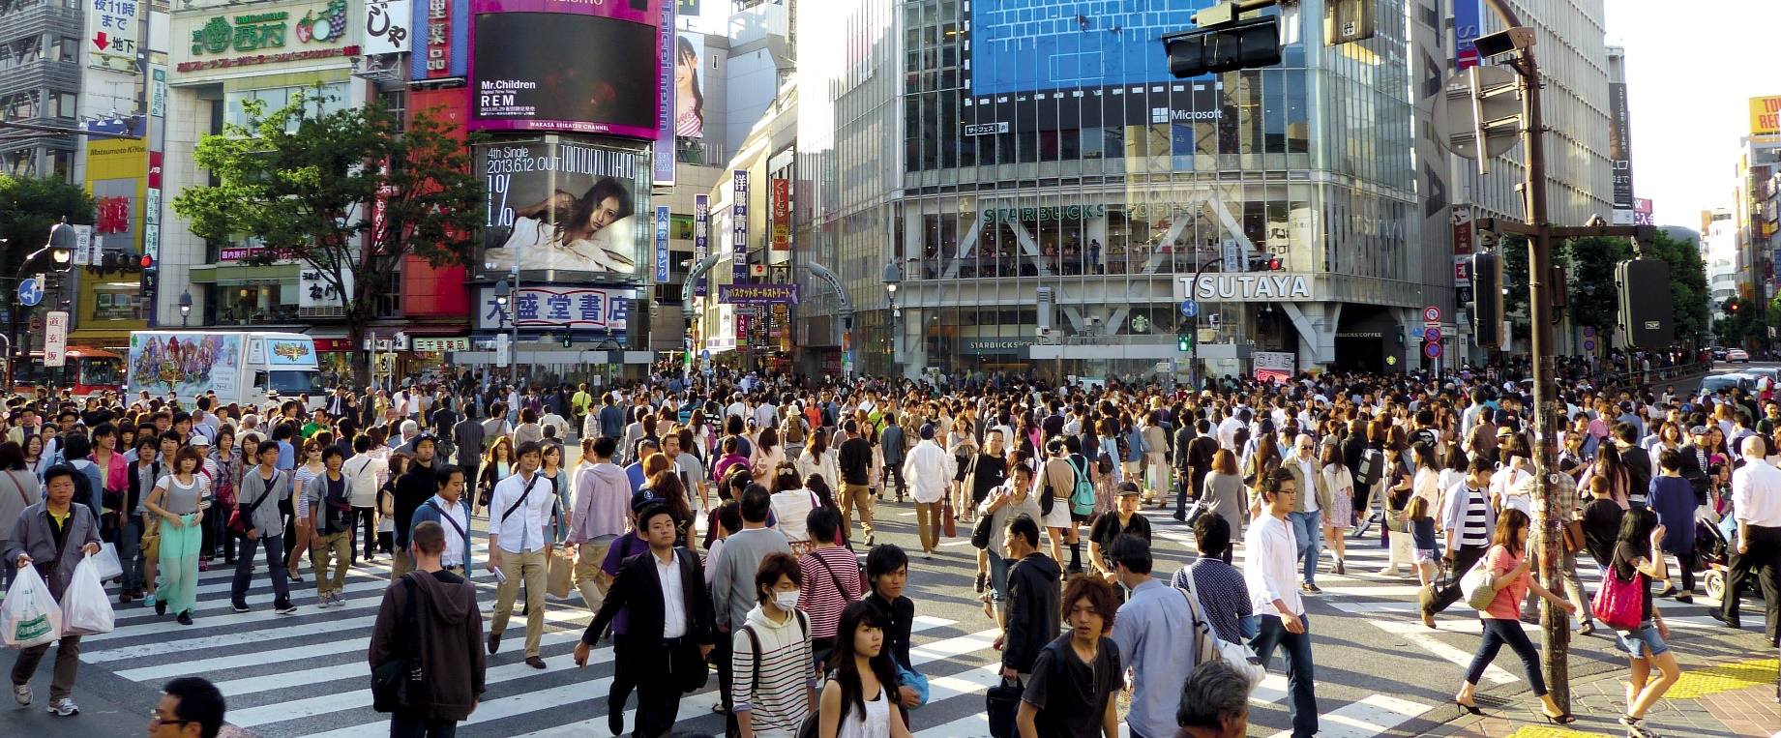
Shibuya Crossing
Shibuya Crossing in Tokyo is famous because it is one of the busiest intersections in the world.
More than 250,000 people use it every day and they have just 2 minutes to make it across the road.

Slide 9
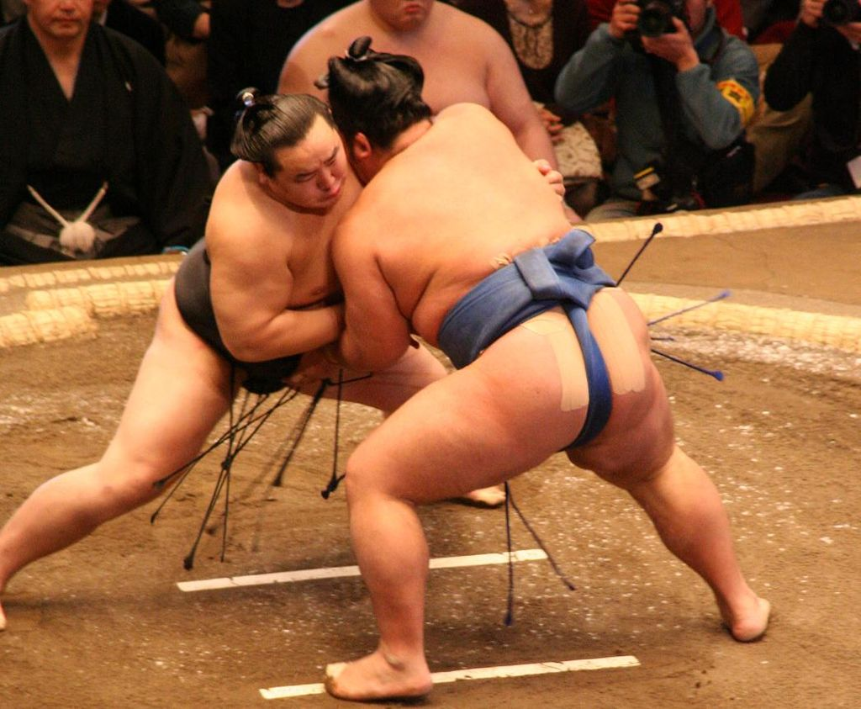
Sumo Wrestling
Sumo wrestling is considered the oldest sport in Japan.
It has strict rules and traditions that have survived to this day. Two wrestlers fight and try to push each other out of the ring. The wrestler, or Rishiki, wears a bun in their hair and just a loincloth to cover themselves.
“Sumo Wrestler Asashōryū fighting against Kotoshogiku at the January Tournament 2008 ” by [Arcimboldo] is licensed under CC BY 3.0

