Slide 1

Handwriting practise:
Friday

Slide 2
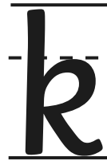

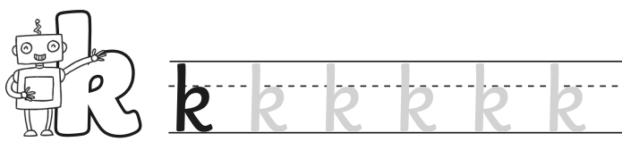
Start at the top, go straight down and then back up to the middle. Make a loop and kick it out!

Slide 3
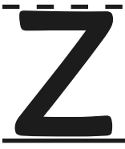
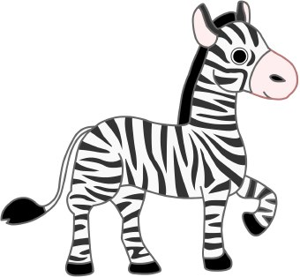
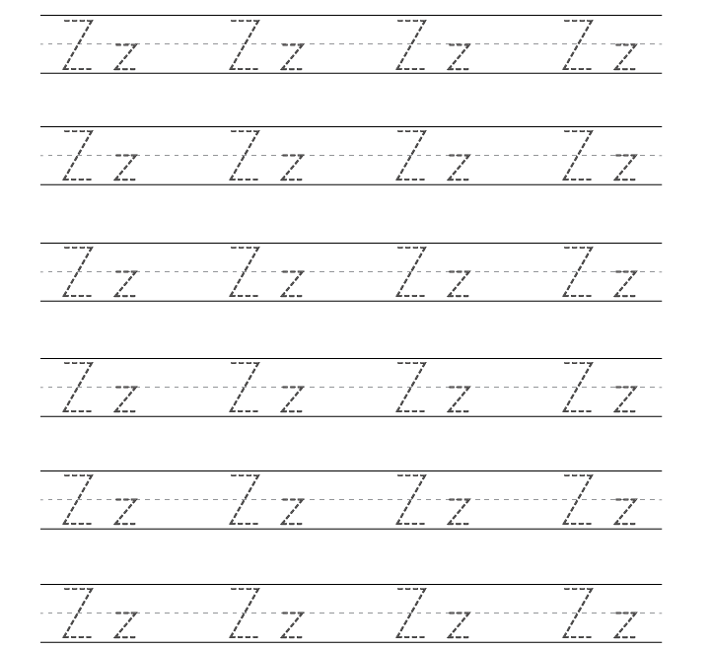
Push your pen forwards, go down on a backwards slant, then push forwards again.

