Slide 2
Tokyo
Tokyo is the capital city of Japan and is a very large city. Almost 14 million people live in Tokyo. That’s nearly 6 million more people than living in London!
The city is a mixture of traditional temples and modern skyscrapers. There are many museums, art galleries, parks and even a Disneyland in Tokyo.
We’re going to look at some landmarks and things to do and see in Tokyo.

Slide 3
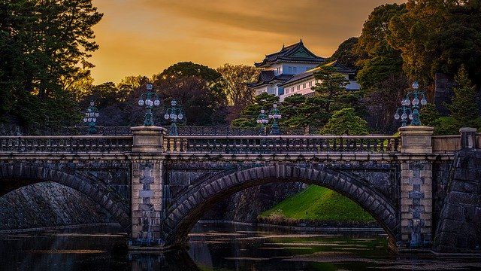
Imperial Palace
Here is the Imperial Palace.
The Emperor of Japan and his family live in the Imperial Palace in Tokyo. The palace is in a large park that people can walk around.
On special occasions, the Emperor and his family stand on a balcony so that people can see them.
Think About It
What do you think about the Imperial Palace?

Slide 4
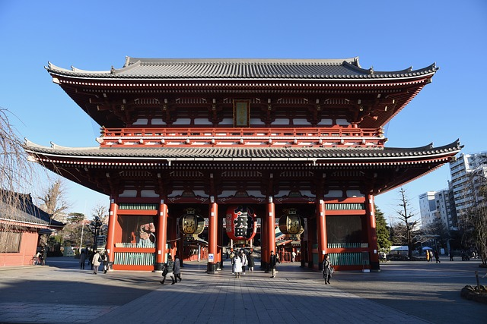
Sensoji Temple
The Sensoji Temple is a Buddhist temple and the oldest one in Japan. It was built in honour of the goddess Kannon in AD 645, making it 1375 years old!
Special events and festivals are held in the temple.

Slide 5
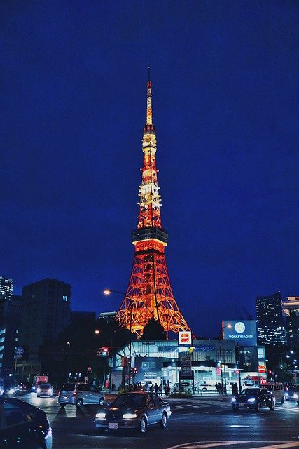
Tokyo Tower
Tokyo Tower is 333 metres tall and is the world’s tallest, self-supporting, steel tower.
It was built as a broadcasting tower but people can go up it and see the view.
It was based on another famous tower in France. Can you guess what it is?
Reveal the Answer
broadcast –
To send and receive radio and television signals.
That’s right! The Tokyo Tower was based on the Eiffel Tower in Paris.

Slide 6
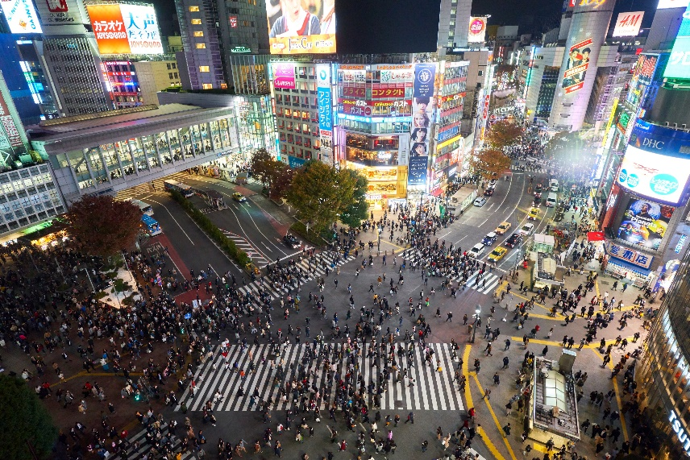
Shibuya Crossing
The Shibuya Crossing is thought to be the busiest road crossing in the world. When the lights turn green, hundreds of people cross the road at the same time. It is also called the ‘Shibuya Scramble Crossing’ and it is easy to see why.
Think About It
“Shibuya Crossing, Tokyo, Japan” by Timo Volz is licensed under CC BY 2.0
What do you think of when you look at this photo?

Slide 7
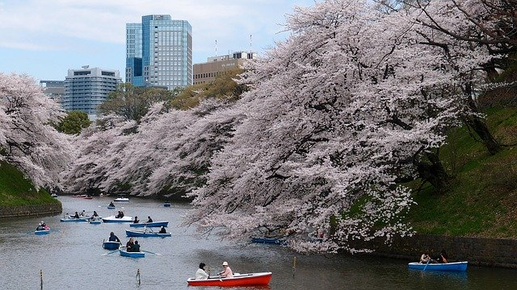
Cherry Blossom
Cherry blossom is one of the national symbols of Japan. It symbolises the coming of spring and is also a reminder of how short life is so people should make the most of it.
In Ueno Park, there are over 1000 cherry trees. A cherry blossom festival takes place to welcome the blossom.

Slide 8
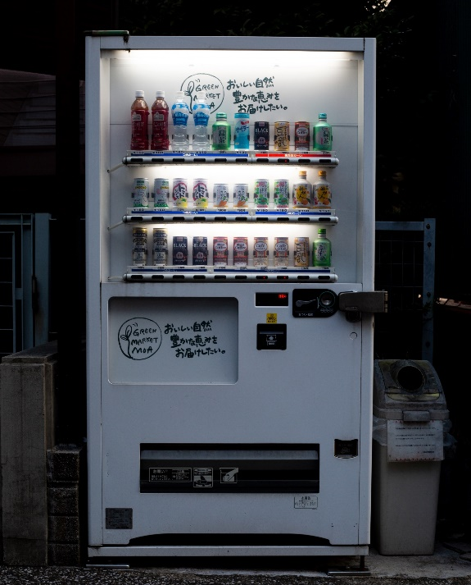
Vending Machines
Tokyo is also known for having hundreds of vending machines. You can buy drinks from them but also more unusual things, such as flowers, hamburgers and even clothes!
Talk About It
What would you want to buy from a vending machine?
“A vending machine” by Darren Halstead is licensed under CC BY 2.0

Slide 9
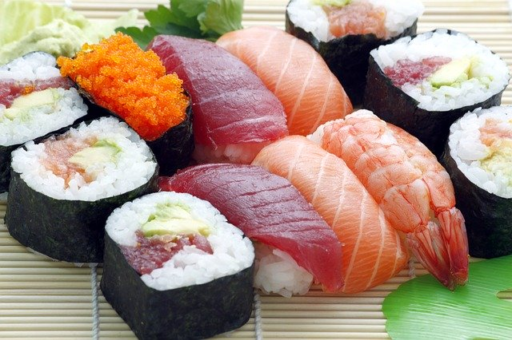
Food in Tokyo
Japanese food is very popular all over the world. Sushi is a special way to prepare rice, often with raw fish. It can include seafood, such as prawns and crab, as well as seaweed and vegetables. It is very healthy.

Slide 10
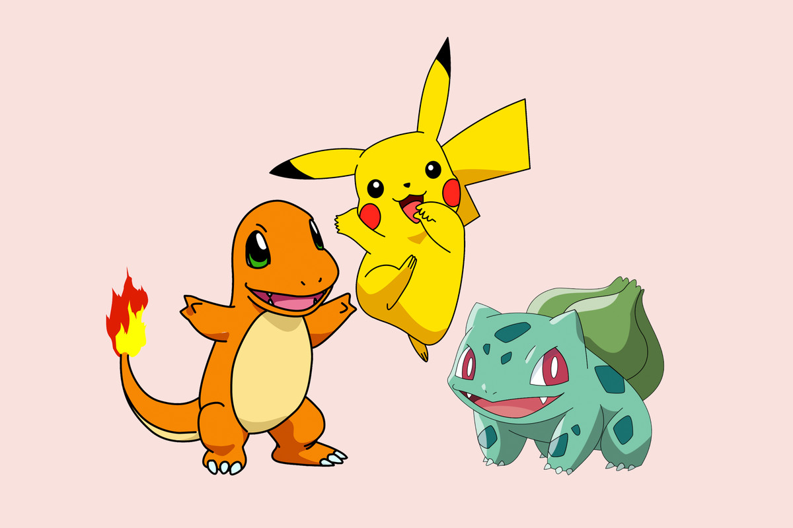
Anime
Tokyo is also known for its anime (animation) and manga films.
You can go to a shop that sells everything about Pokemon called the Pokemon Store.

Slide 11
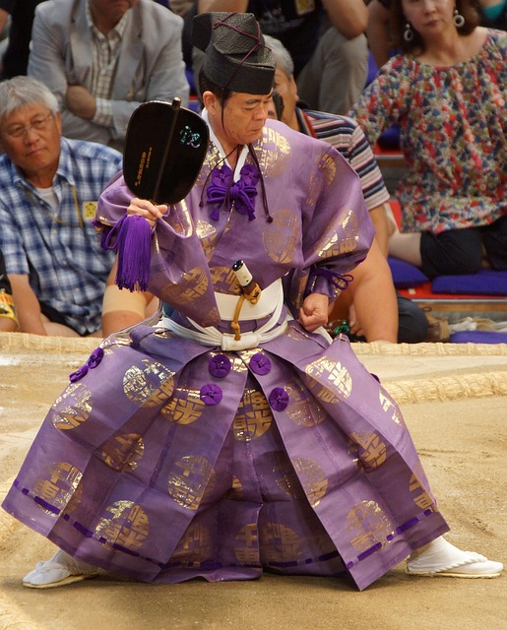
Sumo Wrestling
Baseball, basketball and football are popular sports in Japan but sumo wrestling is a national sport.
It has religious traditions, such as the ring being made pure with salt before a match.
The first wrestler who is pushed out of the ring or who touches the ground with any part of their body apart from the soles of their feet, loses the match.
Six tournaments are held every year and three of these take place in Tokyo.
The referee dresses in traditional Shinto priests' clothing.

Slide 12
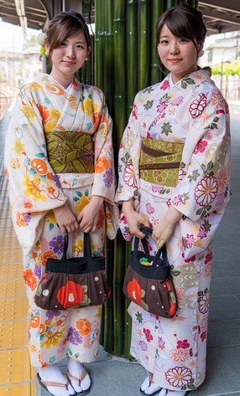
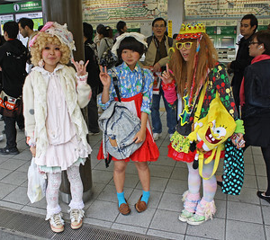
Clothes
In Tokyo, people wear clothes, such as jeans, hoodies and tracksuits just like you. Some people wear the national clothes of Japan called kimonos. These are traditionally made from silk and sewn by hand. They are tied with a large belt called an obi.
Harajuku
Clothes can also be worn on the theme of computer games and cartoon characters. This style is popular in an area in Tokyo called Harajuku.
“sign language” by istolethetv is licensed under CC BY 2.0
Think About It
What character would you want to dress as?

Slide 13
What Did You Learn?
Tell someboday one thinng that you have learnt about Tokyo. Some of these pictures might help remind you.

