Slide 1
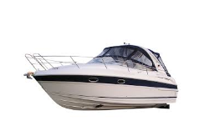
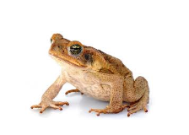
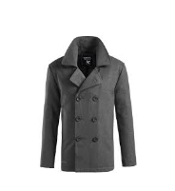
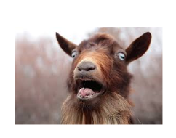
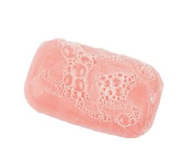
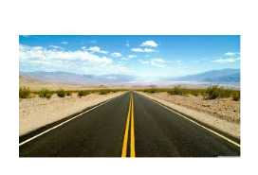
oa

Slide 2
Can you read these words? Use the sound buttons to help you.
boat

Slide 3
coat

Slide 4
soap

Slide 5
toad

Slide 6
goat

Slide 7
road

Slide 8
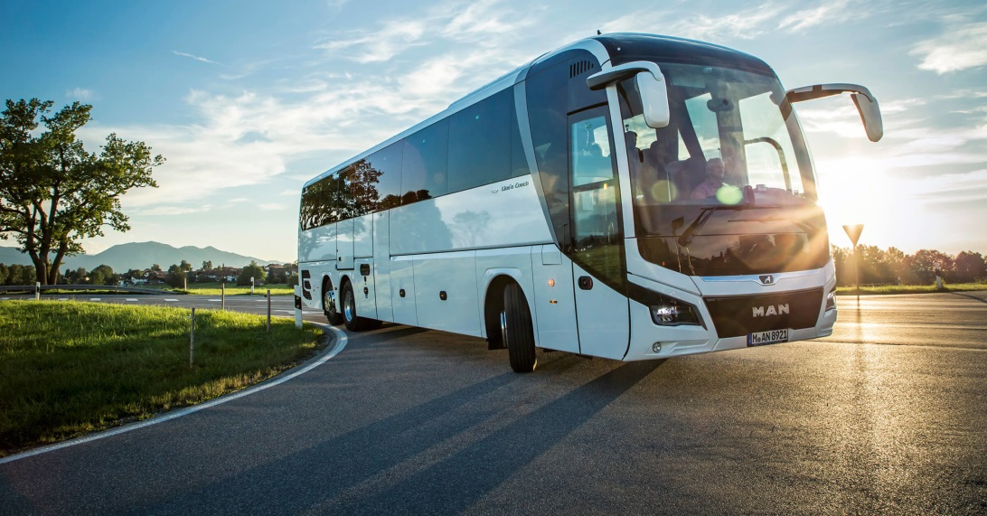
These are a little more difficult because they have more than 1 digraph or a cluster.
coach

Slide 9
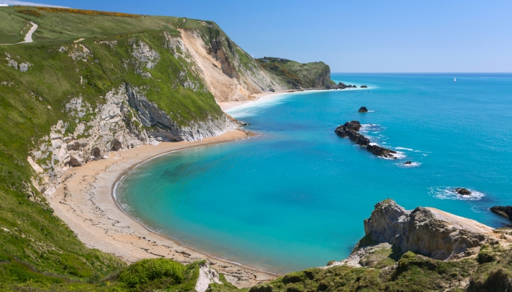
coast

Slide 10
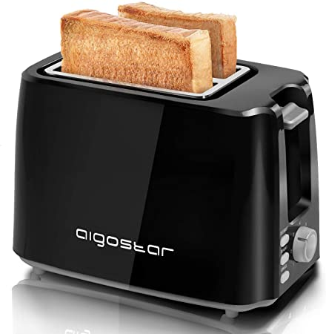
toaster

Slide 11
Chose a picture and write a sentence with your chosen ‘oa’ word.

