Slide 1
Can you match the correct word to the picture?

Slide 2
fern
torch
star

Slide 3
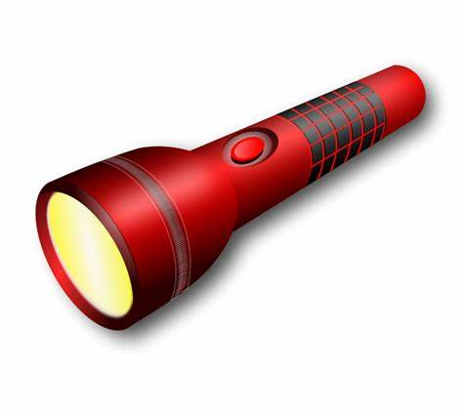
torch
arm
term

Slide 4
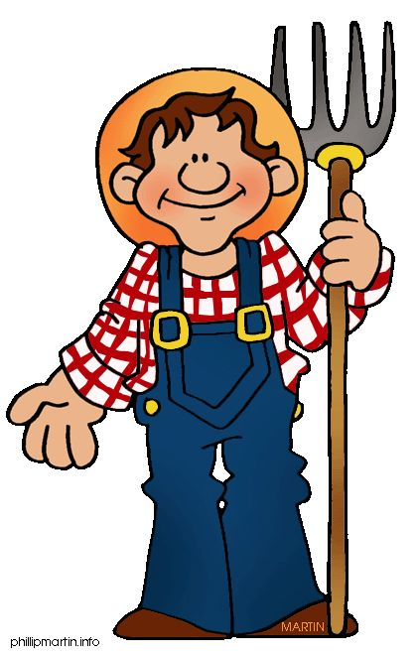
fern
fork
farmer

Slide 5
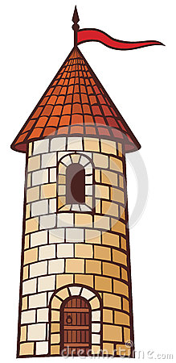
term
tower
fern

