Slide 1
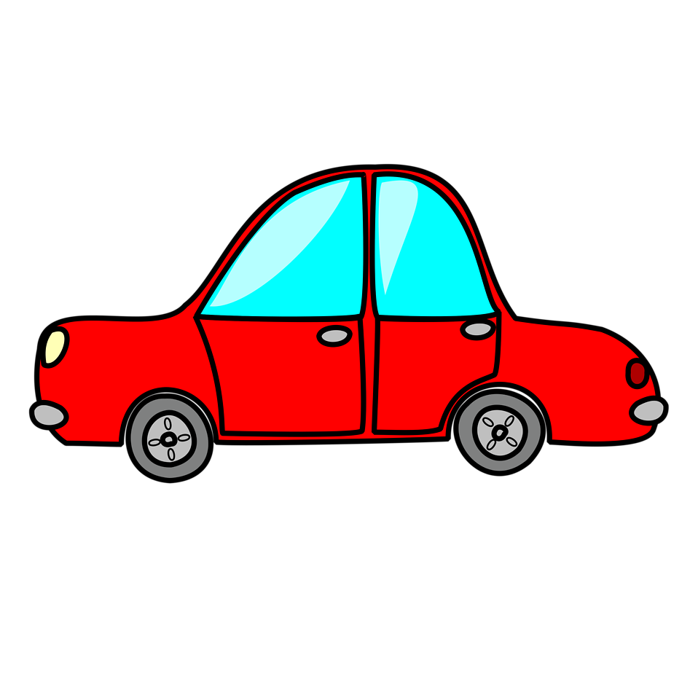
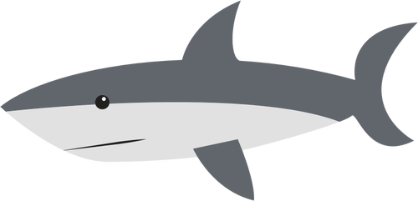
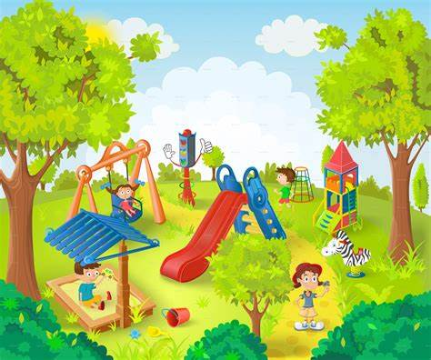
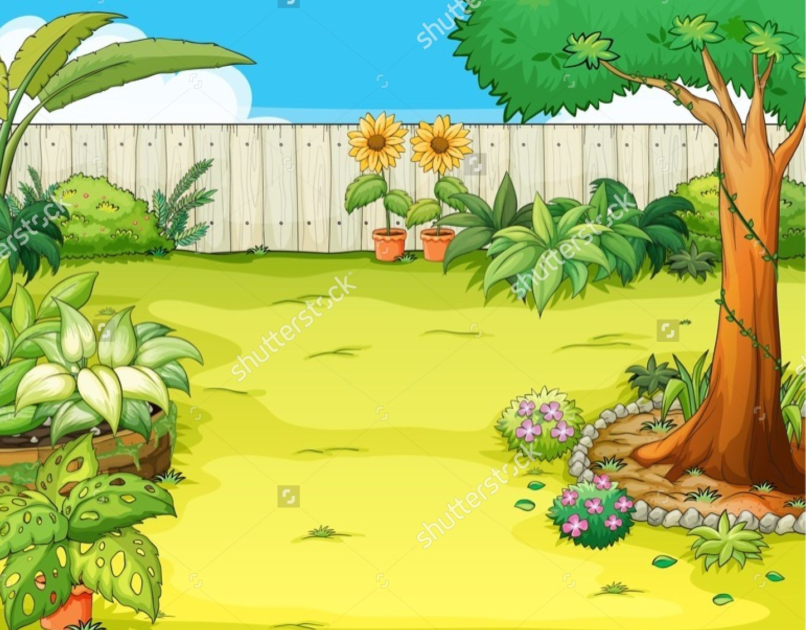
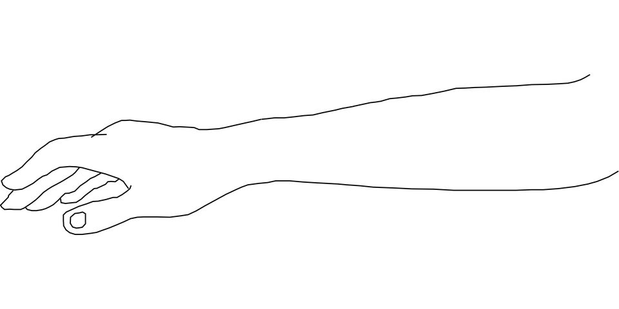
ar

Slide 2
Can you read the words?
arm

Slide 3
Can you read the words?
car

Slide 4
star

Slide 5
shark

Slide 6
park

Slide 7
garden

Slide 8
Mark has a car in the yard.
The shark will harm with its sharp teeth .

