Slide 1
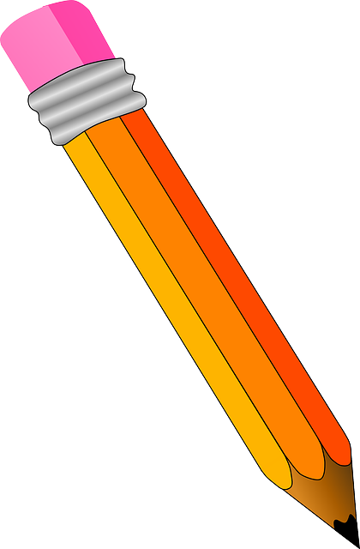
Handwriting practise: Wednesday

Slide 2
Start at the top, go straight down and then straight back up again. Go over with a curl.

Slide 3
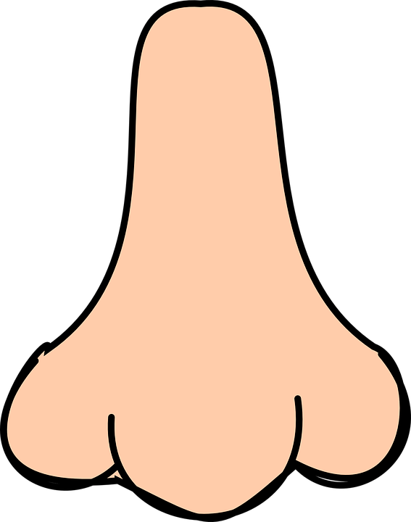
Start at the top, go straight down and then straight back up again. Go over the hill.

Slide 4
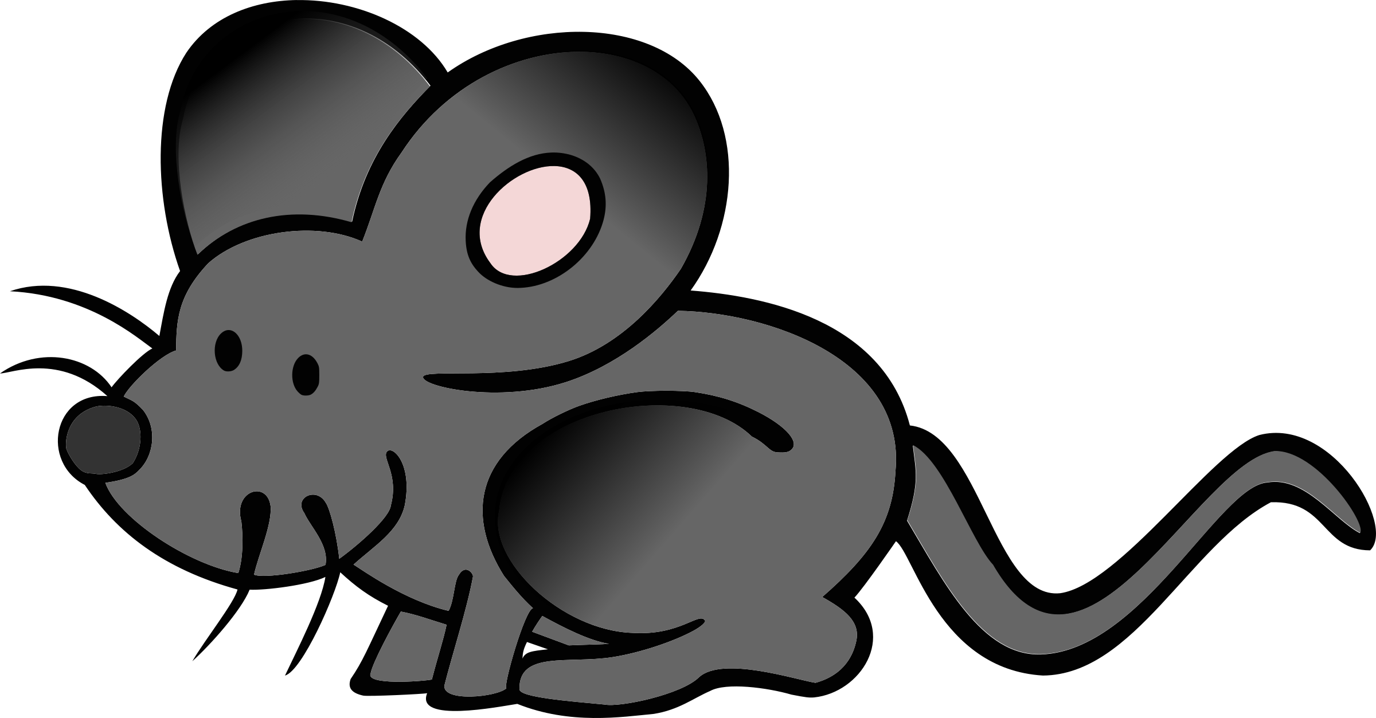
Start at the top, go straight down and then straight back up again. Go over the hill and over the hill again.

Slide 5
Start up high, go straight down and then back up to the middle. Go over the hill.

Slide 6
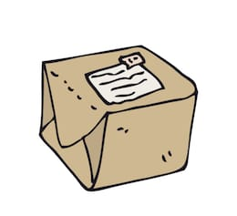
Start at the top, go straight down and then back up. Go round in a loop.

Slide 7
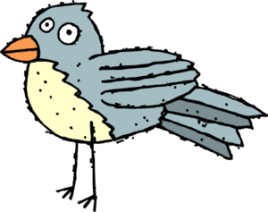
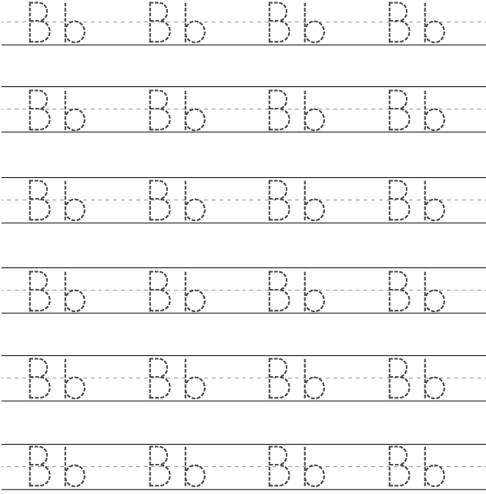
Start at the top, go straight down and then back up to the middle. Go round in a loop.

