Slide 1
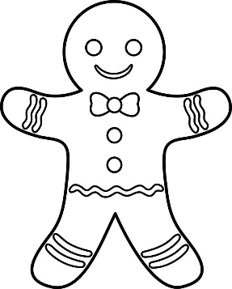
Gingerbread man questions
Listen to the Gingerbread man questions and practise these with your teacher in your best gingerbread men voices.
Help the gingerbread man
find each of these
questions in Spanish.
1.¿Cómo te llamas?
What are you called?
Where do you live?
How old are you?
How are you feeling?
2.¿Dónde vives?
3.¿Cómo estás?
4.¿Cuántos años tienes?
@Primary Languages Network 2017

