Slide 1
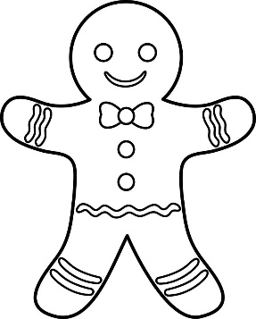


Gingerbread man questions
Listen to the Gingerbread man questions and practise these with your teacher in your best gingerbread men voices.
Help the gingerbread man
find each of these
questions in Spanish.
1. What are you called?
What are you called?
Where do you live?
How old are you?
How are you feeling?
2. Where do you live?
3. How are you feeling?
4. How old are you?
@Primary Languages Network 2017

