Slide 1
Read the words. What digraph can you see in all of the words?
cow
ow
down
owl
brown
town
crown

Slide 2
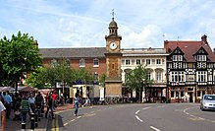
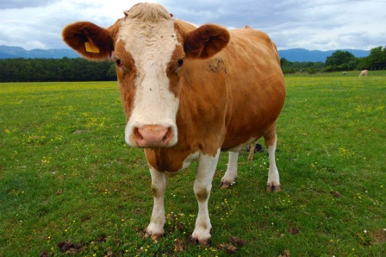
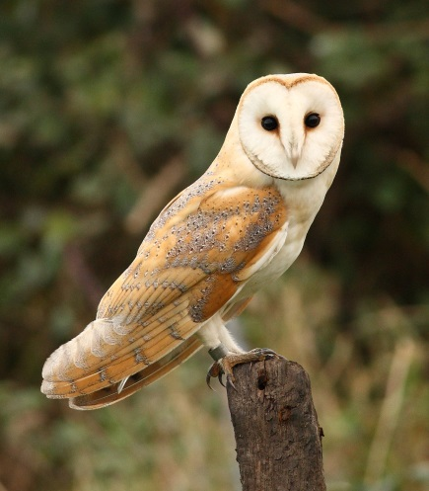
Match the picture to the word then click the slide to see if you are correct.
cow
owl
town
crown

