Slide 2
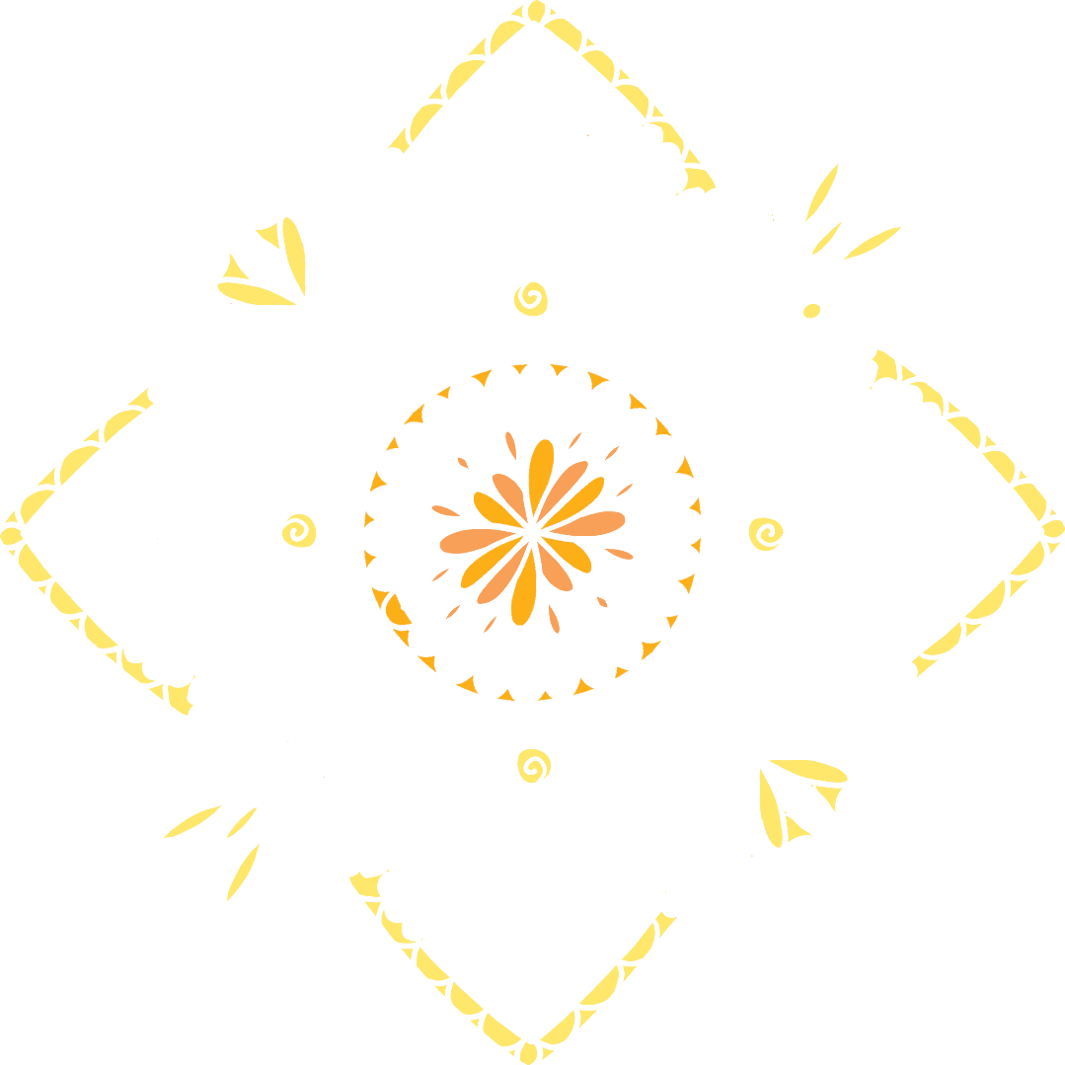
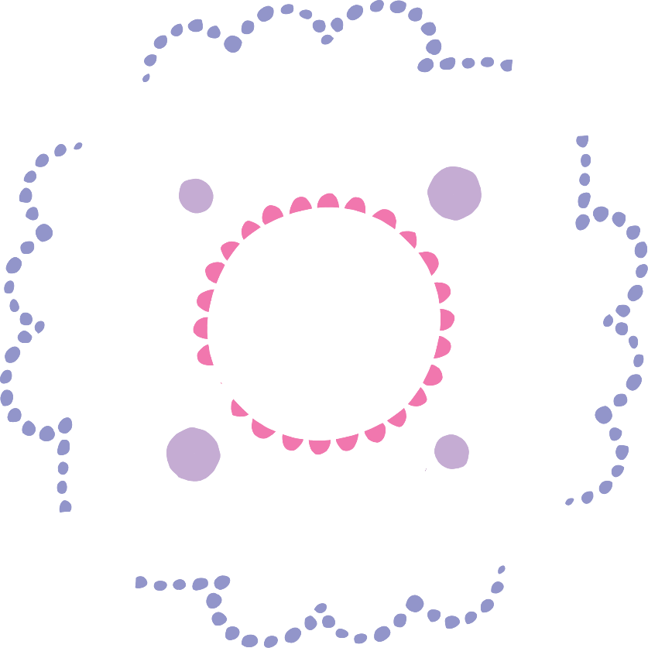
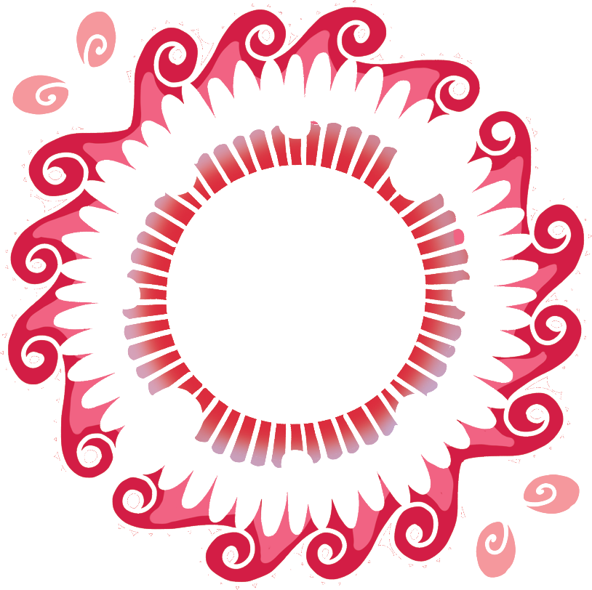
What Is Rangoli?
Rangoli is a type of art that started in India.
A rangoli design is made up of beautiful coloured patterns.
The designs are often very detailed.

Slide 3
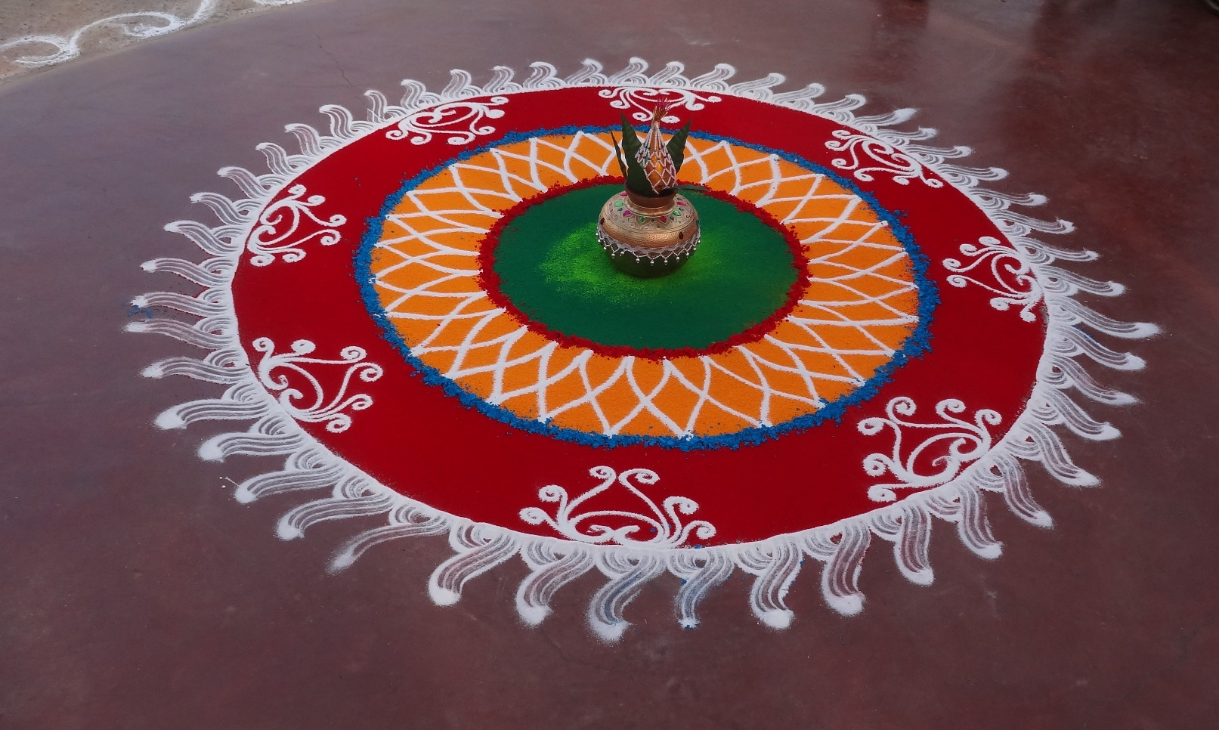
Celebrating with Rangoli
Rangoli designs are usually made during festivals and celebrations.
Lots of rangoli patterns are created during Diwali. They can also be seen at other Hindu festivals and special occasions, such as weddings.

Slide 4
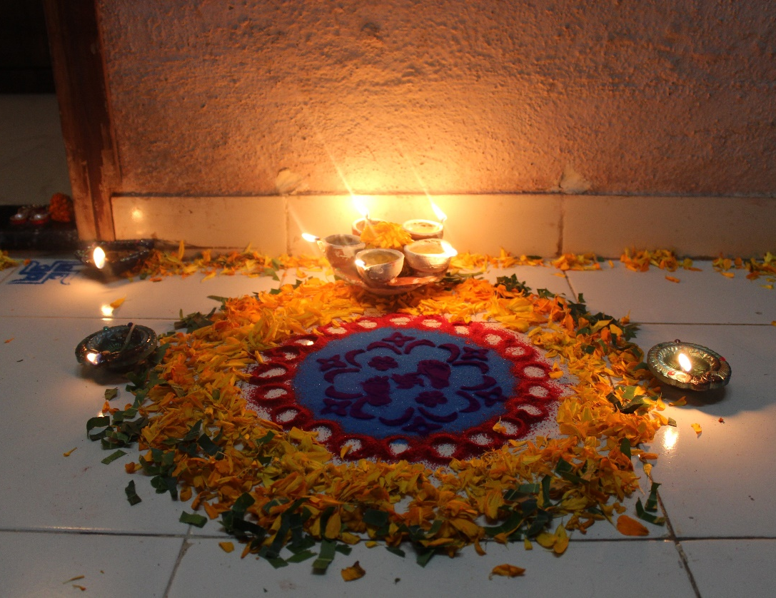
Celebrating with Rangoli
Rangoli designs are thought to bring good luck.
During Diwali, rangoli patterns are created at the entrance to people’s homes to welcome Goddess Lakshmi. Diya lamps are often added.

Slide 5
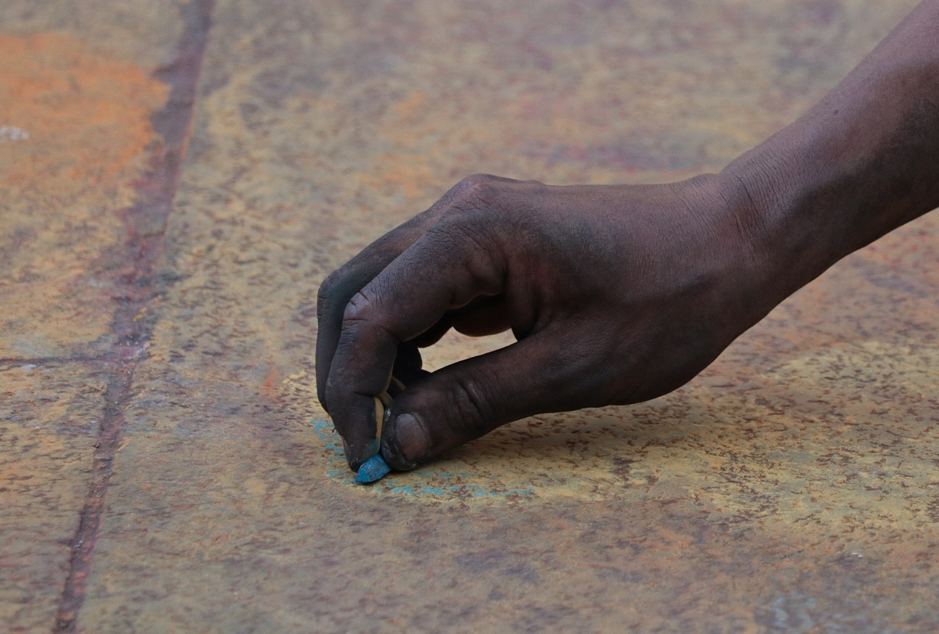
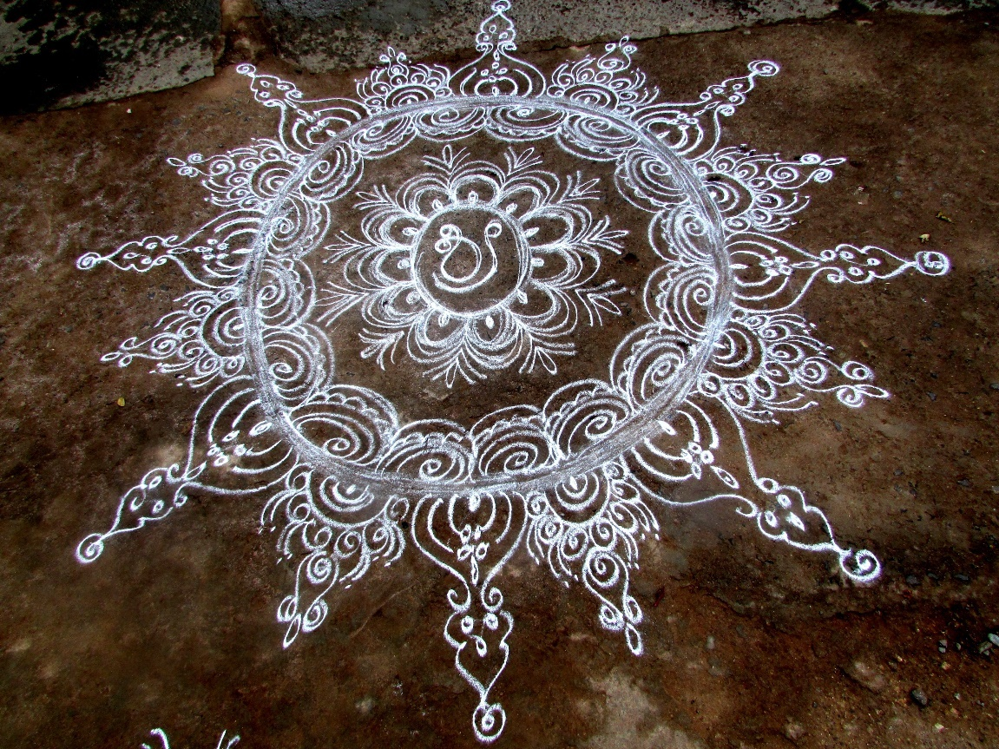
How Are Rangoli Designs Made?
Each rangoli design is different. The designs are passed down from generation to generation. The different designs include different shapes or images.
Rangoli patterns are always made on the floor. The outline is often created before being filled in with colour.

Slide 6
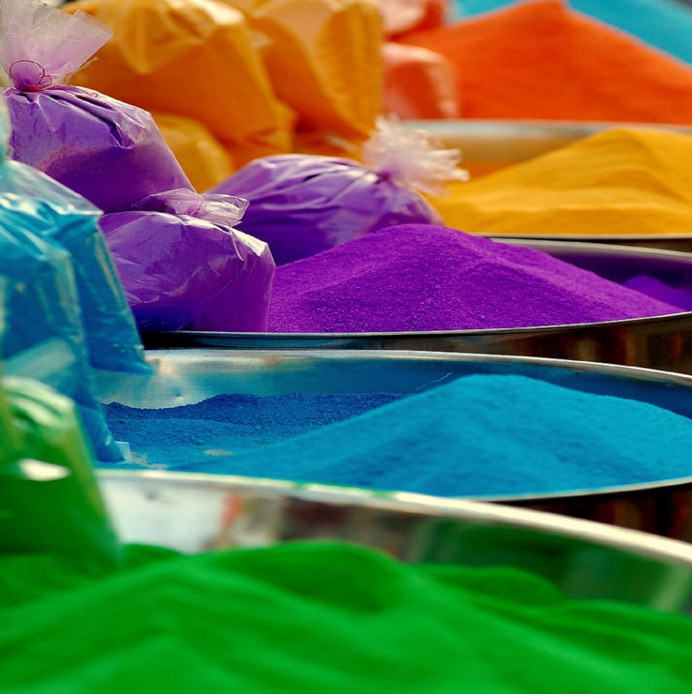
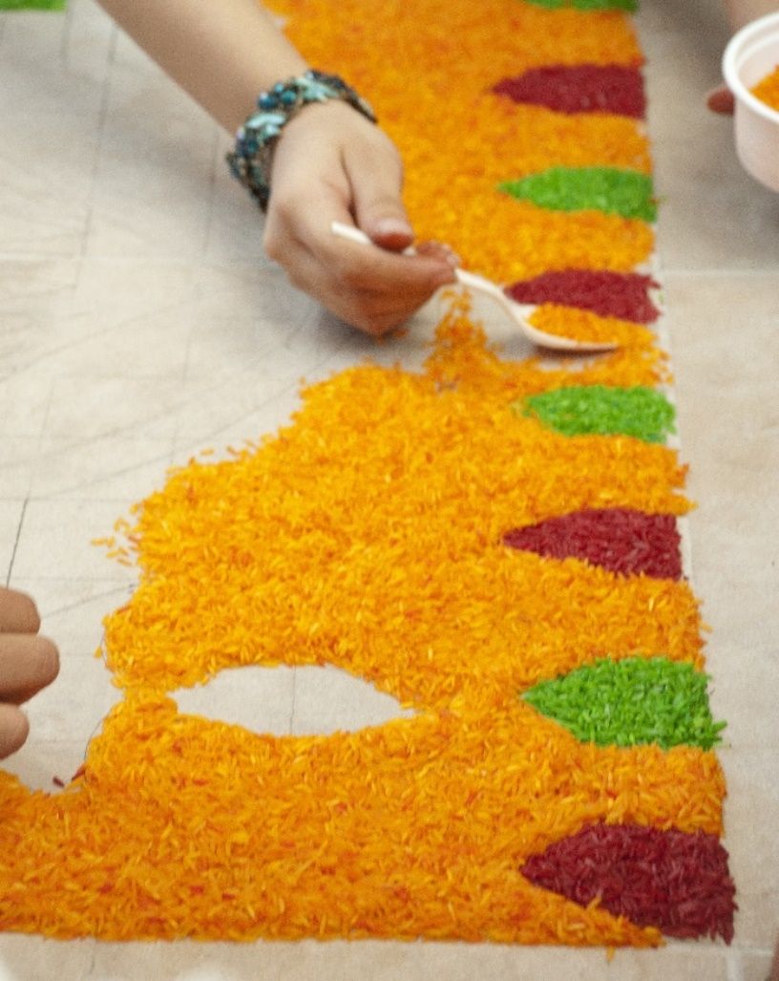
How Are Rangoli Designs Made?
Sometimes, coloured powders are used.
They can be made using different colourful materials. The materials used are things that most people can get easily, without spending lots of money. This means that everyone has the chance to make them.
Coloured rice can also be used in the designs.

Slide 7
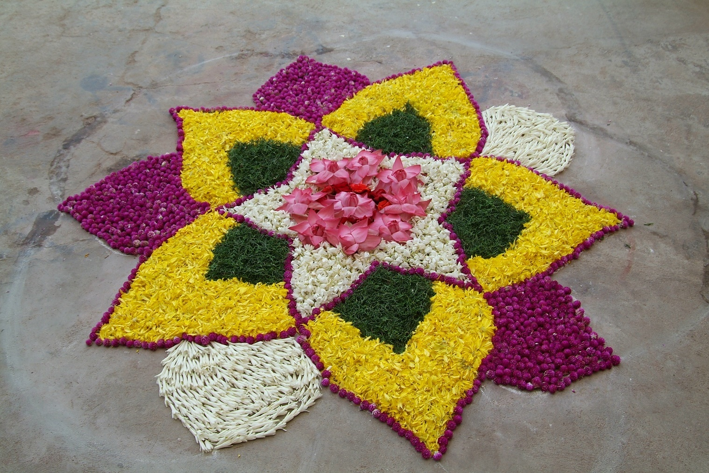
Flower Designs
Rangoli artworks are sometimes made in the shape of flowers.

